Slide 1
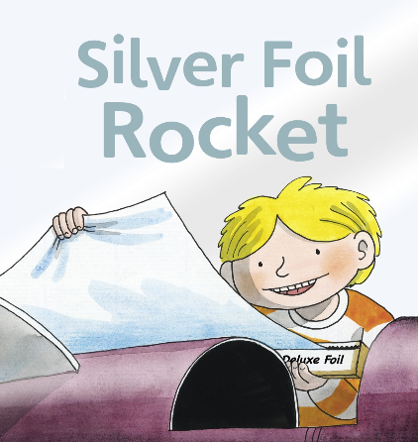

Slide 2


It was time for the summer carnival.

Slide 3
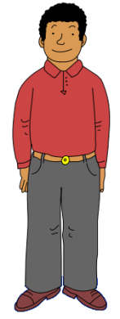


Wilf and Wilma’s dad wanted to win the cup for the best float.

Slide 4

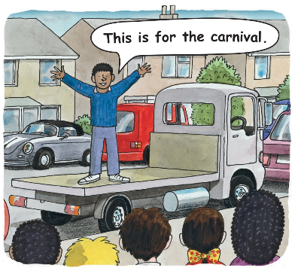
So he got a truck.

Slide 5
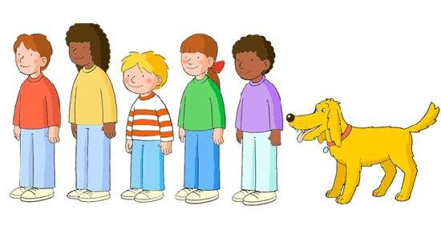
The children all had ideas.

Slide 6

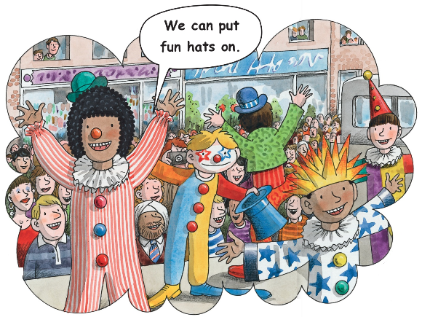
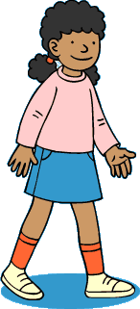

Slide 7
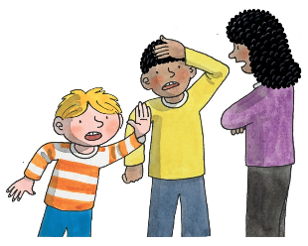
Fun hats will not win us the cup.
Are you sure?
No!

Slide 8

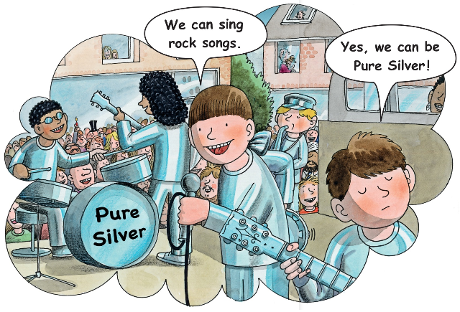
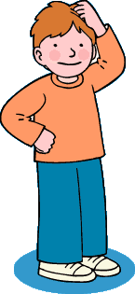
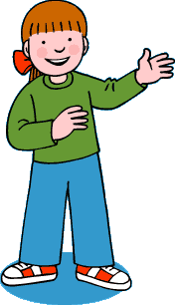

Slide 9
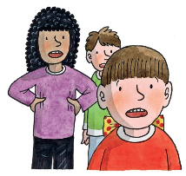
We will not win the cup!
How can we win??

Slide 10

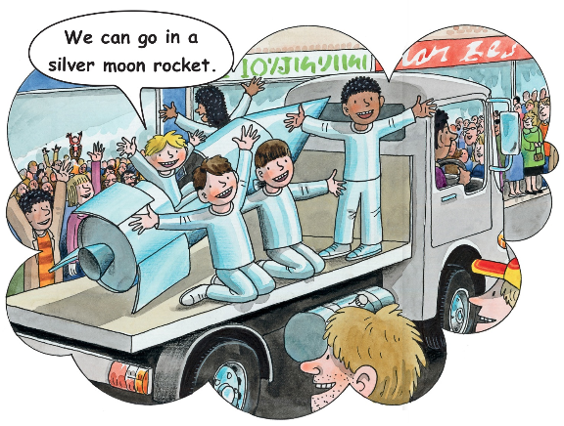
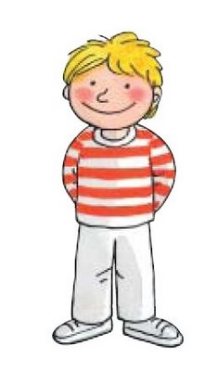

Slide 11
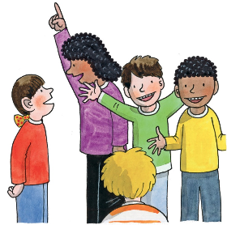
In orbit!
Yes, with moon men.

Slide 12

They all got together to make the rocket.

Slide 13

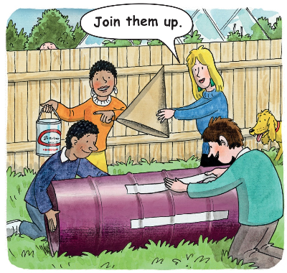
They got oil barrels for the rocket.

Slide 14
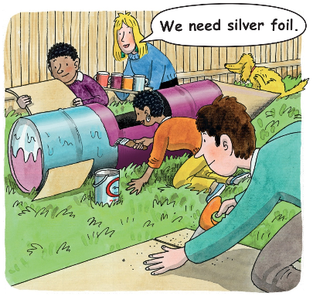
They put fins on the rocket.

Slide 15


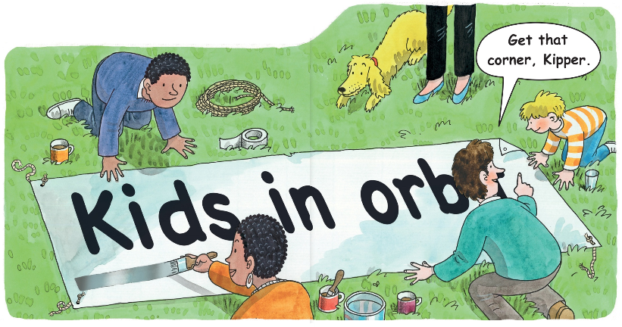
They got cord and card for the banner.

Slide 16

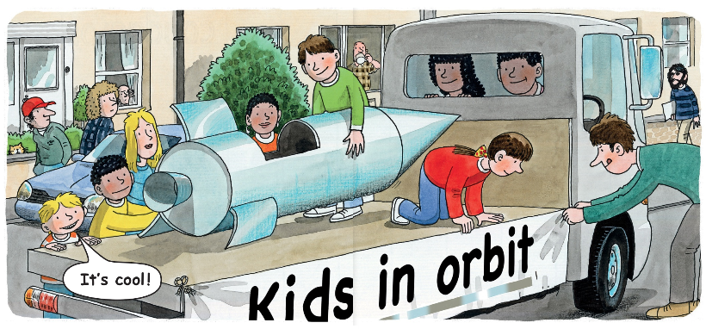
They set up the rocket.
They put the banner on.

Slide 17

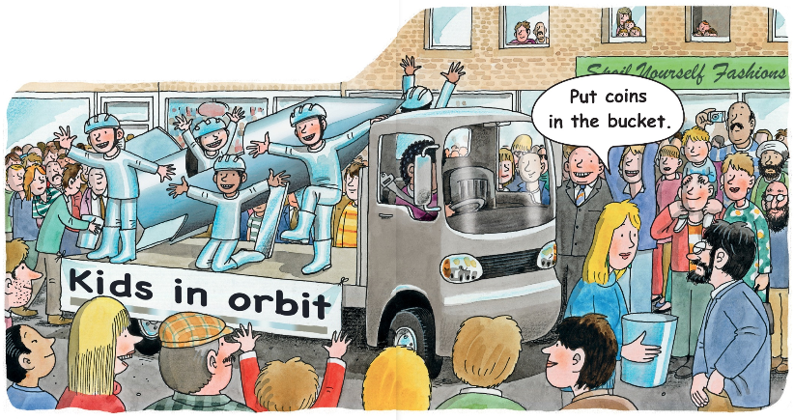
They had fun at the carnival with the
silver foil rocket.

Slide 18
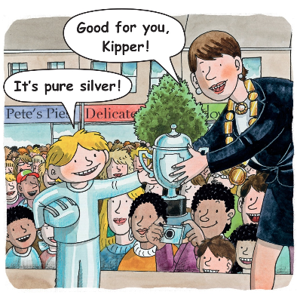
The rocket was the winner!

Slide 19

The end.

