Slide 1


Slide 2
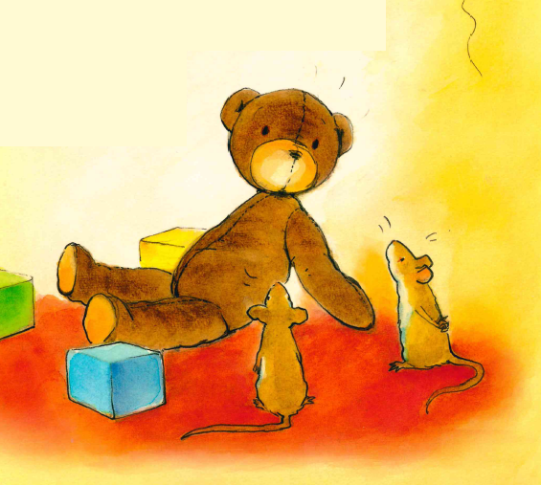

Slide 3
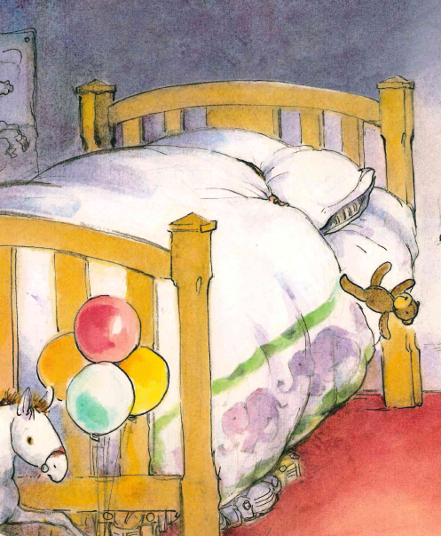
One ted falls out of bed.

Slide 4
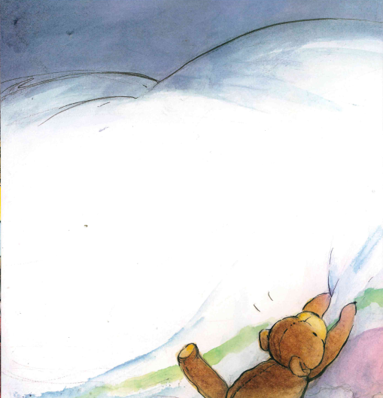
He tugs and pulls BUT…

Slide 5
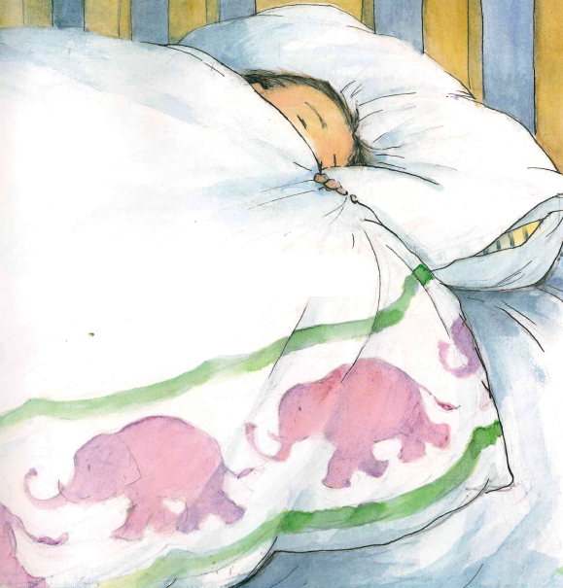
Two eyes are tight shut

Slide 6
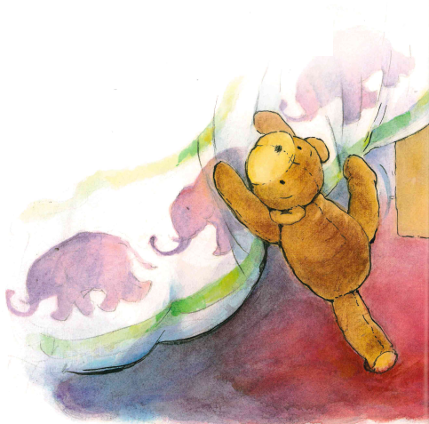
He jumps, shouts and makes a fuss,

Slide 7
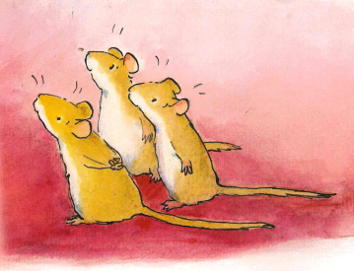
So three mice say…
Come to play with us!

Slide 8
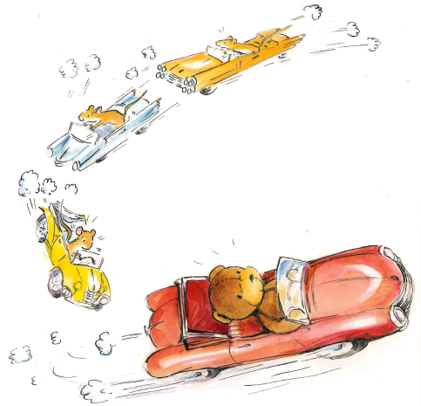
They roar around in four fast cars,

Slide 9
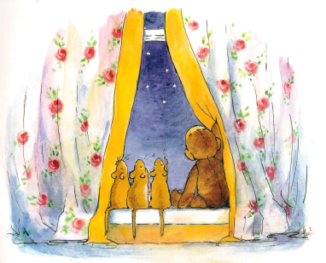
Then sit and gaze at five bright stars.

Slide 10
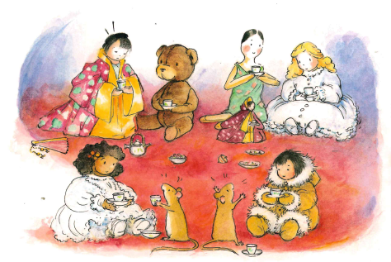
They sip some tea with six kind dolls

Slide 11
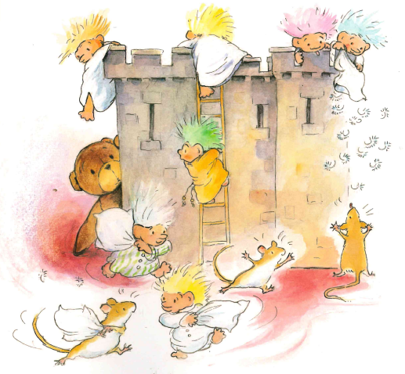
And have a fight with seven trolls.

Slide 12
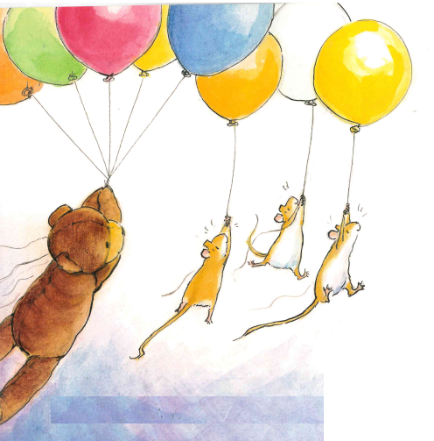
They take a trip with eight balloons.

Slide 13
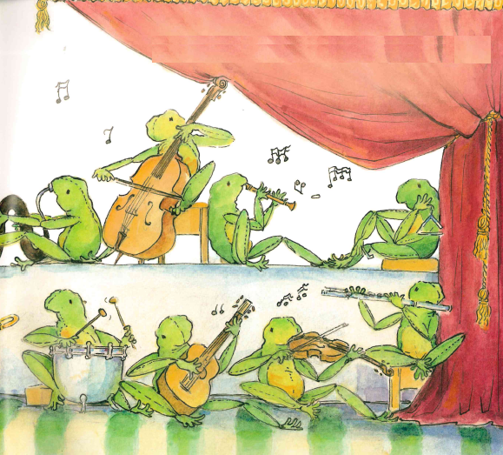
To where nine frogs are playing tunes.

Slide 14
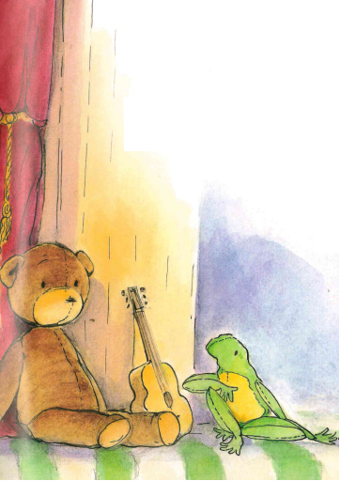
But one ted is missing his bed.
Cheer up, bear – build a stair.

Slide 15
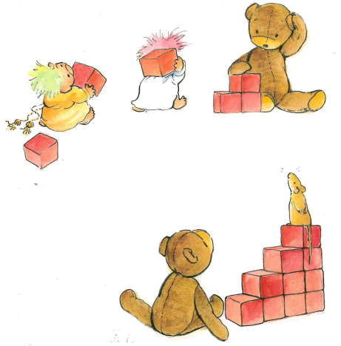
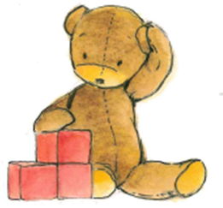
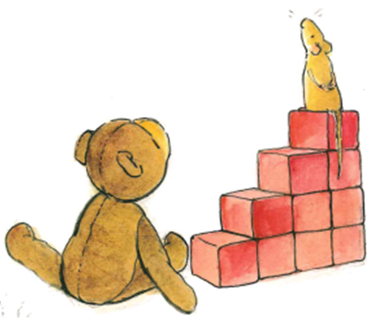
One, two, three,
four, five, six,
seven, eight, nine, ten red bricks.

Slide 16
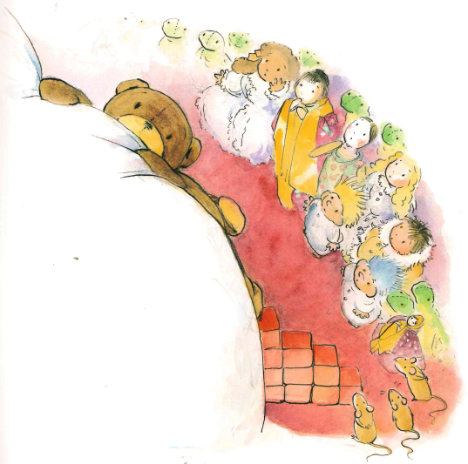
Ted is nearly at the top, when...

Slide 17
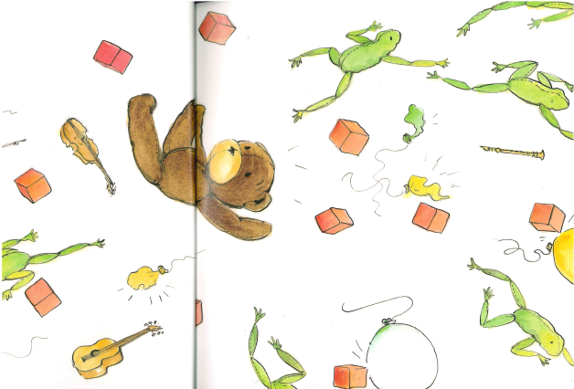
Ten bricks crash,
And eight balloons go bang, snap, POP!
Nine frogs hop,

Slide 18
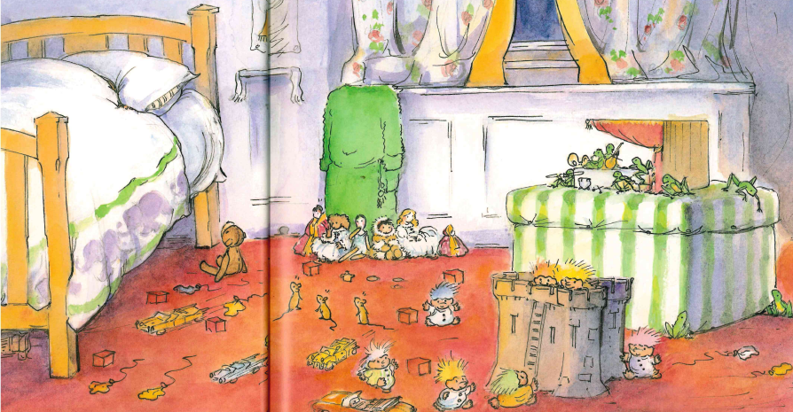
Seven trolls start running riot,
Five stars shine as bright as day.
Six dolls say
ssh, be quiet!
Four cars hoot and roar away.
Notes:
ssh, be quiet

Slide 19

Three mice scamper off to hide…

Slide 20
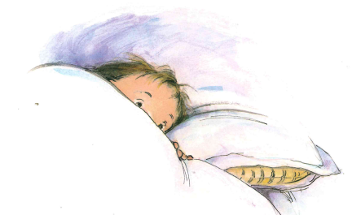
…and two eyes open wide,

Slide 21
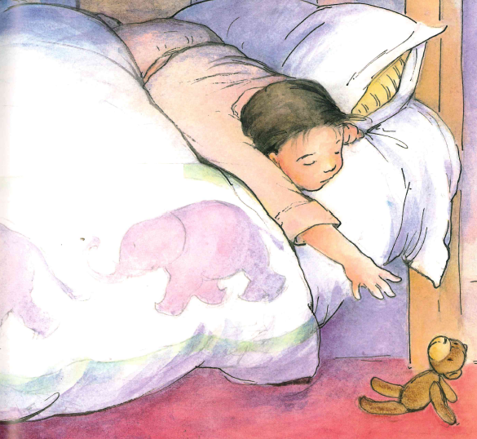
And one ted…

Slide 22
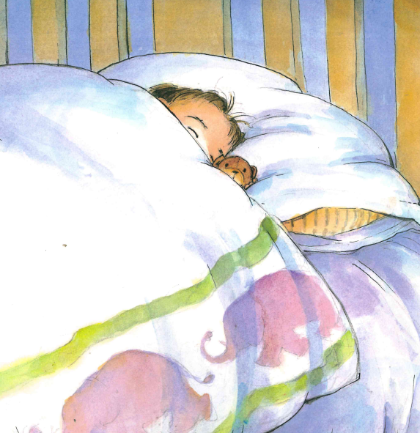
…is back in bed.

Slide 23
The end.

