Slide 1
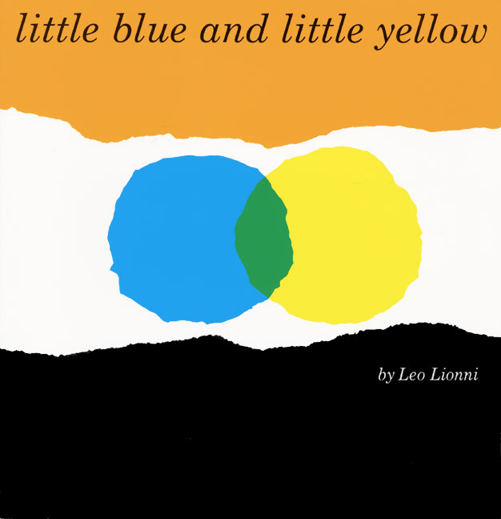

Slide 2
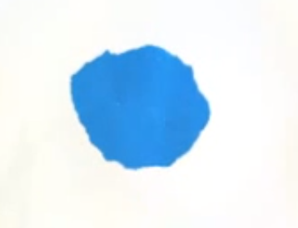
This is little blue.

Slide 3







He lives in a house
with mummy and daddy blue

Slide 4
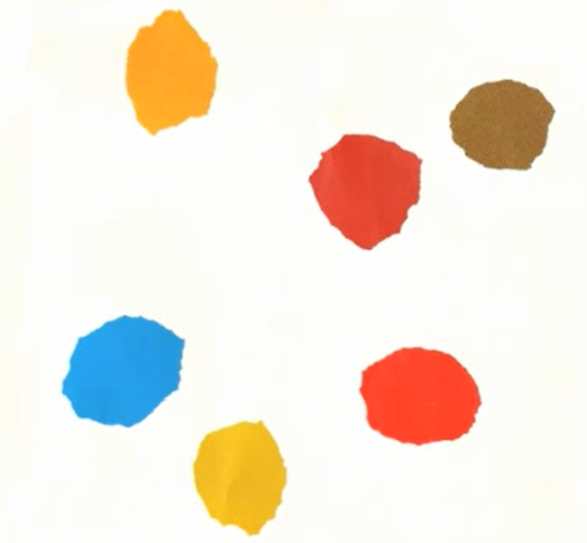


Little blue has lots of friends.

Slide 5


But his best friend is little yellow.

Slide 6




Little yellow lives across the street from Little blue,
in a house with mummy and daddy yellow.

Slide 7


They love to play….

Slide 8
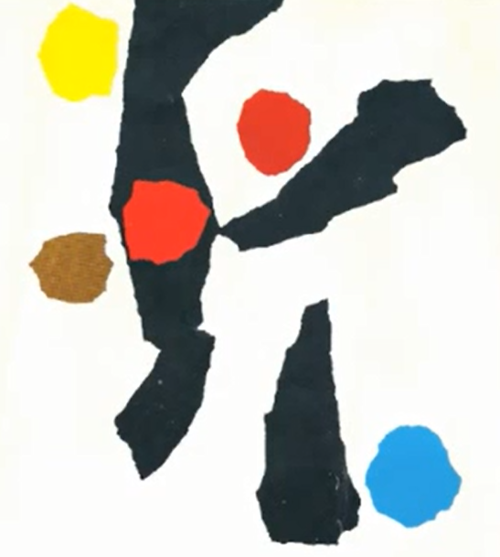


hide and seek

Slide 9
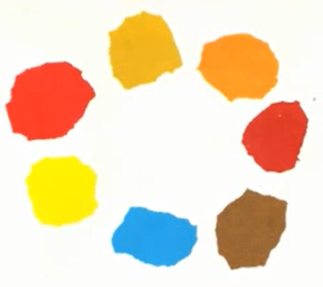
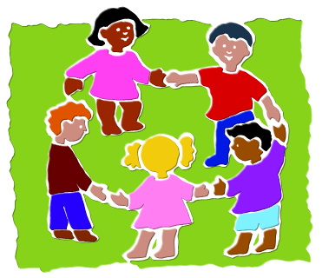
‘Ring a Ring o’ Roses’

Slide 10
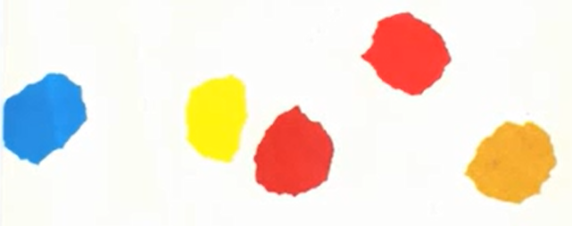


running and jumping.

Slide 11



Stay at home.
One day mummy blue went shopping.
“Stay at home,” she told little blue.

Slide 12


Where are you, little yellow!?
But little blue went out to look for little yellow.

Slide 13

He looked in the house across the street.
But the house was empty.

Slide 14


He looked here.

Slide 15

He looked there.

Slide 16

He looked everywhere.

Slide 17

Until suddenly, around the corner,
there was little yellow.
Notes:
Until suddenly around the corner

Slide 18



They were so happy
they hugged each other
Notes:
There was little yellow

Slide 19
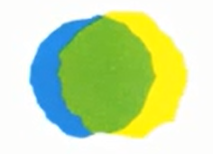
and hugged each other
Notes:
There was little yellow

Slide 20

until they were green.
Notes:
There was little yellow

Slide 21
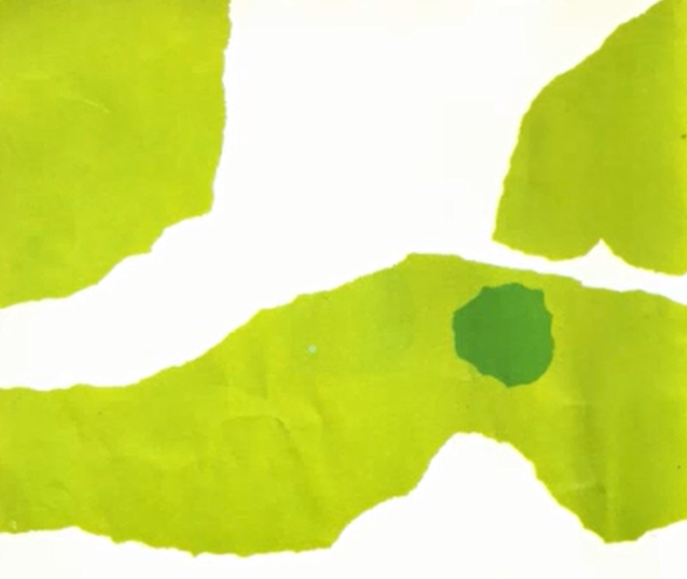

They went to play in the park.
Notes:
Then they went to play in the park

Slide 22


They ran through a tunnel,
Notes:
They ran through a tunnel,

Slide 23
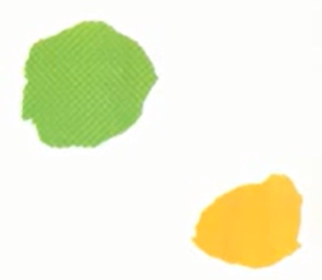

they chased little orange,
Notes:
They chased little orange

Slide 24
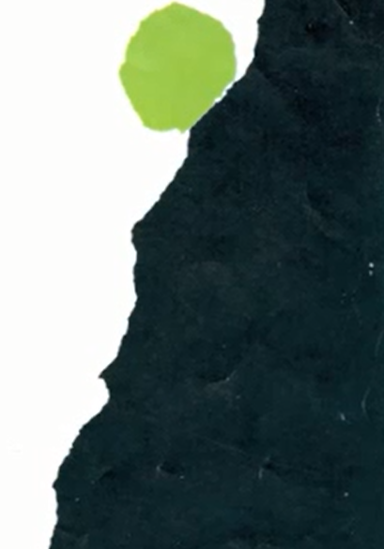

and they climbed the mountain.
Notes:
and they climbed the mountain.

Slide 25


When they were tired,
they went home.
Notes:
There was little yellow

Slide 26

But mummy and daddy blue said “you are not our little blue, you are green.”

Slide 27
And mummy and daddy yellow said “you are not our little yellow, you are green.”

Slide 28



They were very sad.
They cried big blue and yellow tears.
Notes:
They were very sad. They cried big blue and yellow tears.

Slide 29

They cried and cried
until they were all tears.
Notes:
They cried and cried until they were all tears.

Slide 30



When they stopped crying they said,
“Will they believe us now?”
Notes:
When they stopped crying they said, “Will they believe us now?”

Slide 31

Mummy and daddy blue were very happy to see their little blue.
They hugged and kissed him.
Notes:
Mummy and daddy blue were very happy to see their little blue.
They hugged and kissed him.

Slide 32
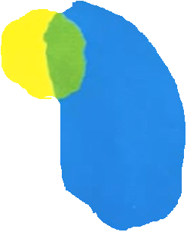

They hugged and kissed little yellow too.
And they became green.
Notes:
They hugged and kissed little yellow too. And they became green.

Slide 33


Now they knew what had happened.
So they went across the street to bring the good news.
Notes:
Now they knew what had happened. So they went across the street to bring the good news.

Slide 34
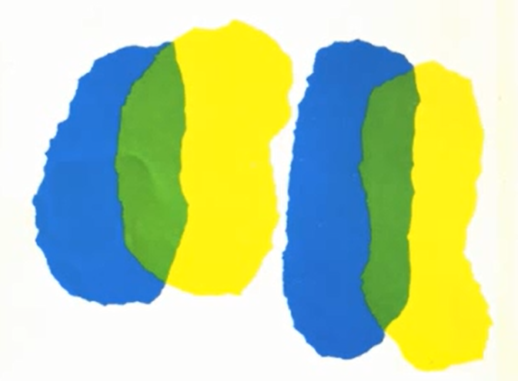

They all hugged each other with joy.
Notes:
They all hugged each other with joy

Slide 35
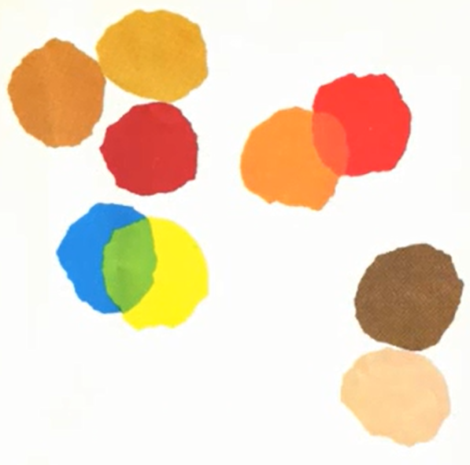




And the children played until supper time.
Notes:
And the children played until supper time.

Slide 36
The end.
Notes:
The end

Slide 37
http://www.youtube.com/watch?v=vTaaYWLH2pE
Clay animation

