Slide 1



Slide 2






Sometimes it looked like spilt milk.

Slide 3

But it wasn’t spilt milk.

Slide 4

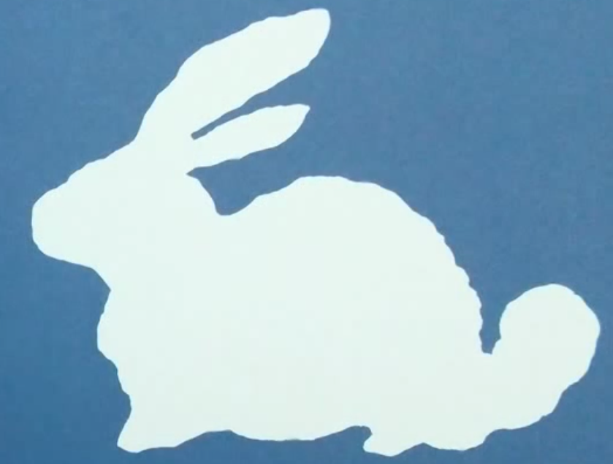
Sometimes it looked like a rabbit.

Slide 5
But it wasn’t a rabbit.

Slide 6

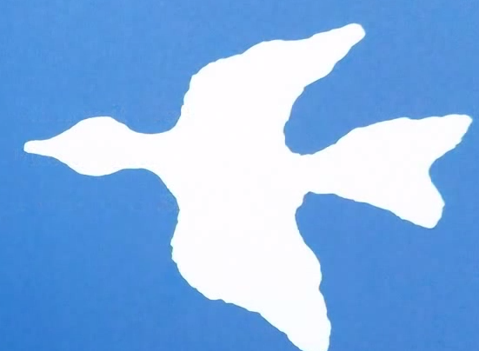
Sometimes it looked like a bird.

Slide 7
But it wasn’t a bird.

Slide 8


Sometimes it looked like a tree.

Slide 9
But it wasn’t a tree.

Slide 10

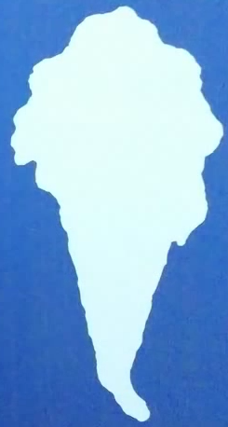
Sometimes it looked like an ice cream.

Slide 11
But it wasn’t an ice cream.

Slide 12


Sometimes it looked like a flower.

Slide 13
But it wasn’t a flower.

Slide 14

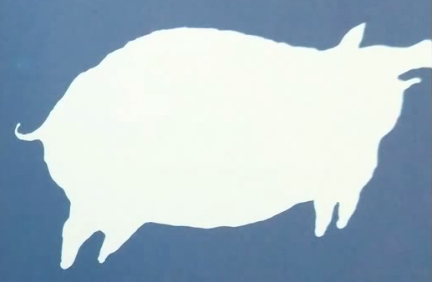
Sometimes it looked like a pig.

Slide 15
But it wasn’t a pig.

Slide 16


Sometimes it looked like a birthday cake.

Slide 17
But it wasn’t a birthday cake.

Slide 18

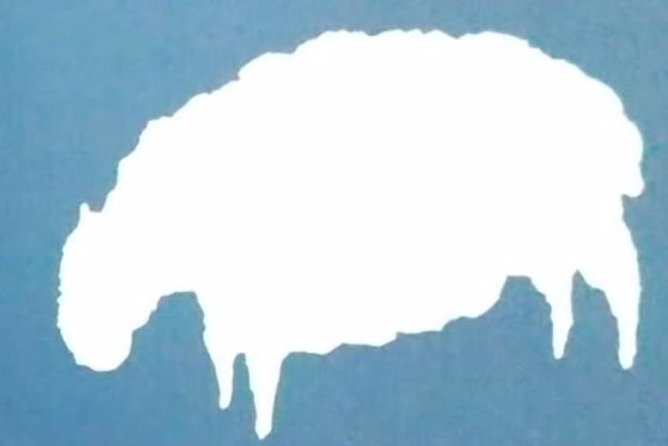
Sometimes it looked like a sheep.

Slide 19
But it wasn’t a sheep.

Slide 20

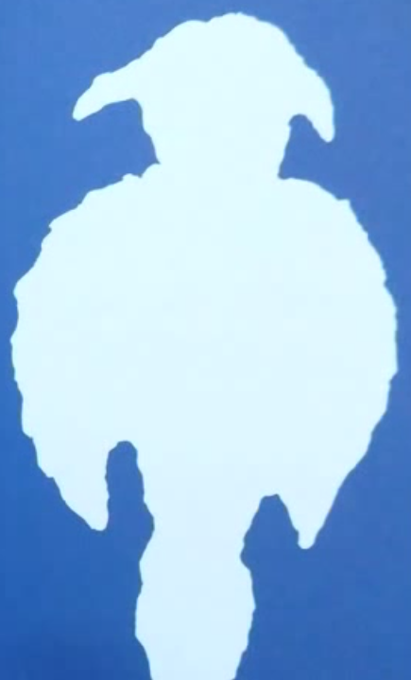
Sometimes it looked like an owl.

Slide 21
But it wasn’t an owl.

Slide 22

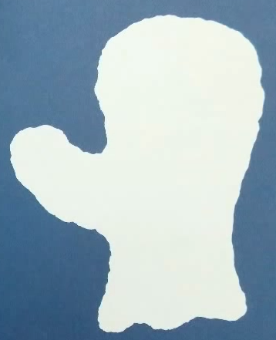
Sometimes it looked like a mitten.

Slide 23
But it wasn’t a mitten.

Slide 24

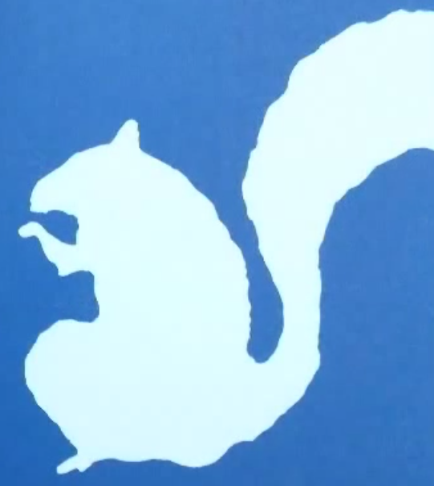
Sometimes it looked like a squirrel.

Slide 25
But it wasn’t a squirrel.

Slide 26

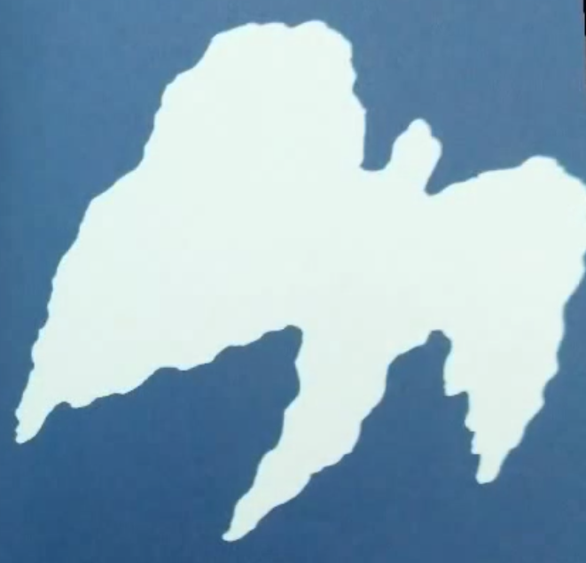
Sometimes it looked like an angel.

Slide 27
But it wasn’t an angel.

Slide 28
Sometimes it looked like spilt milk.

Slide 29
But it wasn’t spilt milk.

Slide 30


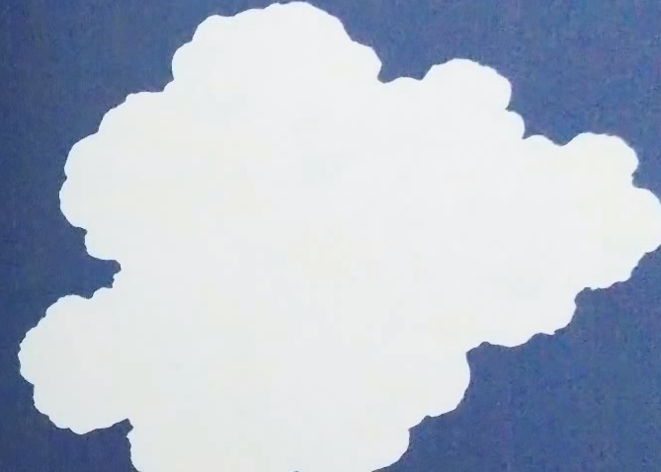
It was just a cloud in the sky.

Slide 31
The end.

Slide 32
Child telling it: http://www.youtube.com/watch?v=YAx5o286984
Told with music: http://www.youtube.com/watch?v=sbg-tFF7yLw
Very short animation (no sound): http://www.youtube.com/watch?v=nSPdaTazh-o&list=PLSAlt43yMt9ECTSjXSXgV-gu84h7IzV_Y
Version made by children: http://www.youtube.com/watch?v=IXD9RBBBePE

