Slide 1
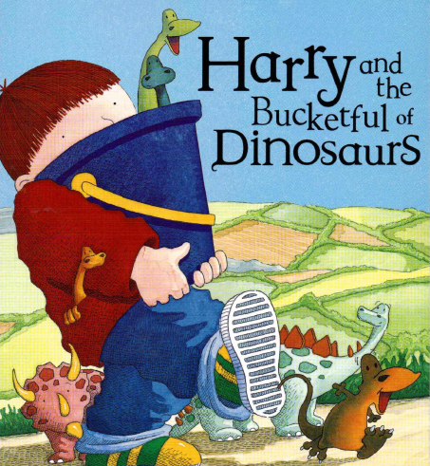

Slide 2



Story written by
Pictures draw by

Slide 3
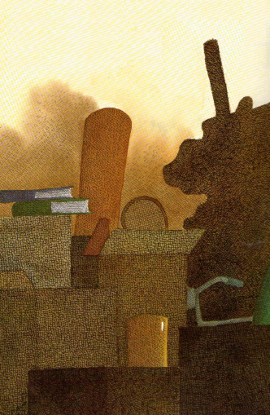




Harry and Grandma were cleaning the attic.
H

Slide 4
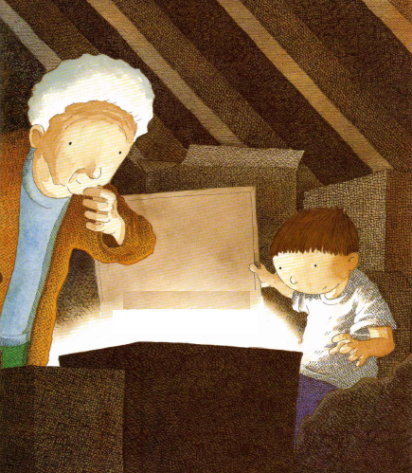


They found a box.

Slide 5
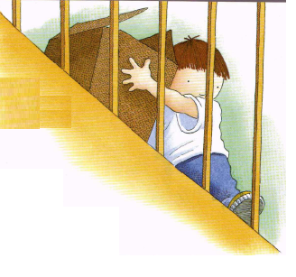
Harry took the box downstairs.

Slide 6
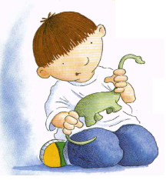

Inside the box was…
DINOSAURS!!

Slide 7

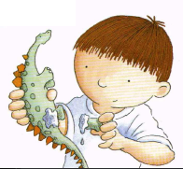
Harry fixed the ones that were broken…

Slide 8
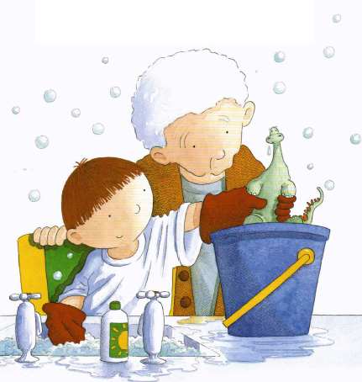

…and
washed them all.

Slide 9

So he put them all in
a bucket.
Dinosaurs don’t like being in boxes.

Slide 10
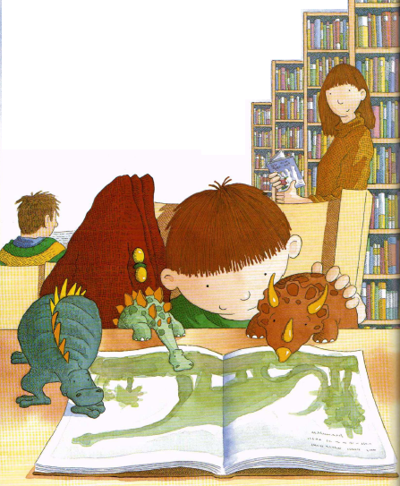


The next day Harry went to
the library and found a book all about dinosaurs.
He found out
their names.

Slide 11
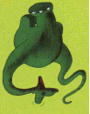


scelidoraurus
apatosaurus
triceratops

Slide 12



tyrannosaurus
stegosaurus
anchisaurus

Slide 13
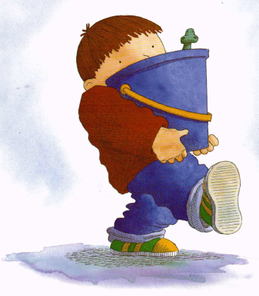
The dinosaurs went everywhere with Harry.

Slide 14
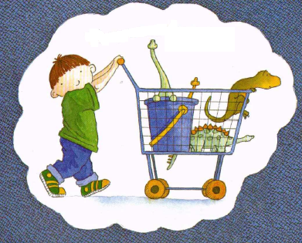

They went to the shops.

Slide 15
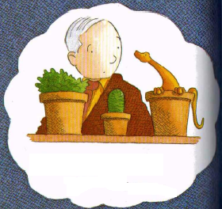

They went to the garden centre.

Slide 16
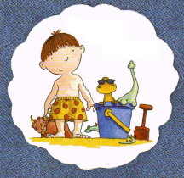

They went to the beach.

Slide 17
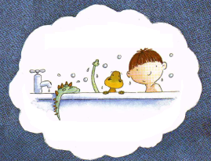

They even went in the bath with Harry.

Slide 18

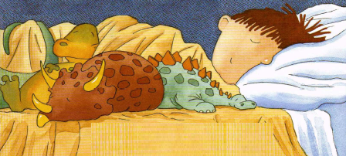
And when Harry when to bed, so did his dinosaurs.

Slide 19
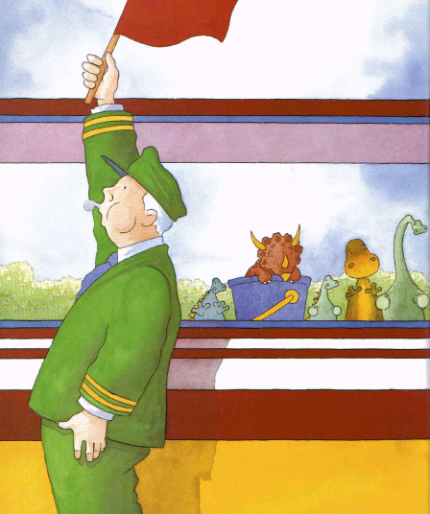


But one day
Harry forgot his bucket of dinosaurs on
the train.

Slide 20
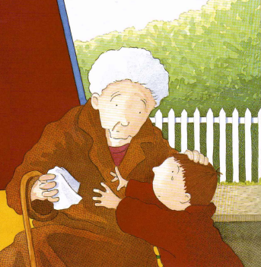

Harry was
so sad.
I’ll buy you a new DVD!

Slide 21
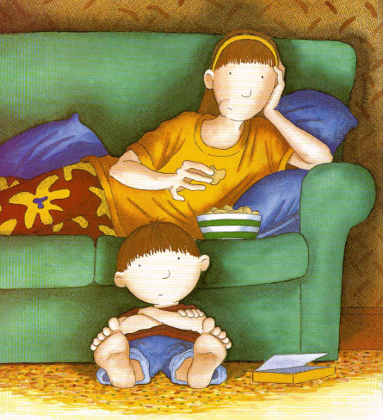

Harry and his sister watched the
new DVD.

Slide 22
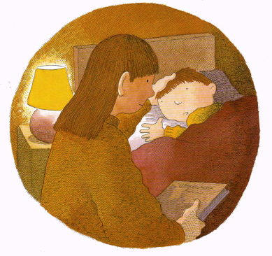
After the DVD finished it was time for bed.
I like DVDs but I miss my dinosaurs.

Slide 23
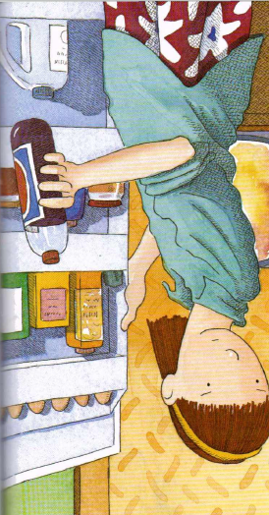
The next morning, Harry’s sister was not being kind to him.
Who cares about those silly old dinosaurs anyway!

Slide 24
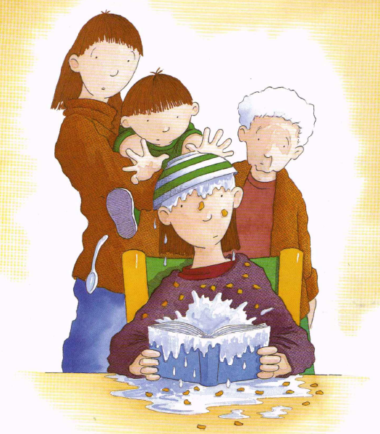


Harry was
cross.
And he threw
his cereal over his sister’s head!

Slide 25
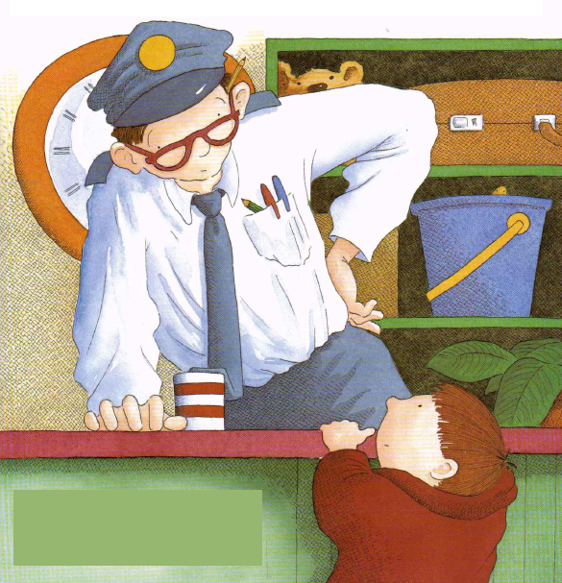

Grandma took Harry back to
the train station.

Slide 26
I do have a bucketful of dinosaurs. But how do I know they are yours?
Have you seen my bucketful of dinosaurs?

Slide 27
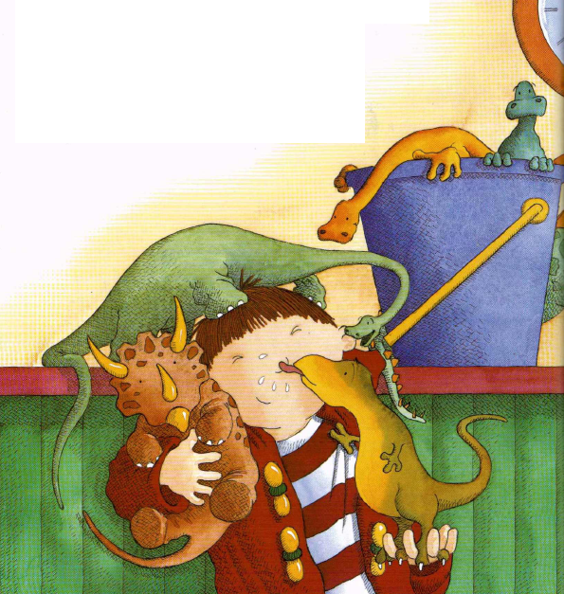
So Harry began to call all their
names and they came running to him.

Slide 28
After that, Harry made sure he always held on tight to his bucket.

Slide 29
The end.

