Slide 1
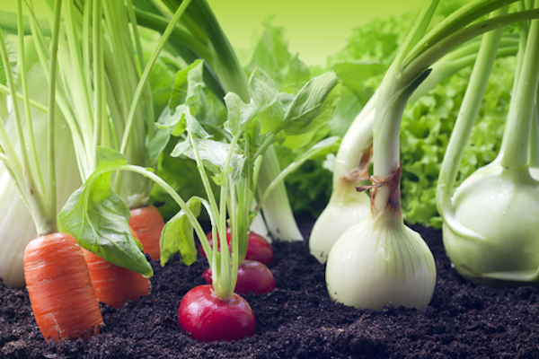
Growing vegetable soup

Slide 2

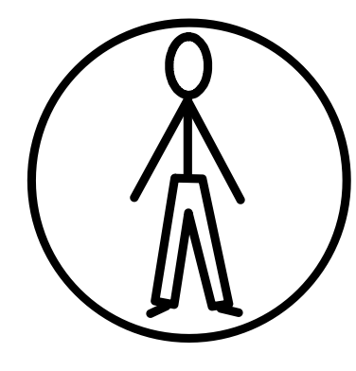
Dad says we are going to grow vegetable soup.

Slide 3
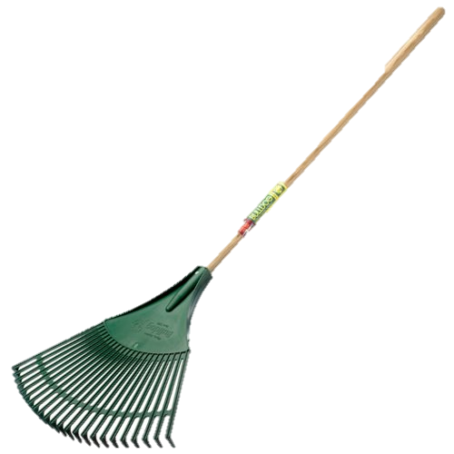
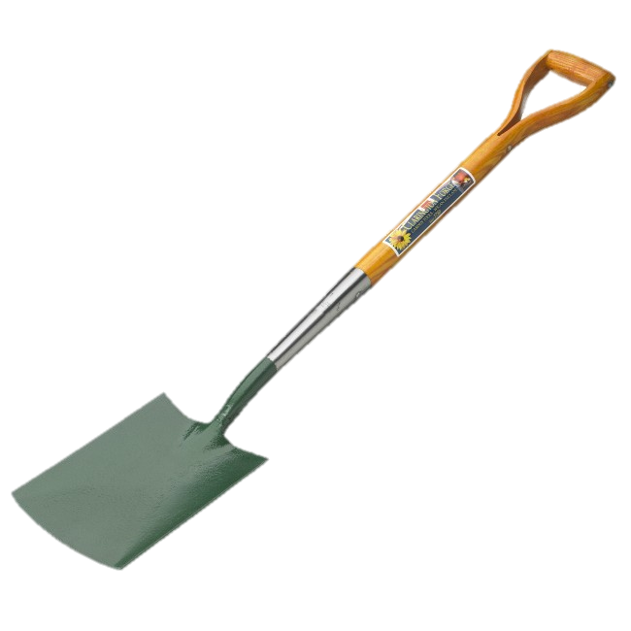
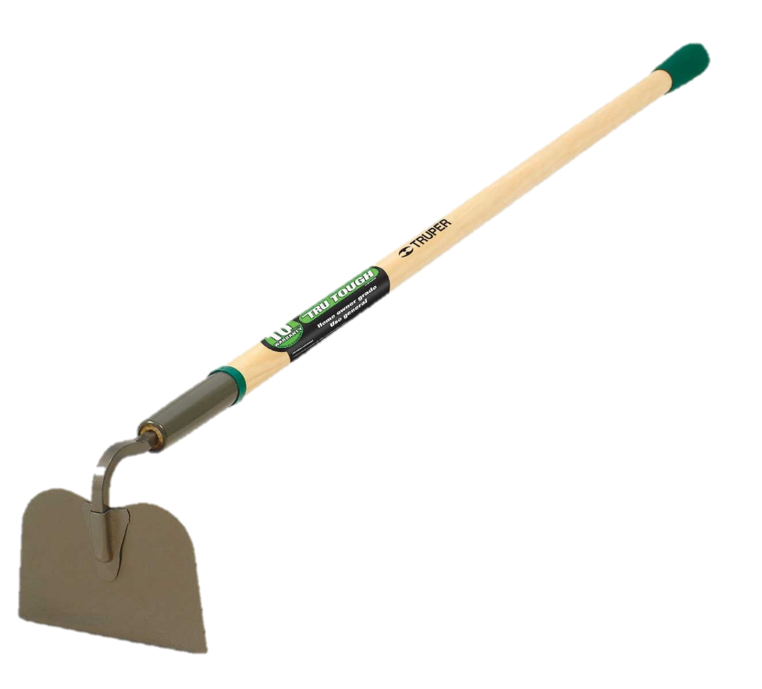



We’re ready to work, and our tools are ready too.

Slide 4
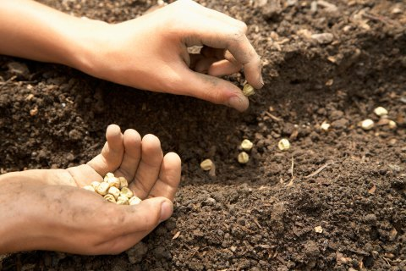
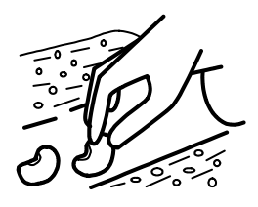
We are planting the seeds…

Slide 5
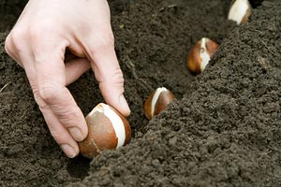

…and all the bulbs…

Slide 6
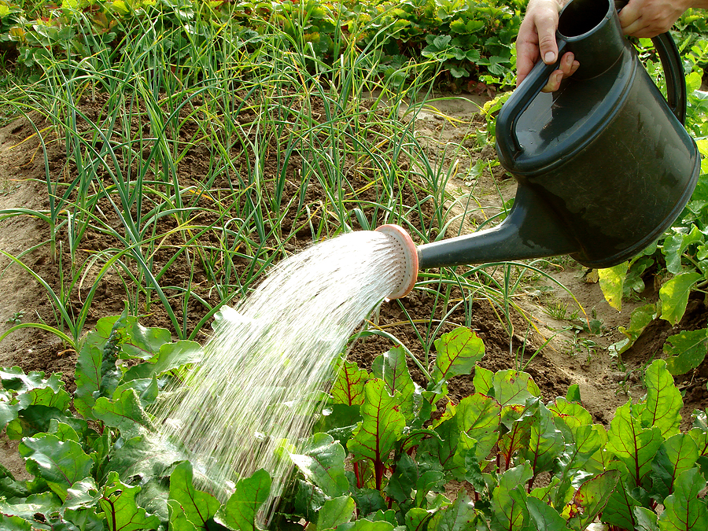

…and giving them water…

Slide 7


…and waiting for the warm sun to make them grow…

Slide 8
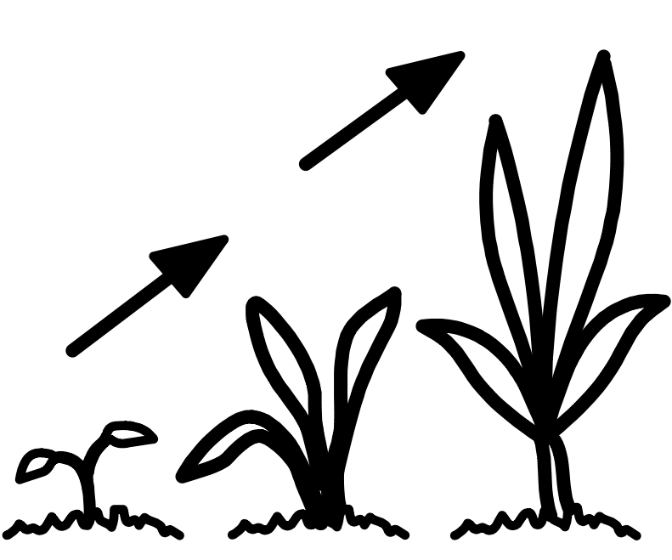
…and grow…

Slide 9
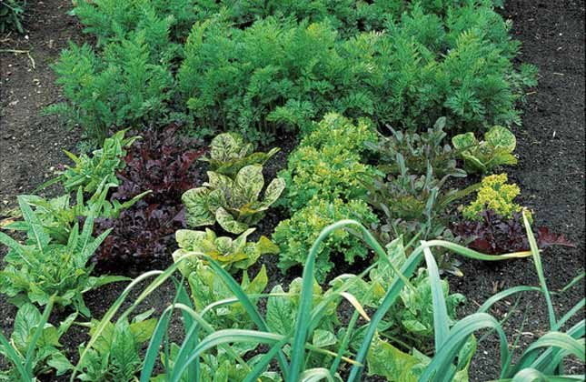
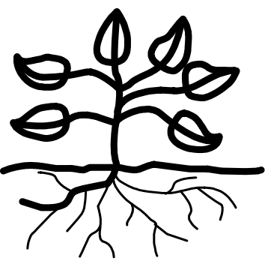
…and grow into plants.

Slide 10
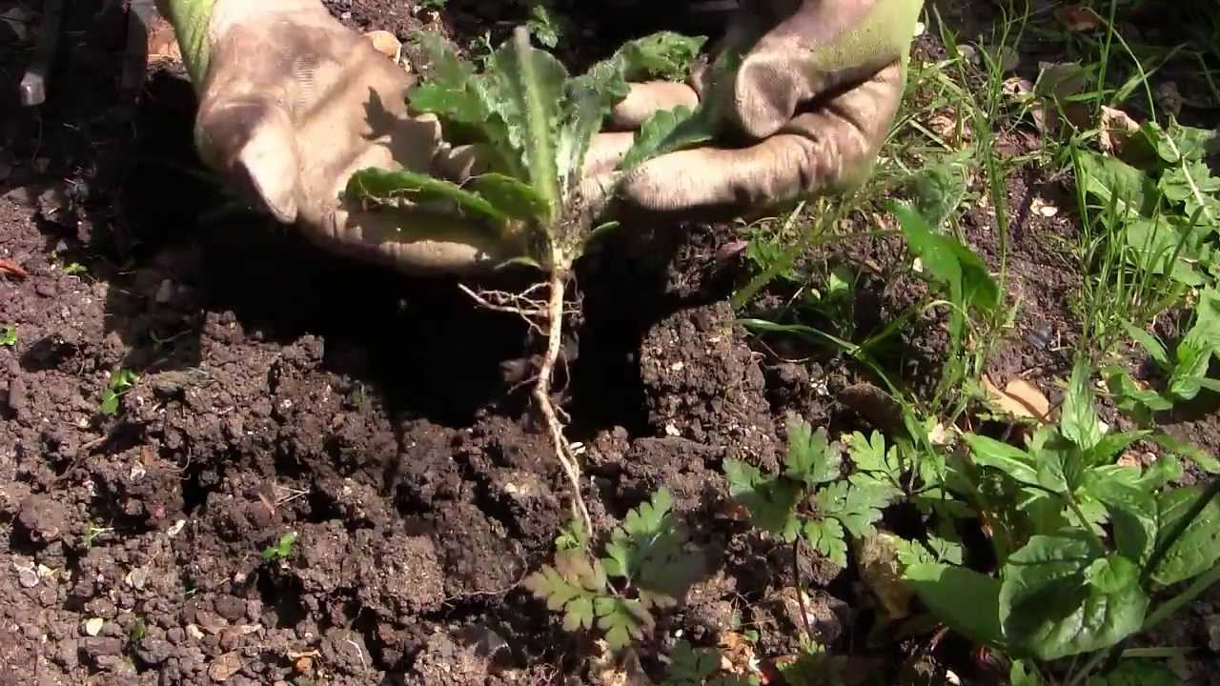

We watch over them and weed…

Slide 11
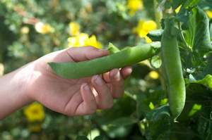
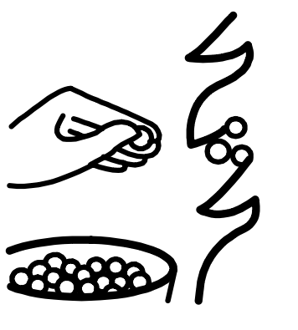
…until the vegetables are ready for us to pick…

Slide 12
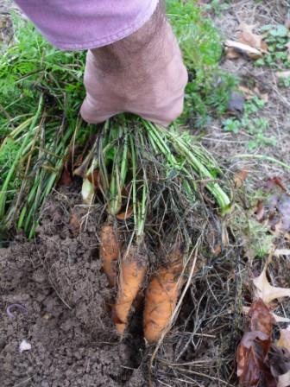

…or dig up...

Slide 13
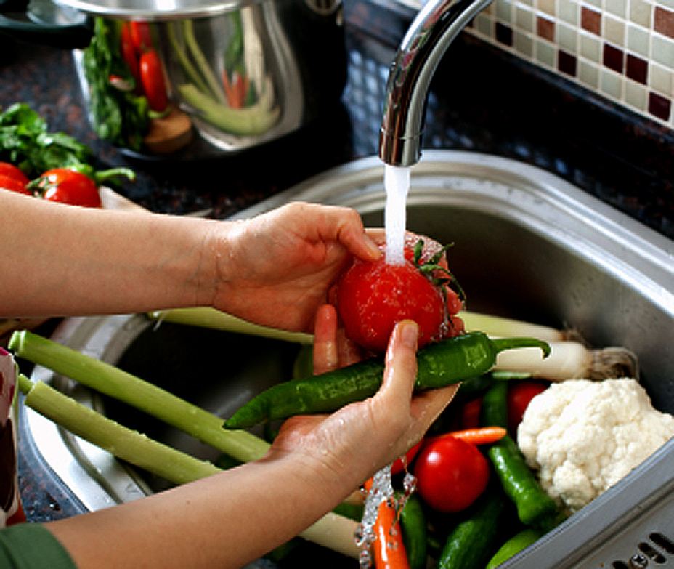
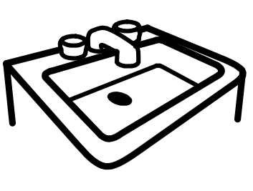
…and carry home.
Then we wash them…

Slide 14
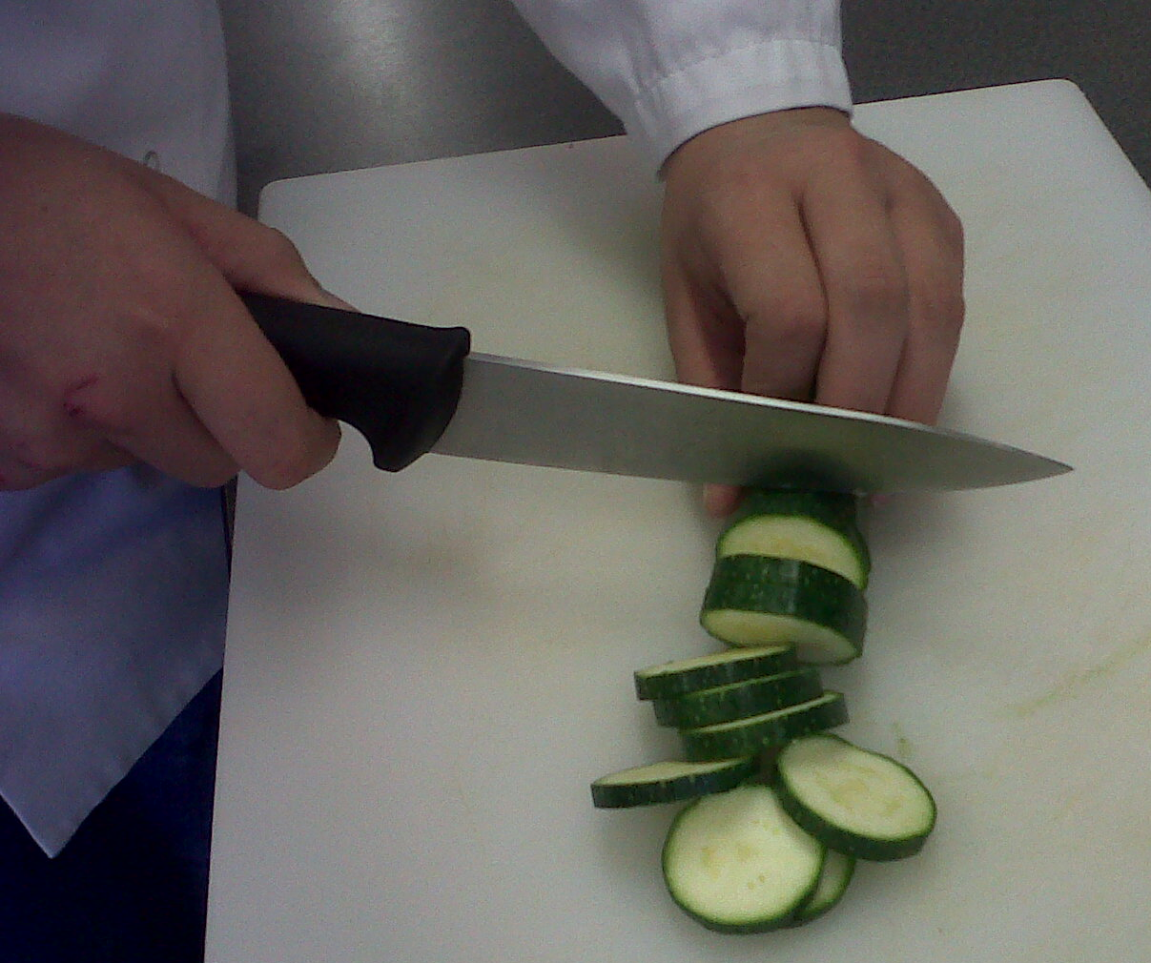
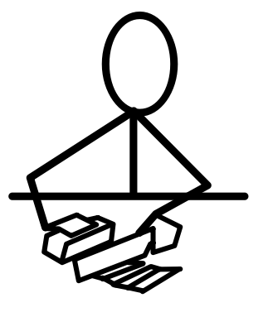
…and chop them and put them in a pot of water…

Slide 15
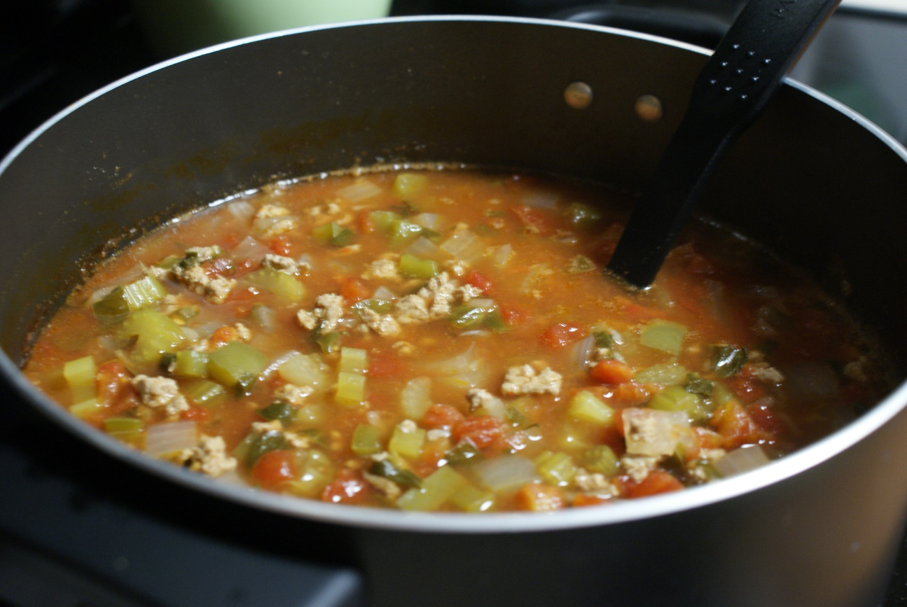
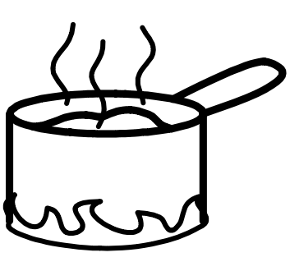
…and cook them into vegetable soup!

Slide 16
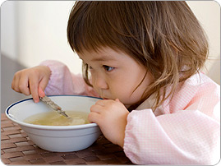
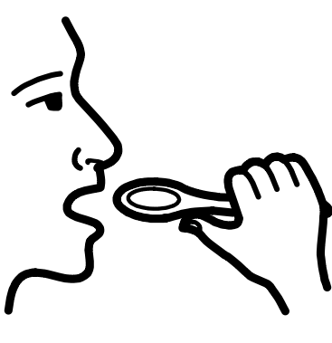
At last it’s time to eat it all up!

Slide 17
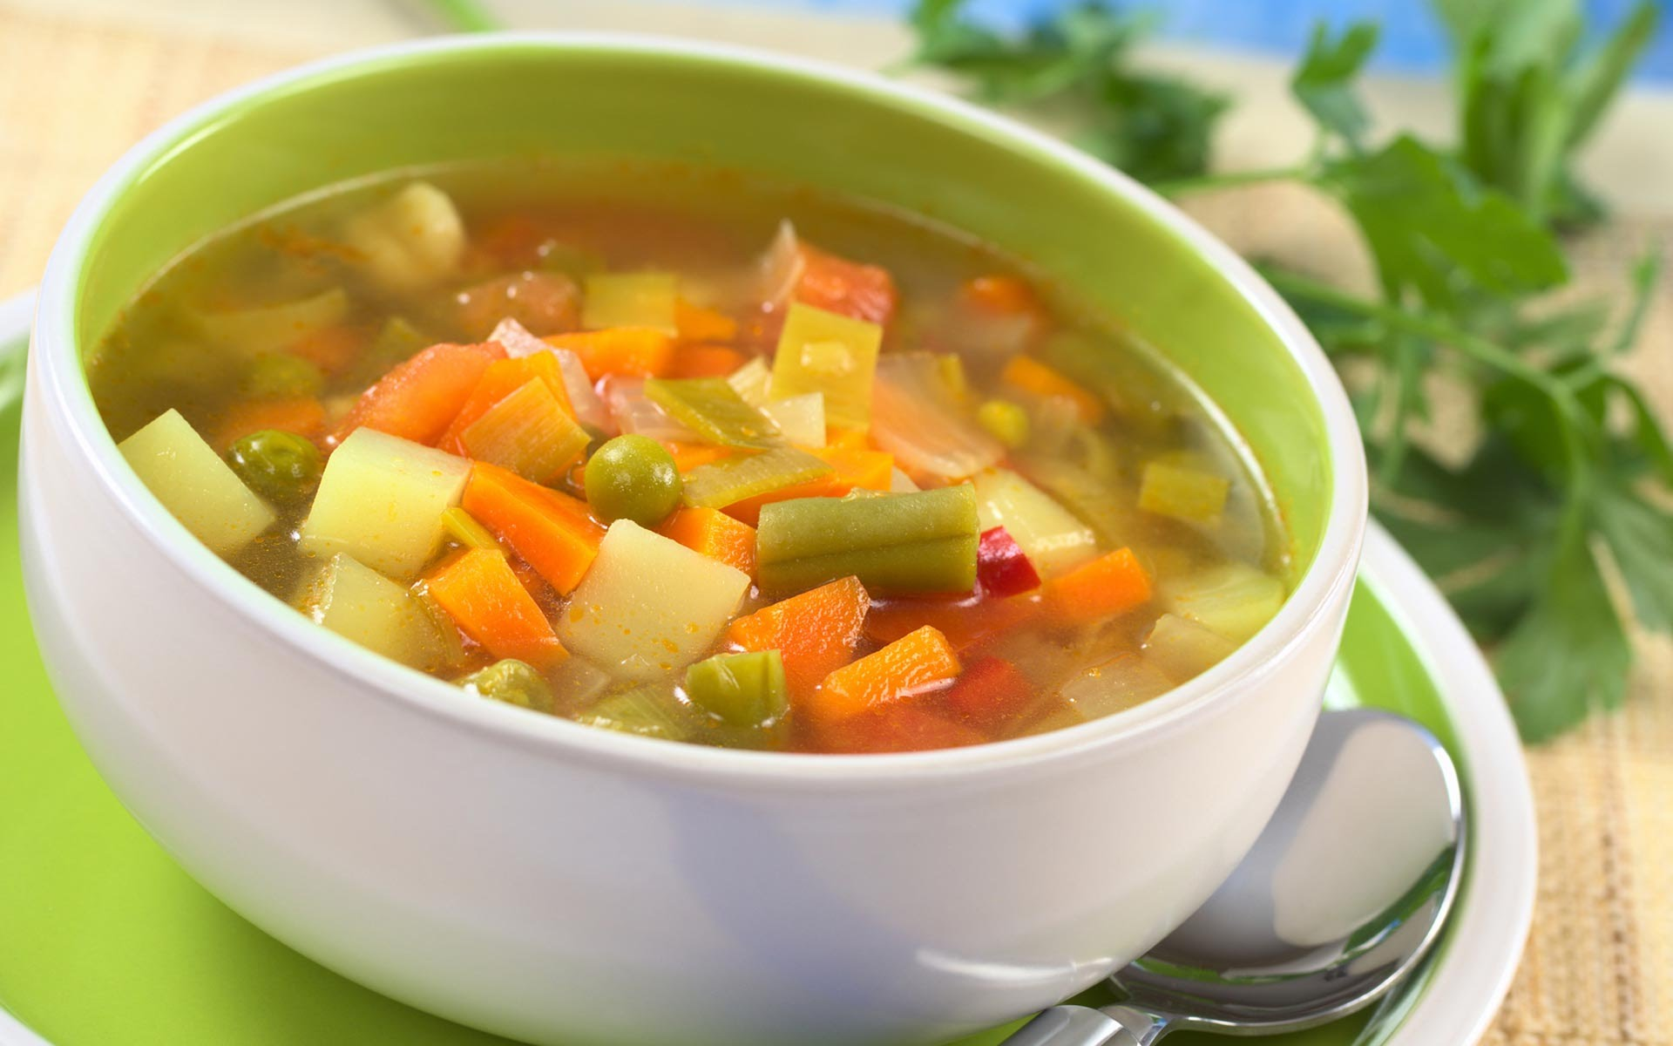

It was the most delicious soup ever…

Slide 18

…and we can grow it again next year.

Slide 19

The end.

