Slide 1
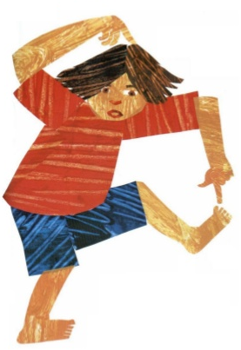
From head to toe

Slide 2
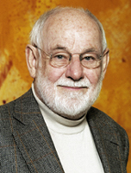
By Eric Carle

Slide 3
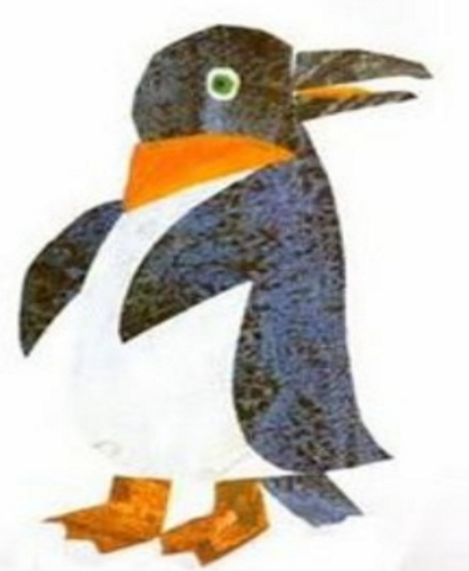
I am a penguin

Slide 4
and I turn my head.

Slide 5

Can you do it?

Slide 6
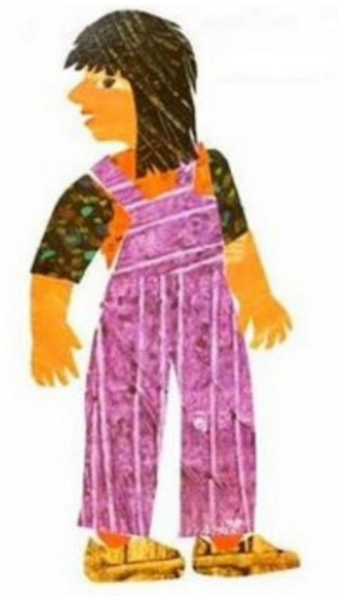
I can do it!

Slide 7
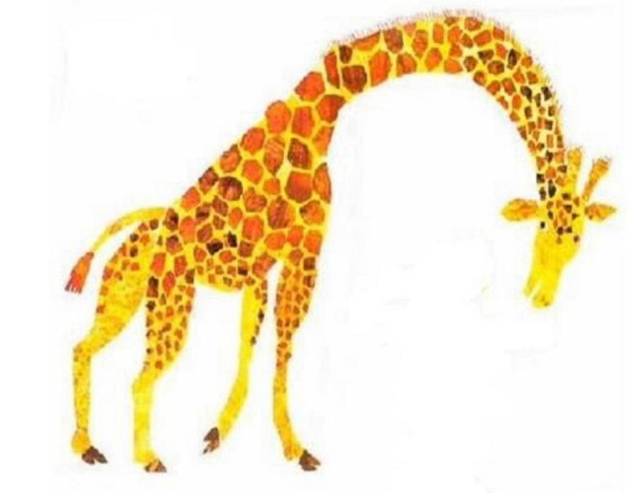
I am a giraffe

Slide 8
and I bend my neck.

Slide 9
Can you do it?

Slide 10
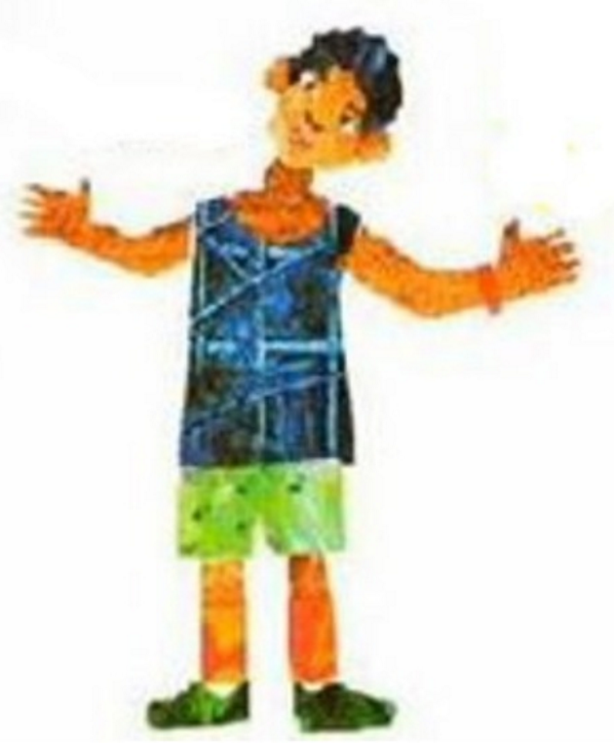
I can do it!

Slide 11
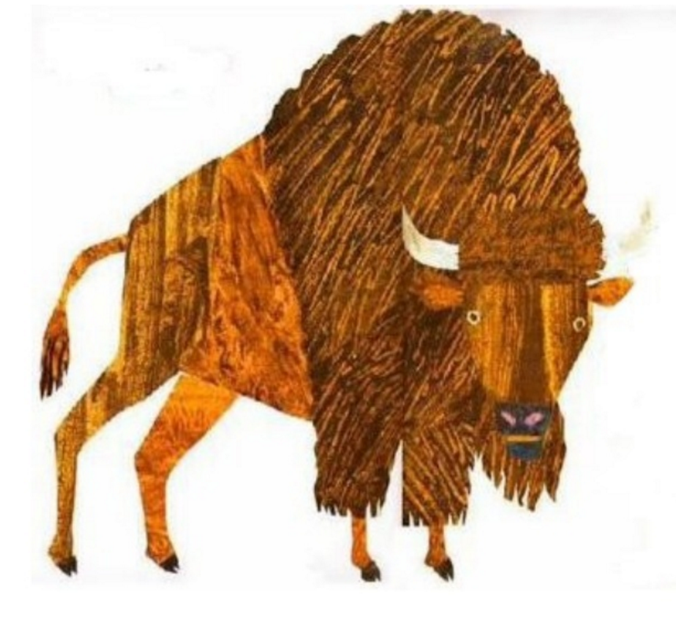
I am a buffalo

Slide 12
and I raise my shoulders.

Slide 13
Can you do it?

Slide 14
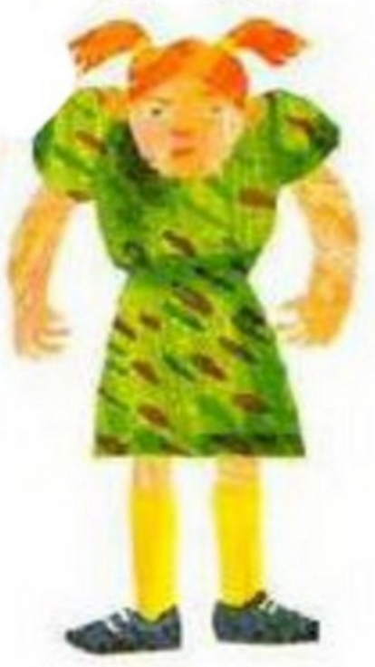
I can do it!

Slide 15
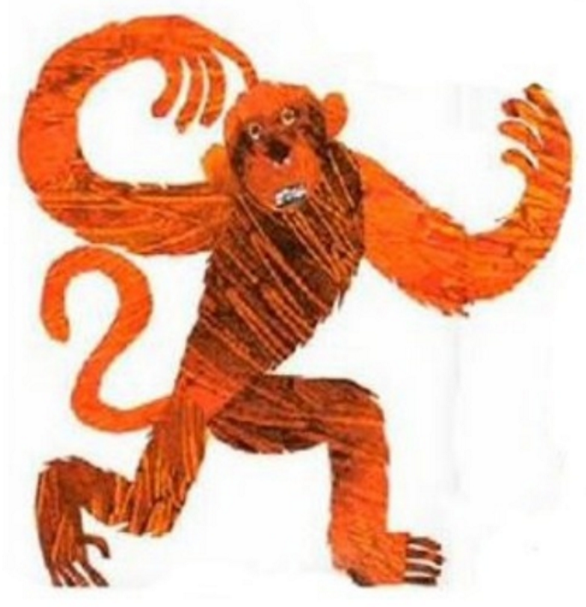
I am a monkey

Slide 16
and I wave my arms.

Slide 17
Can you do it?

Slide 18
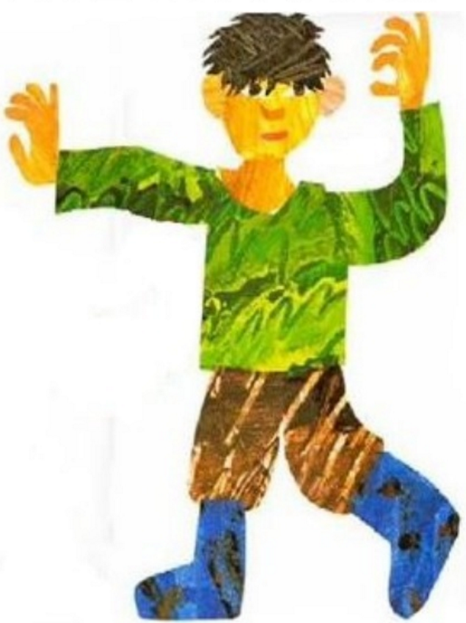
I can do it!

Slide 19

I am a seal

Slide 20
and I clap my hands.

Slide 21
Can you do it?

Slide 22
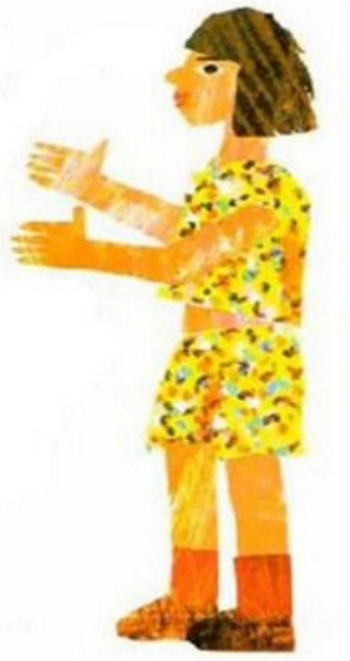
I can do it!

Slide 23
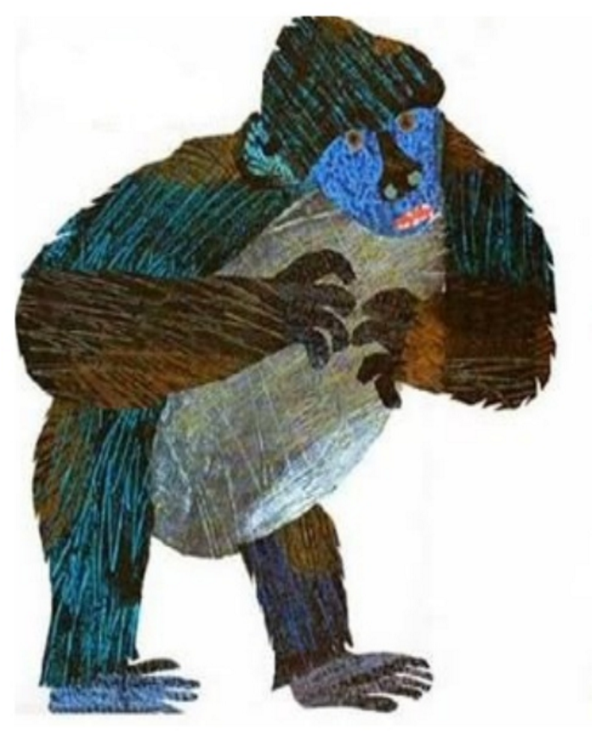
I am a gorilla

Slide 24
and I thump my chest.

Slide 25
Can you do it?

Slide 26
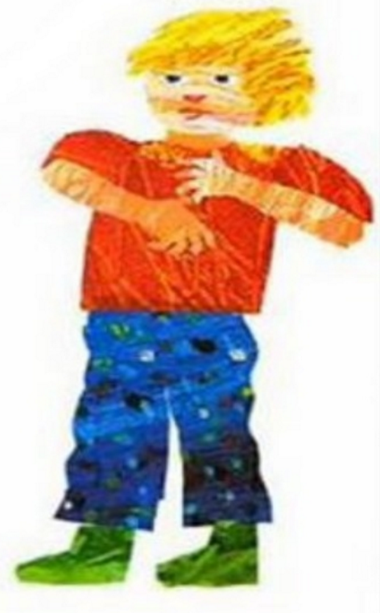
I can do it!

Slide 27
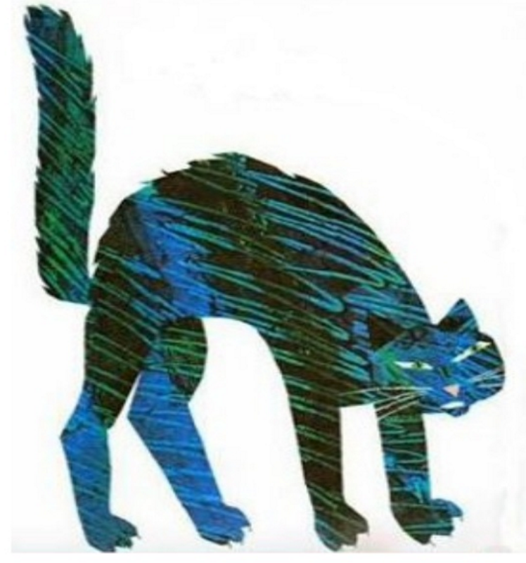
I am a cat

Slide 28
and I arch my back.

Slide 29
Can you do it?

Slide 30
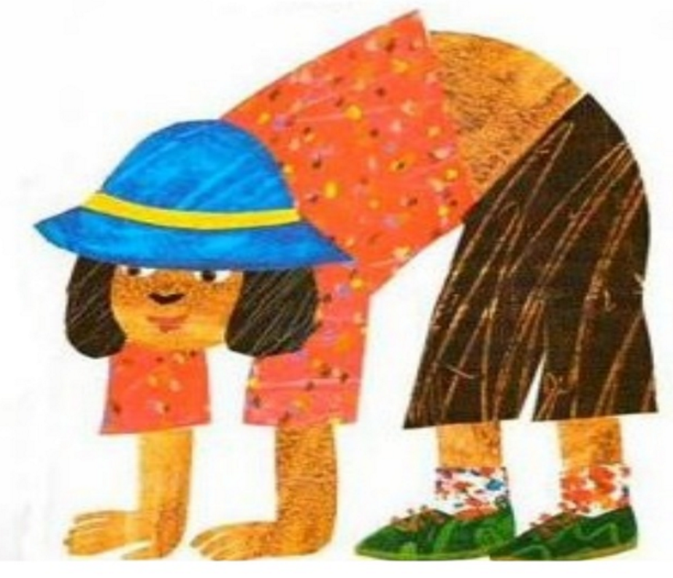
I can do it!

Slide 31
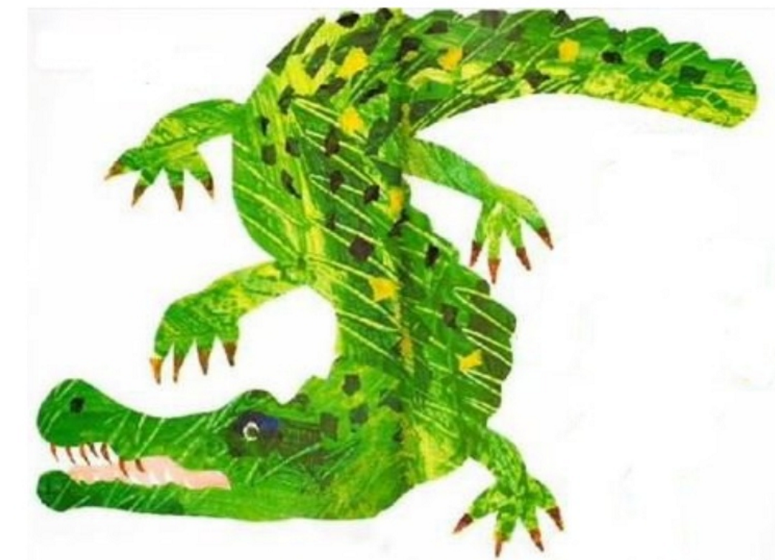
I am a crocodile

Slide 32
and I wriggle my hips.

Slide 33
Can you do it?

Slide 34
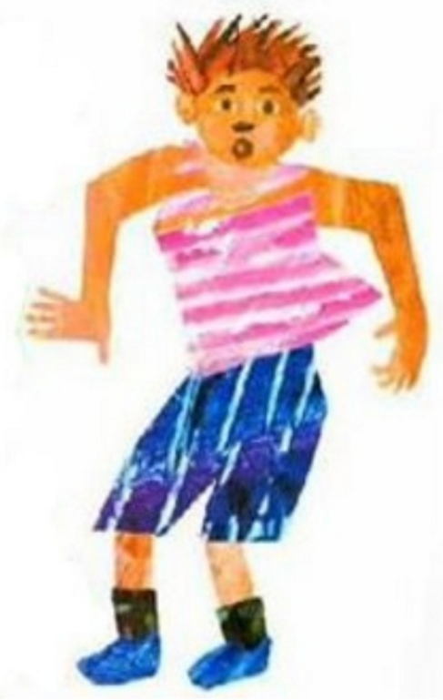
I can do it!

Slide 35
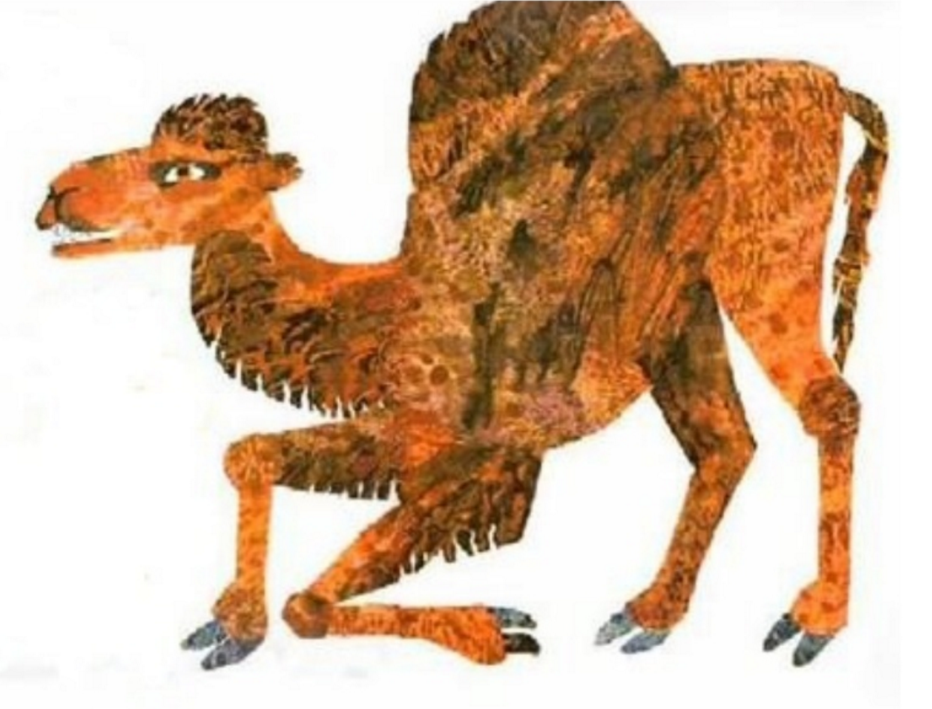
I am a camel

Slide 36
and I bend my knees.

Slide 37
Can you do it?

Slide 38
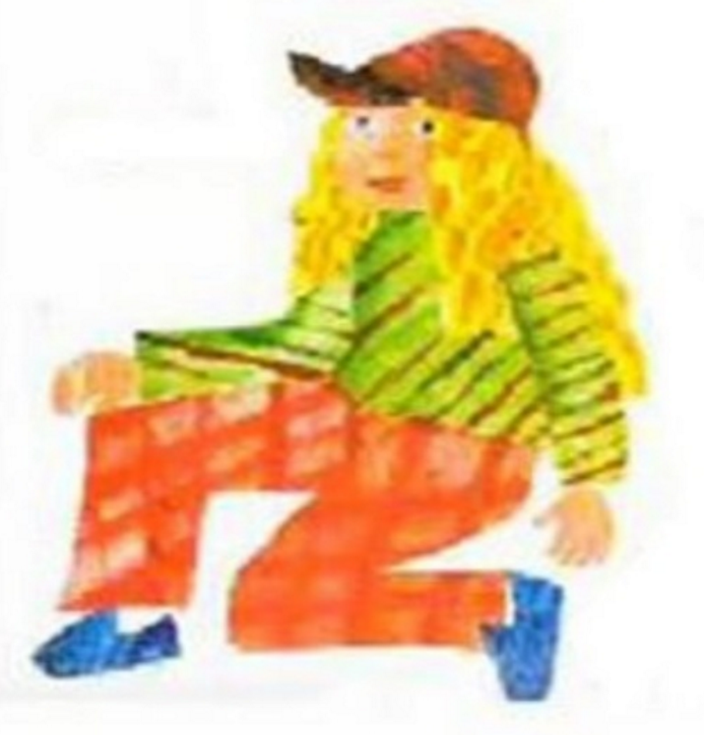
I can do it!

Slide 39
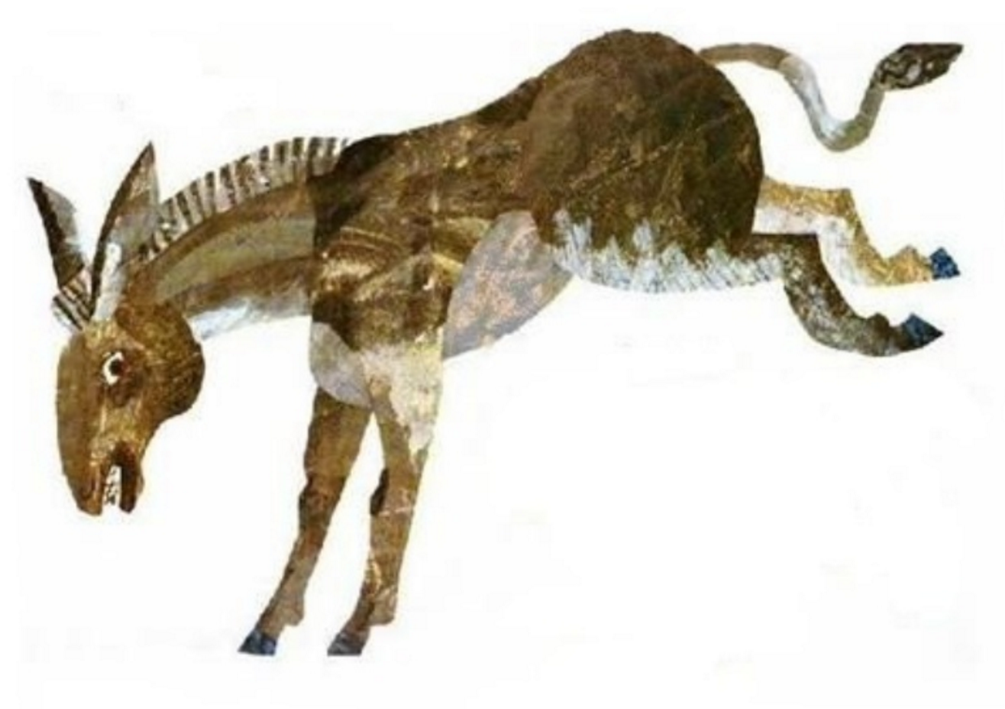
I am a donkey

Slide 40
and I kick my legs.

Slide 41
Can you do it?

Slide 42
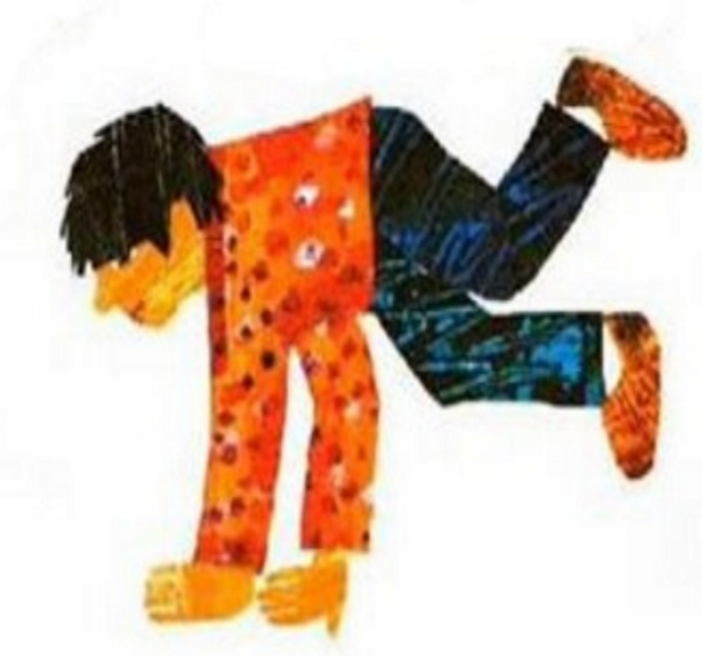
I can do it!

Slide 43
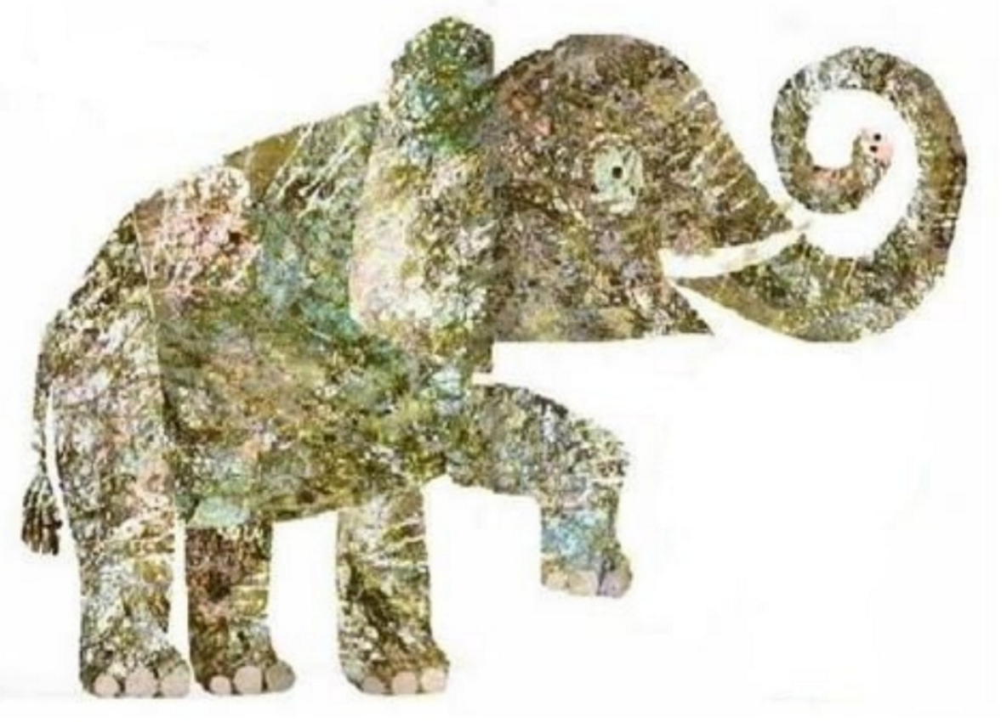
I am an elephant

Slide 44
and I stomp my foot.

Slide 45
Can you do it?

Slide 46
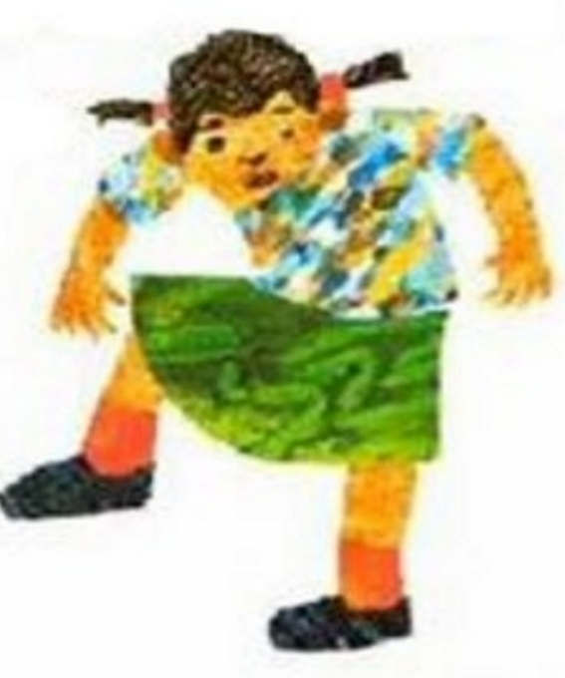
I can do it!

Slide 47
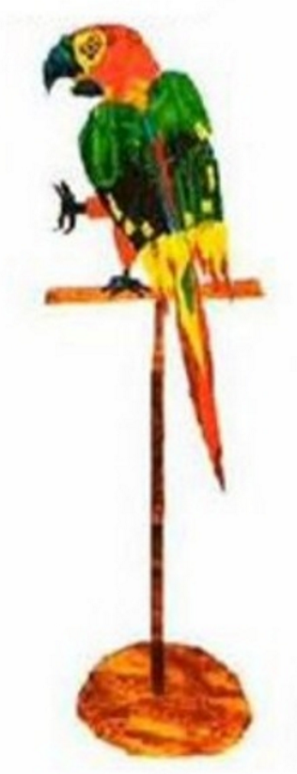
I am a parrot

Slide 48
and I wiggle my toe.

Slide 49
Can you do it?

Slide 50
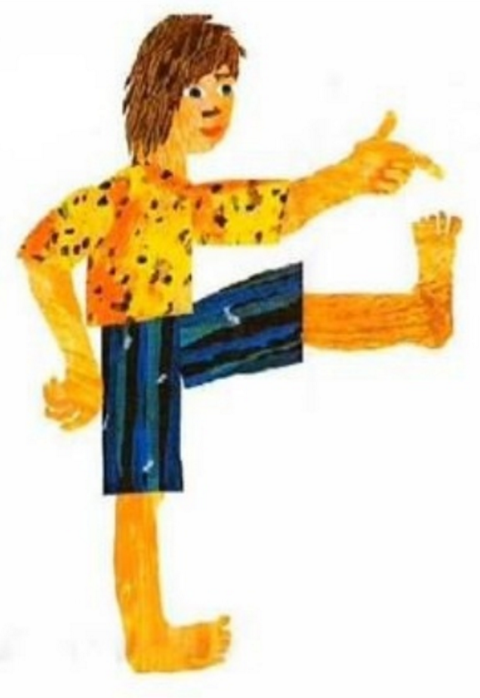
I can do it!

Slide 51


