Slide 1
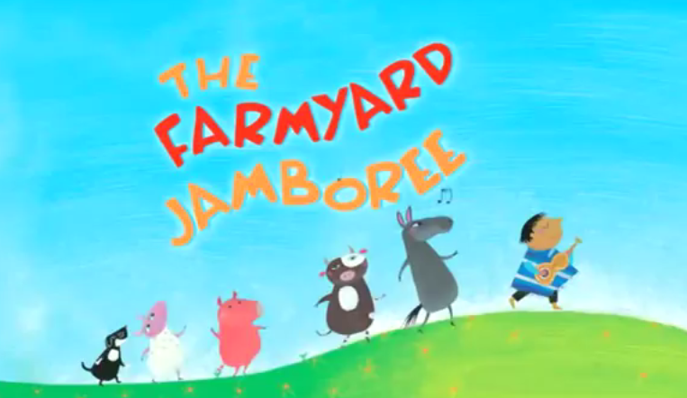

Slide 2
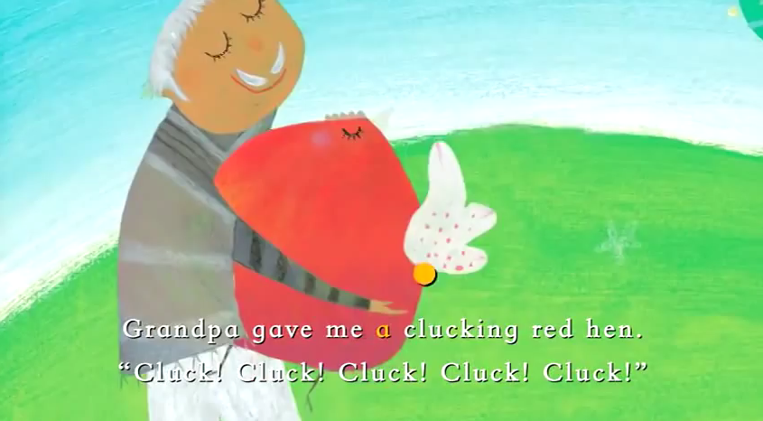

Slide 3
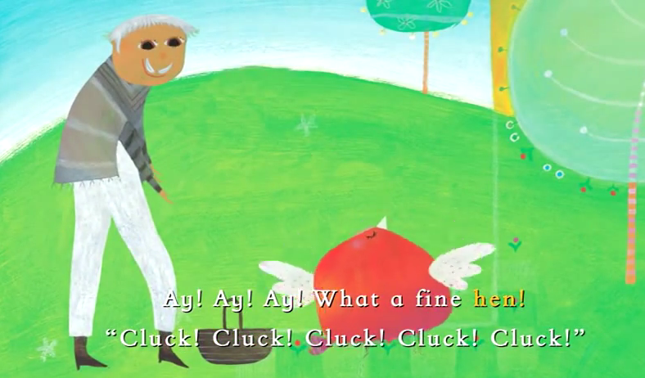

Slide 4
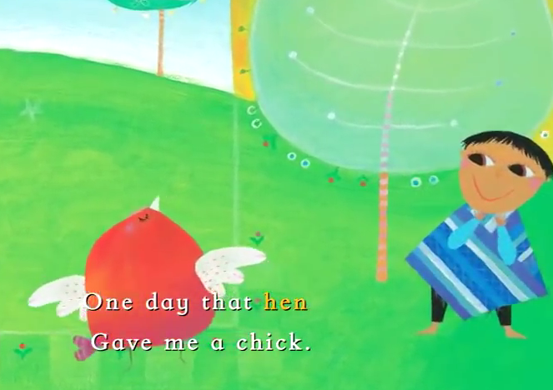

Slide 5
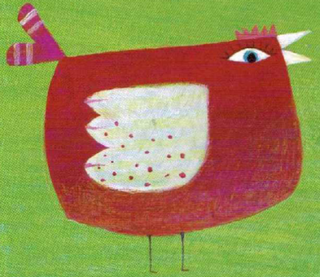
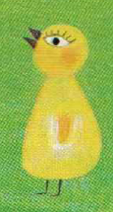
I had a hen,
And I had a chick.

Slide 6
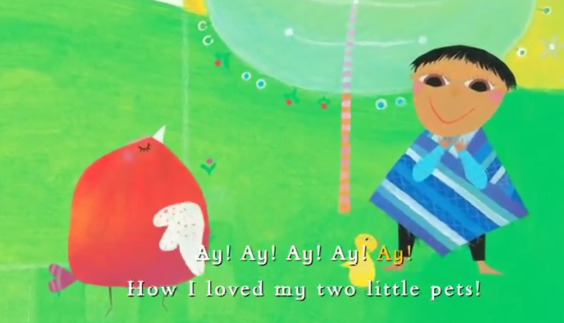

Slide 7
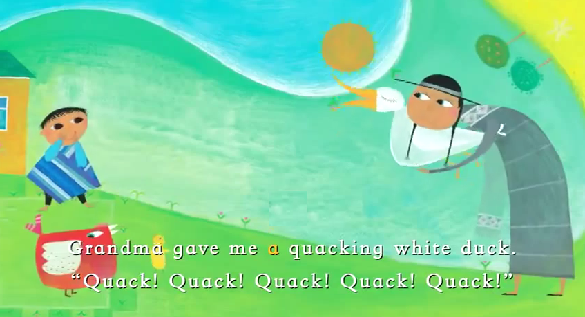

Slide 8
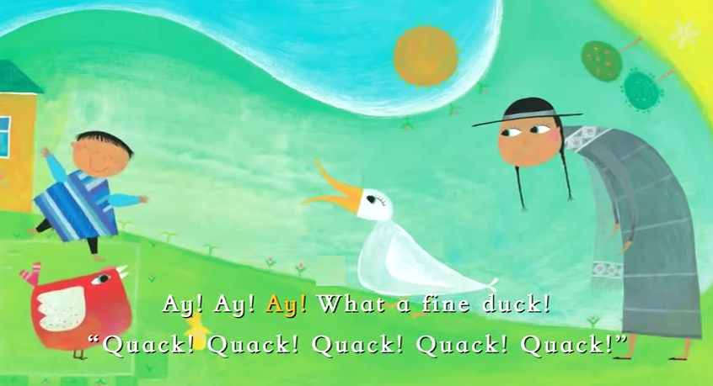

Slide 9
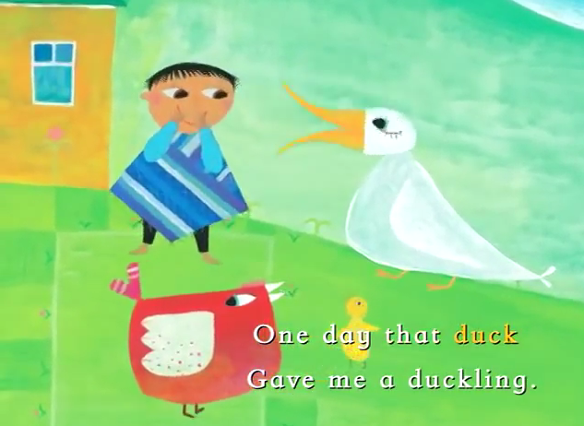

Slide 10
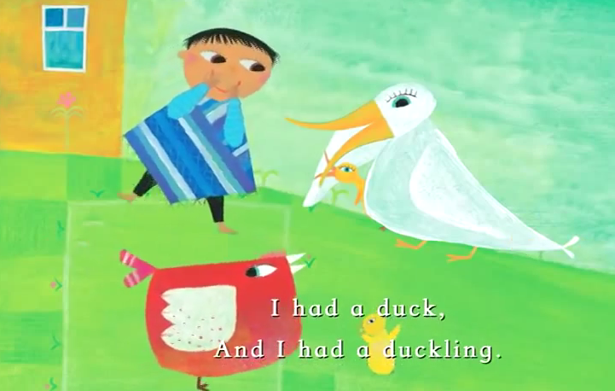

Slide 11
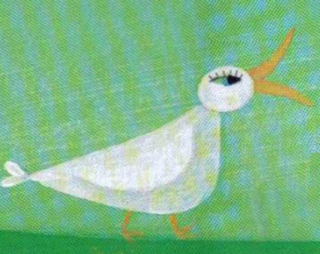
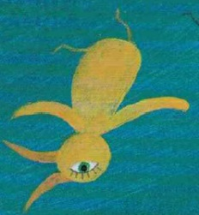
I had a duck,
And I had a duckling.
I had a hen,
I had a chick,

Slide 12
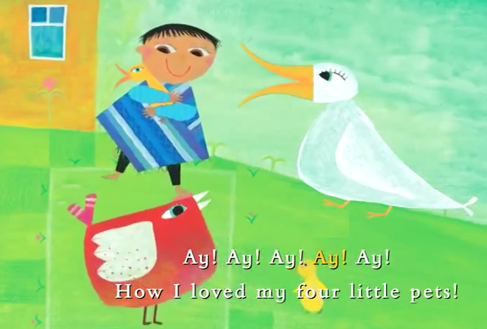

Slide 13
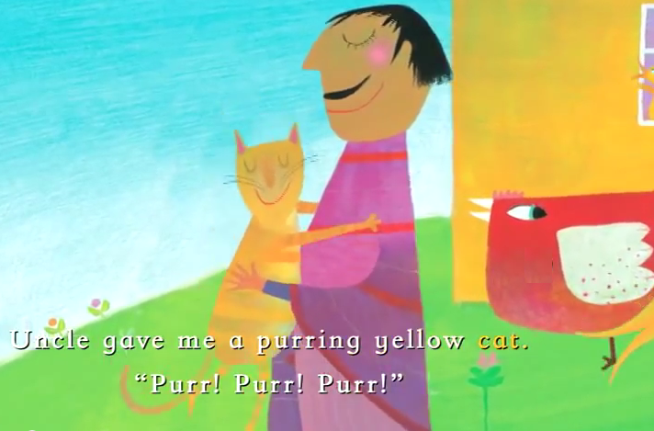

Slide 14
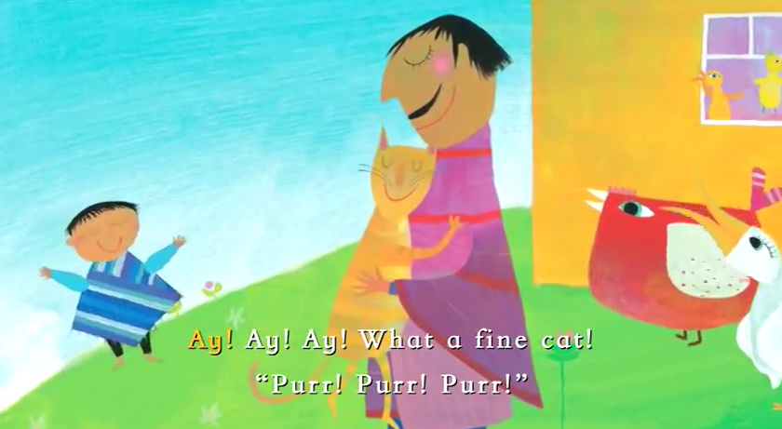

Slide 15
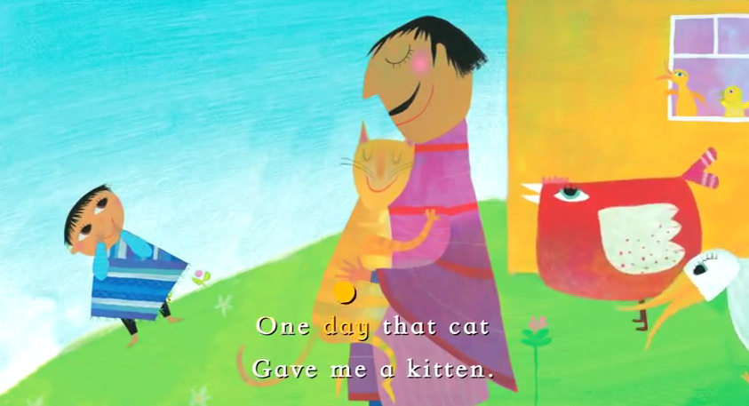

Slide 16
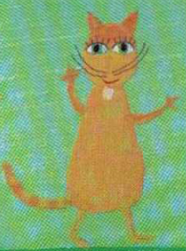
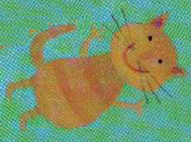
I had a cat,
And I had a kitten.
I had a duck,
I had a duckling.
I had a hen,
I had a chick.

Slide 17
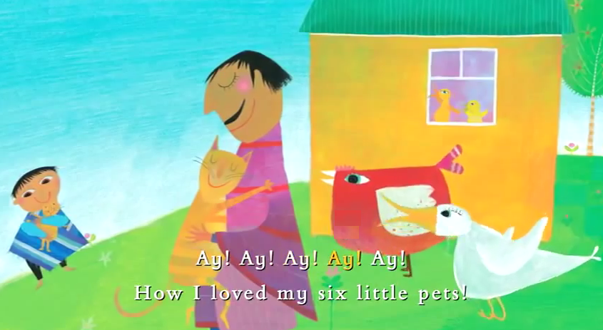

Slide 18
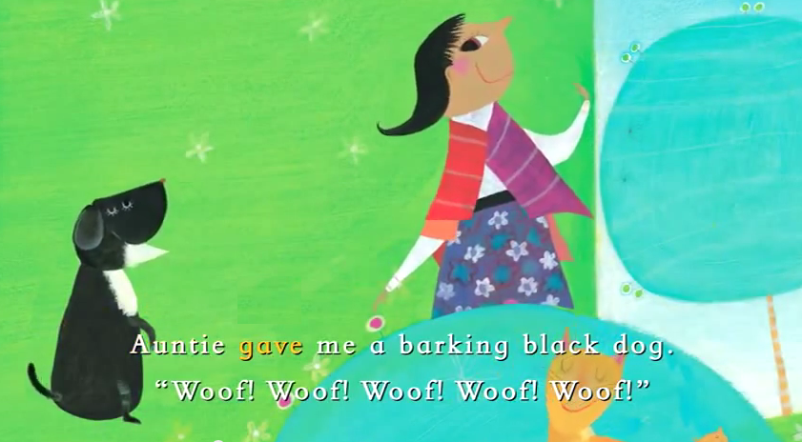

Slide 19
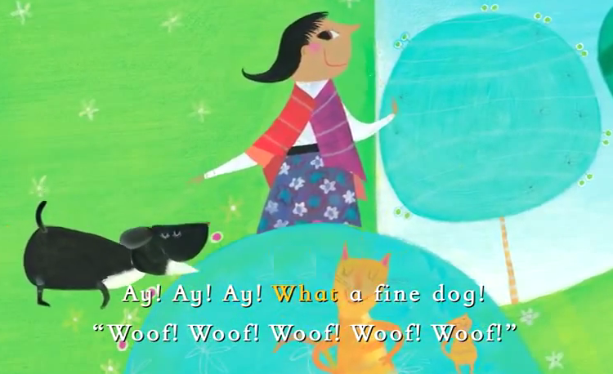

Slide 20
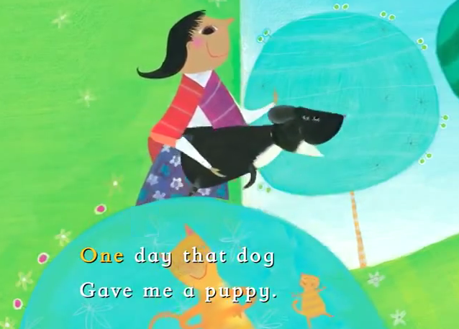

Slide 21
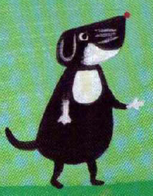
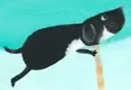
I had a dog,
And I had a puppy.
I had a cat,
I had a kitten.
I had a duck,
I had a duckling.

Slide 22

I had a hen,
I had a chick.

Slide 23
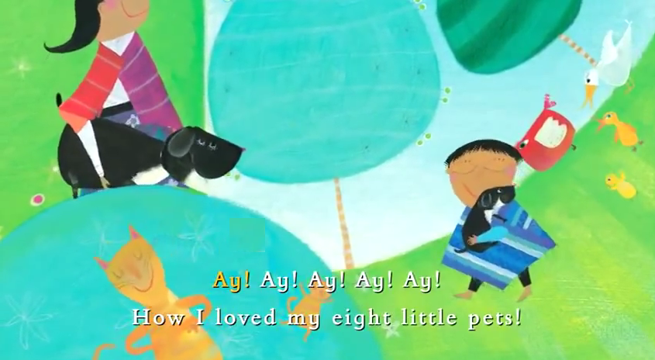

Slide 24
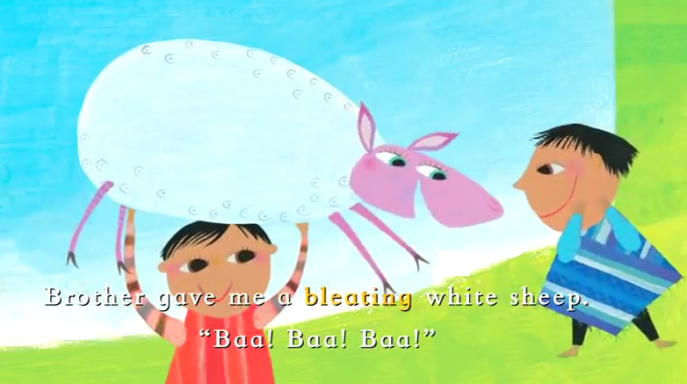

Slide 25
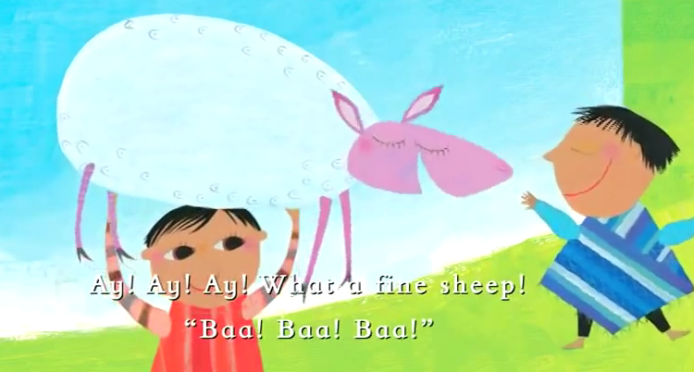

Slide 26
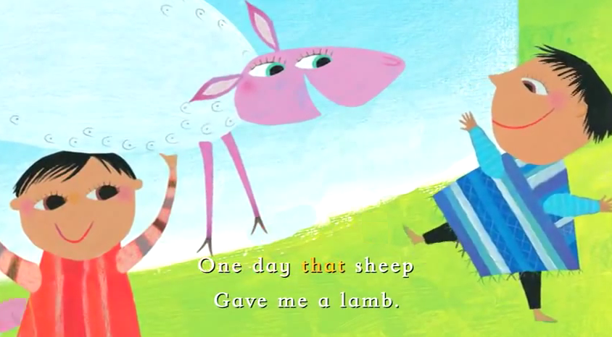

Slide 27
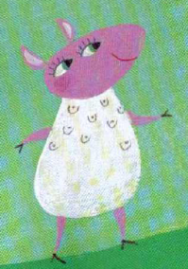
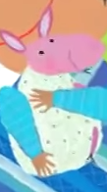
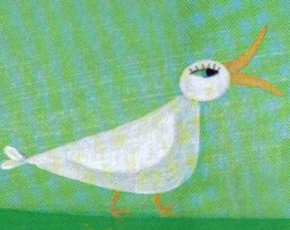

I had a sheep,
And I had a lamb,
A dog…a puppy.
A cat…a kitten
A duck…a duckling
A hen…a chick.

Slide 28
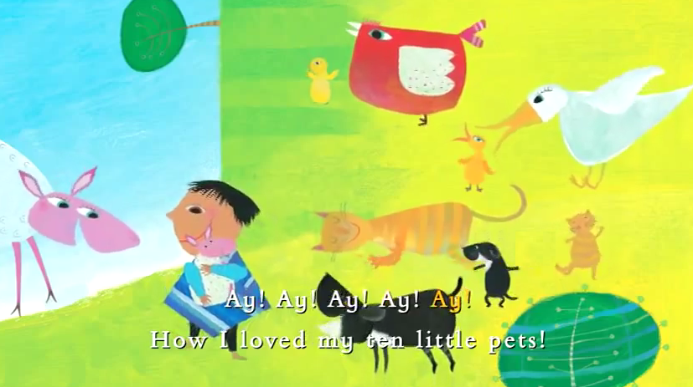

Slide 29
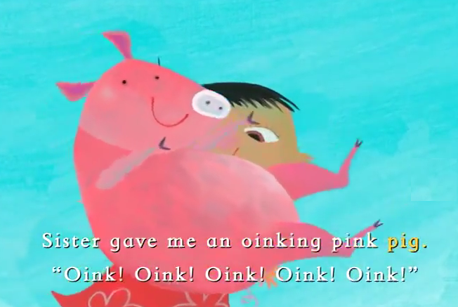

Slide 30
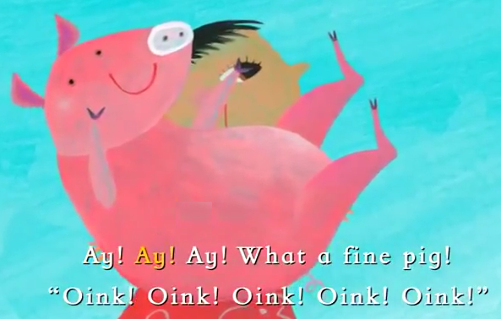

Slide 31
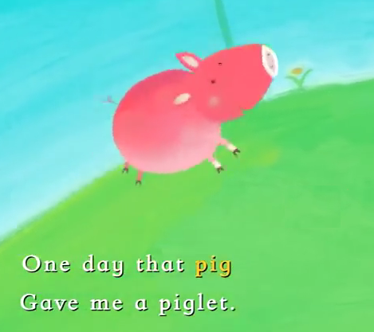

Slide 32
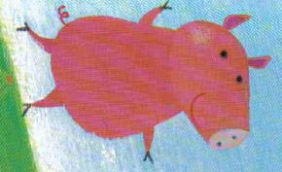
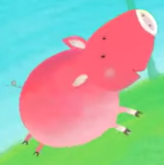

I had a pig.
And I had a piglet.
A sheep…a lamb.
A dog…a puppy.
A cat…a kitten
A duck…a duckling

Slide 33
A hen…a chick.

Slide 34
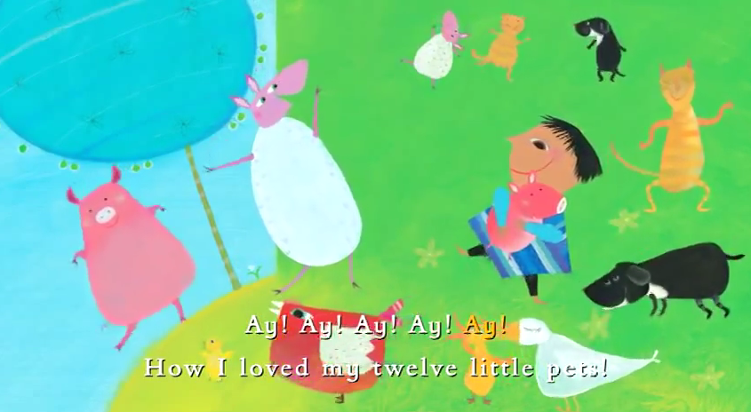

Slide 35
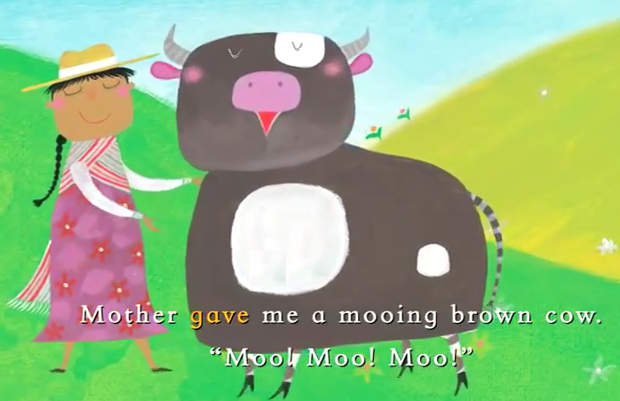

Slide 36
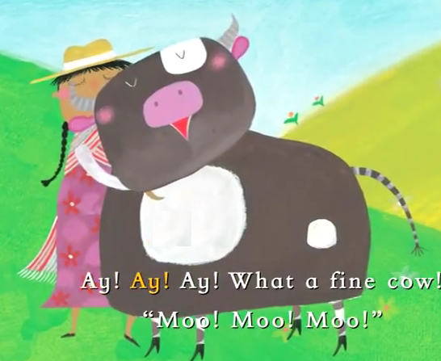

Slide 37
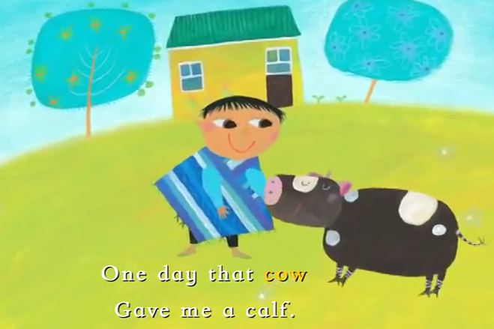

Slide 38
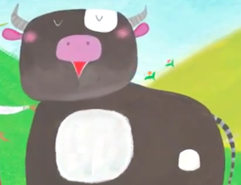
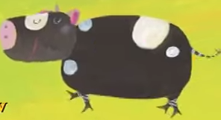
I had a cow,
And I had a calf.
A pig….a piglet.
A sheep…a lamb.
A dog…a puppy.
A cat…a kitten

Slide 39
A duck…a duckling
A hen…a chick.

Slide 40
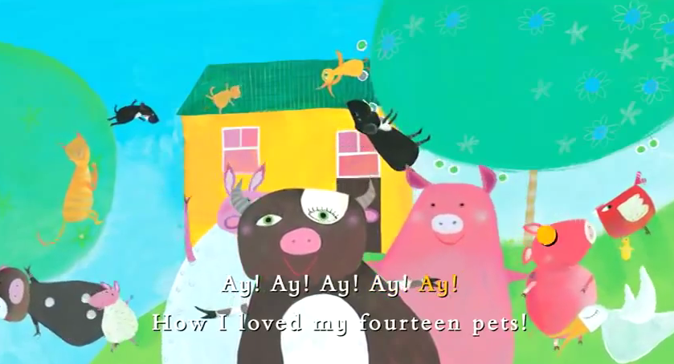

Slide 41
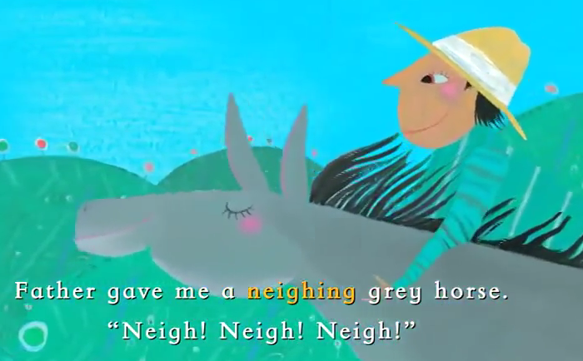

Slide 42
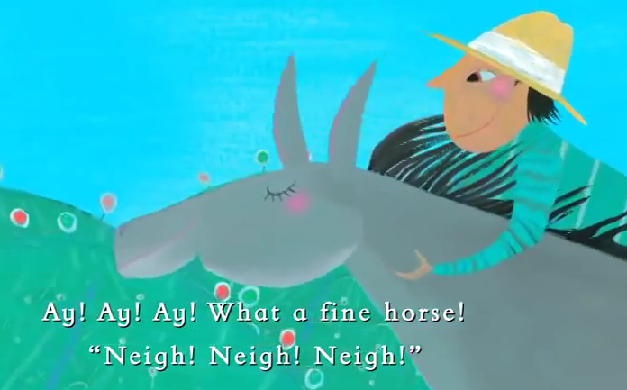

Slide 43
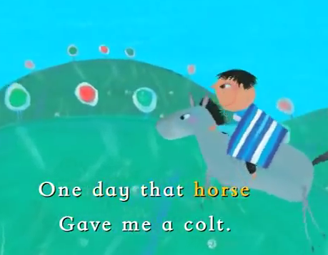

Slide 44
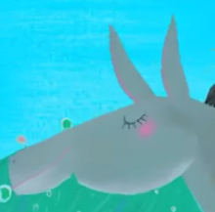
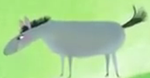


I had a horse,
And I had a colt,
A cow…a calf.
A pig…a piglet.
A sheep…a lamb.
A dog…a puppy.

Slide 45


A cat…a kitten.
A duck…a duckling.
I had a hen,
And I had a chick,

Slide 46


Slide 47


Slide 48


Slide 49


Slide 50


Slide 51


Slide 52


Slide 53


Slide 54


Slide 55


Slide 56


Slide 57


Slide 58


Slide 59

The end.

