Slide 1


Slide 2
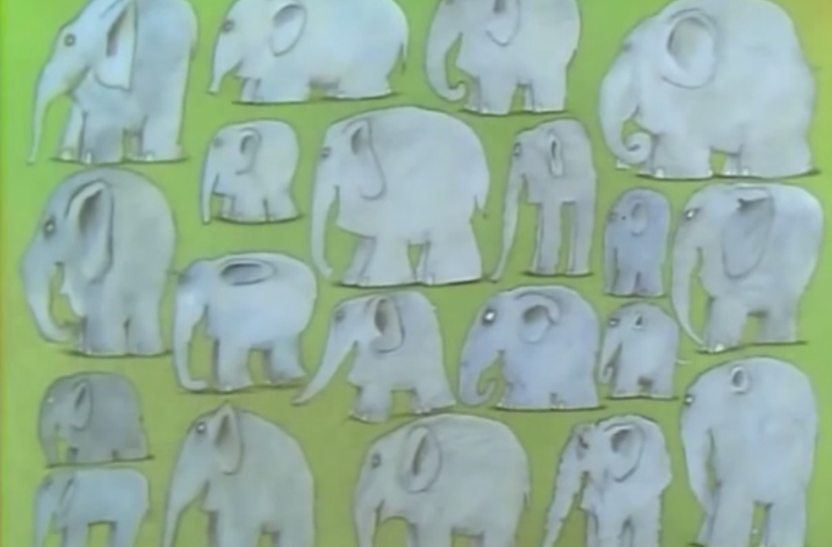


elephants
There was once a herd of elephants. Elephants like this, that or the other, but all happy and all the same colour – grey.
grey
Notes:
Lots of grey elephant toys lined up on a table for all children to see – allow each child to hold and explore an elephant. Support children to sign “grey” and “elephant”

Slide 3
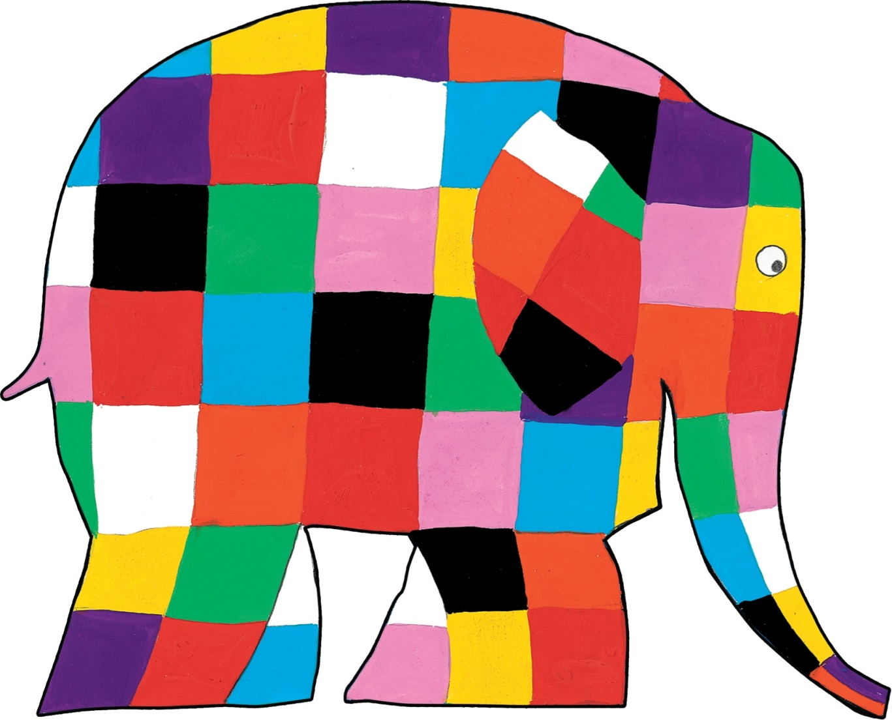


different
All that is except Elmer. Elmer was different. Elmer was multi-coloured.
multi-coloured
Notes:
Anticipation as show picture of Elmer on IWB and then show laminated Elmer

Slide 4
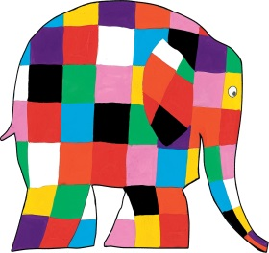









Elmer was…
yellow
orange
red
pink
purple
blue
green
black
white
Notes:
Point to each colour on laminated Elmer as each colour is said and signed – TAs to support children to sign colours.

Slide 5

Elmer was not elephant colour.

Slide 6
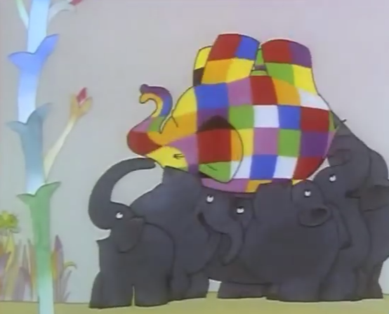

happy
It was Elmer who kept the other elephants happy.

Slide 7
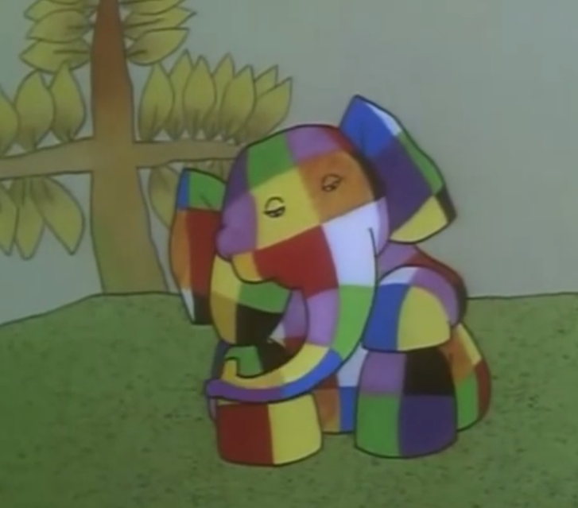

sad
Elmer was sad. He thought the other elephants were laughing at him. Elmer didn’t want to be different anymore.
different

Slide 8
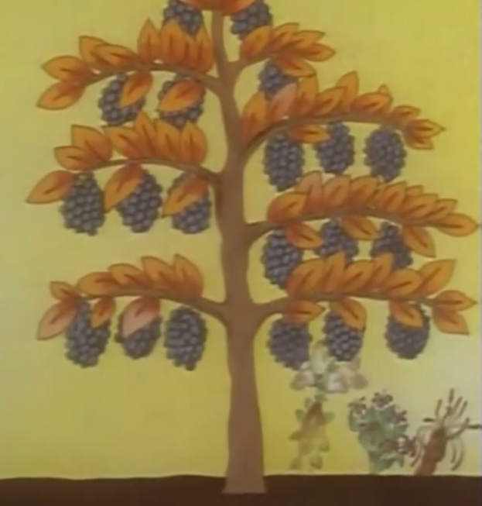


bush
After a long walk Elmer found what he was looking for – a large bush. The bush was covered in berries.
berries
Notes:
Blueberries to squish?

Slide 9
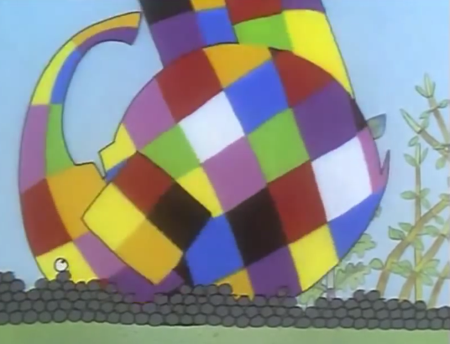


shake
Elmer shook the bush so hard that the berries fell on the ground. Elmer lay down and rolled over and over, this way and that way, and back again.
roll
Notes:
Have children act this bit out
Paint laminated Elmer in grey paint

Slide 10
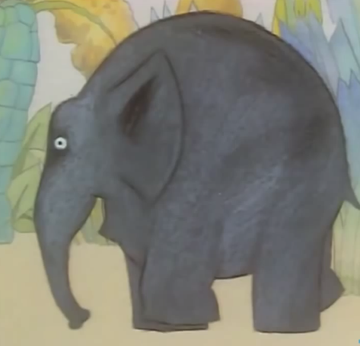
When he finished he looked like any other elephant. He wasn’t multi-coloured anymore.

Slide 11
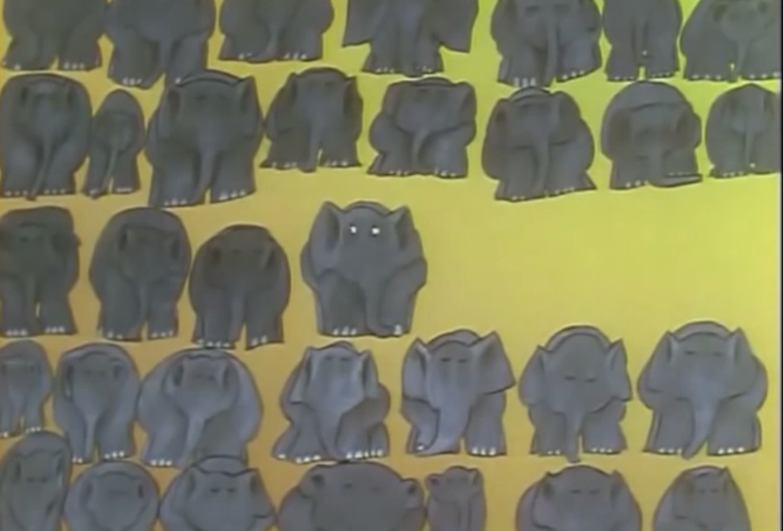

quiet
When Elmer rejoined the other elephants, they were all standing quietly. None of them noticed Elmer as he walked to the middle of the herd.
Notes:
Support children to be silent

Slide 12
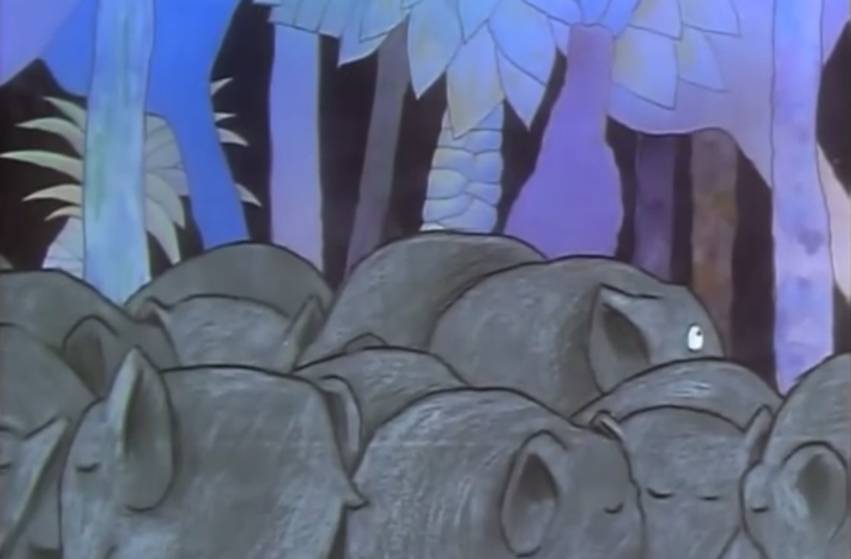
quiet
Elmer had never seen the elephants so quiet before.
Notes:
Support children to be silent

Slide 13
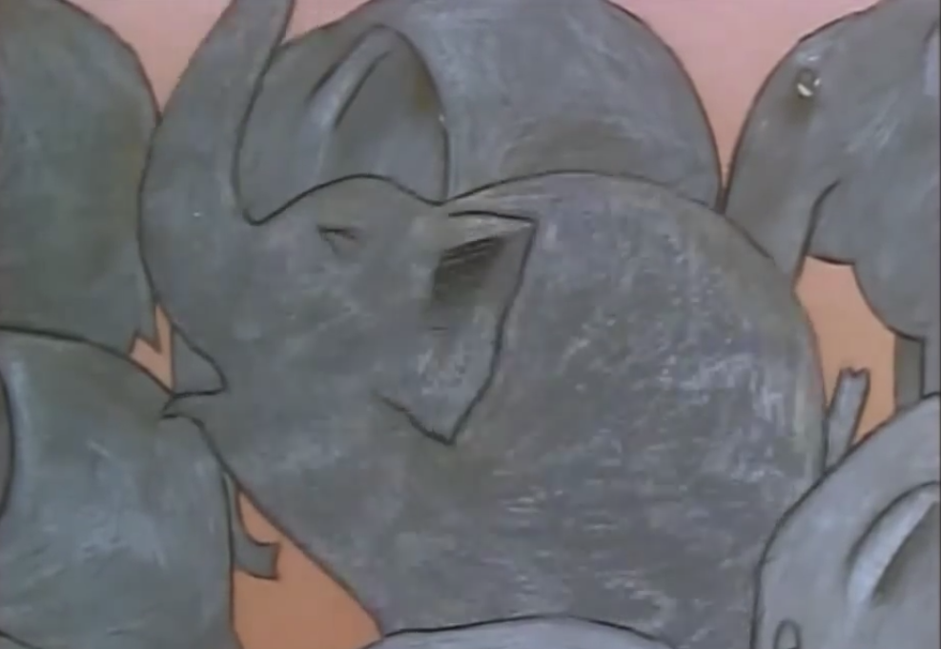

trunk
Finally he could bear it no longer. He lifted his trunk and at the top of his voice he shouted… BOO!!!!!
Notes:
Each child to have a turn shouting Boo and/or pressing recorded button where it has been prerecorded really loudly

Slide 14
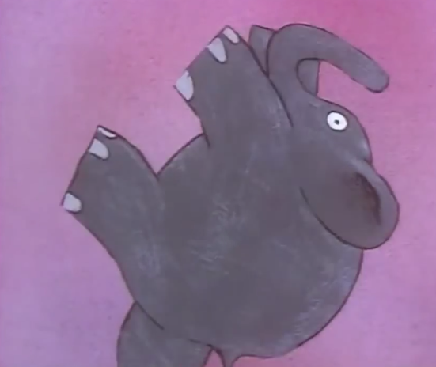


jump
The elephants jumped and fell in all ways of surprise. “It must be Elmer!” they said.
surprise
Notes:
All children to jump

Slide 15
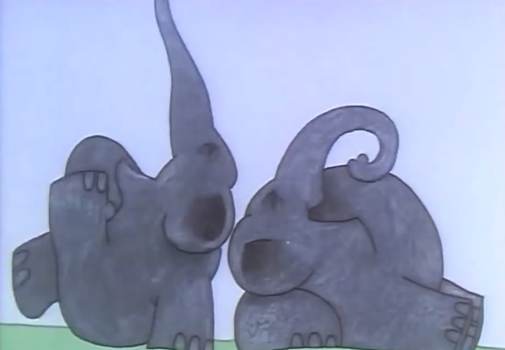

laugh
All the elephants laughed as they had never laughed before.
Notes:
Encourage children to pretend to laugh (pre-recorded laughter on button?)

Slide 16
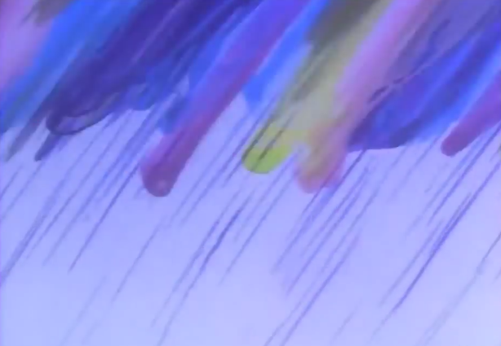

rain
As they laughed, the cloud burst and rain started to come down.
Notes:
Rainstick

Slide 17
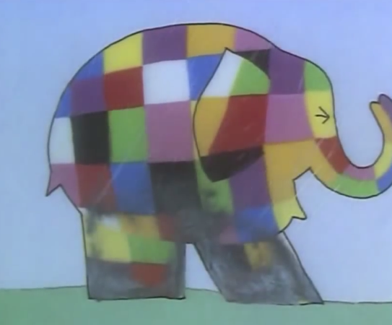
rain
As the rain fell on Elmer, his colours started to show again.
colours
Notes:
Rainstick & spray

Slide 18
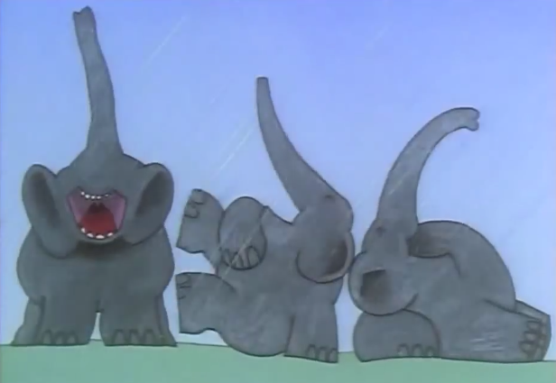

joke
“Oh Elmer! You’ve played some good jokes but this has been the biggest laugh of all. It didn’t take long to show your true colours.”
laugh
Notes:
Laughing

Slide 19
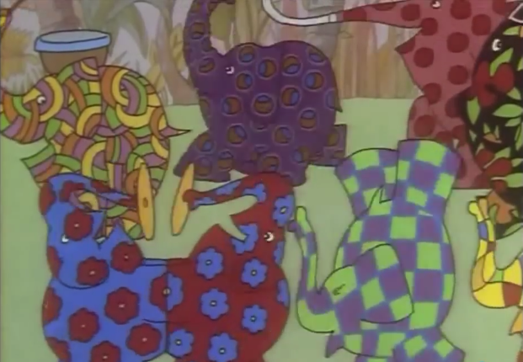


celebrate
“We must celebrate this day every year,” said another. “This will be Elmer’s day. All elephants must decorate themselves and Elmer will decorate himself elephant colour.
decorate
Notes:
Face paints/masks?
Celebration music?

Slide 20

The end.

