Slide 1

It is time for a…
Read through story

Slide 2
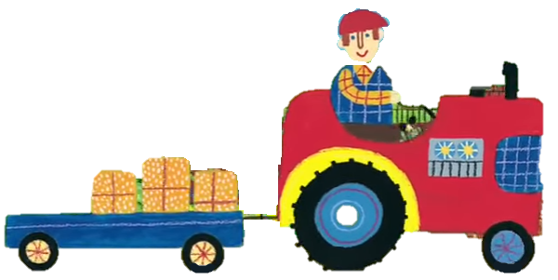
Driving my tractor down a bumpy road.

Slide 3
And in my trailer there’s a heavy load.

Slide 4
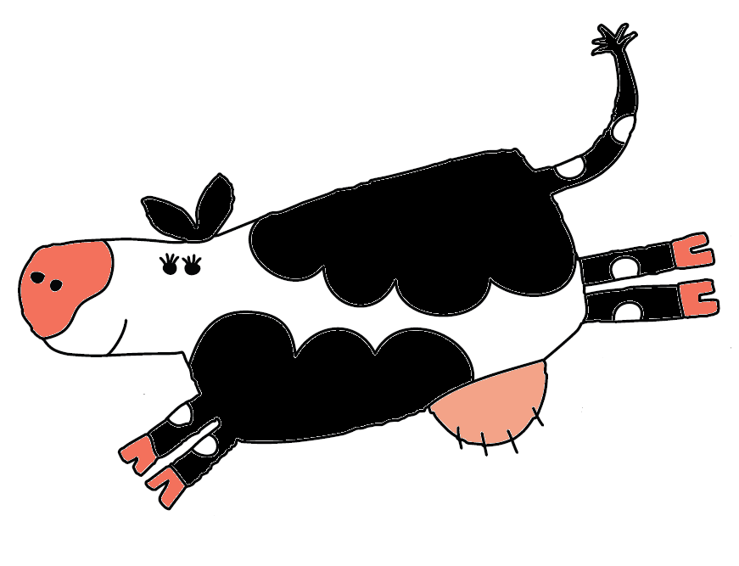
There’s a black and white cow…

Slide 5
Going moo, moo, moo.

Slide 6
It’s a very busy day.

Slide 7
Driving my tractor down a bumpy road.

Slide 8
And in my trailer there’s a heavy load.

Slide 9
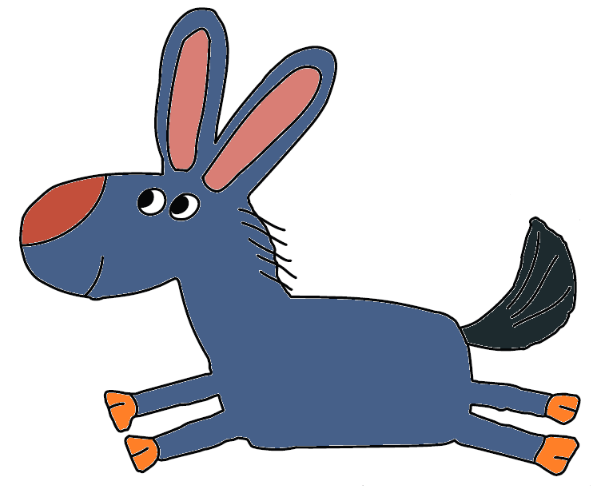
There are two grey donkeys…

Slide 10
Going bray, bray, bray.

Slide 11
It’s a very busy day.

Slide 12
Driving my tractor down a bumpy road.

Slide 13
And in my trailer there’s a heavy load.

Slide 14
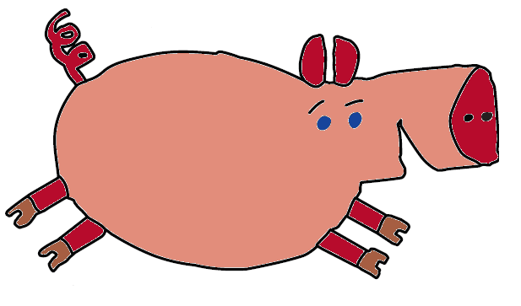
There are three pink pigs…

Slide 15
Going oink oink oink…

Slide 16
It’s a very busy day.

Slide 17
Driving my tractor down a bumpy road.

Slide 18
And in my trailer there’s a heavy load.

Slide 19
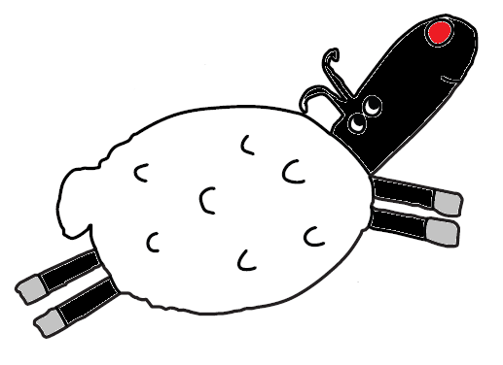
There are four white lambs…

Slide 20
Going bah bah bah…

Slide 21
It’s a very busy day.

Slide 22
Driving my tractor down a bumpy road.

Slide 23
And in my trailer there’s a heavy load.

Slide 24
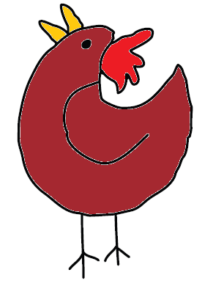
There are five brown chickens…

Slide 25
Going cluck cluck cluck…

Slide 26
It’s a very busy day.

Slide 27
Driving my tractor down a bumpy road.

Slide 28
The trailer hit a stone and it shook my load.

Slide 29
The animals fell out and they ran away.

Slide 30
It’s a very busy day.

Slide 31
Driving my tractor back home again.

Slide 32
Chugging along down the bumpy lane.

Slide 33
I get to the farm and what do I see?

Slide 34
All the animals waiting for me.

Slide 35


