Slide 1
Brown bear, brown bear what do you see?
Story by Bill Martin, Jr
Pictures by Eric Carle

Slide 2
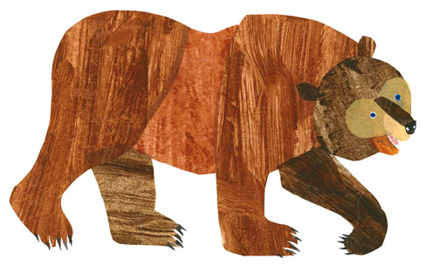
Brown bear, brown bear, what do you see?
I see a red bird looking at me.

Slide 3
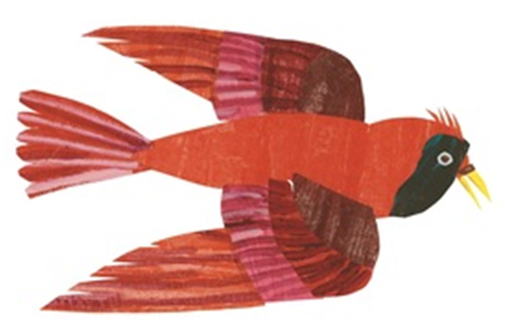
Red bird, red bird, what do you see?
I see a yellow duck looking at me.

Slide 4
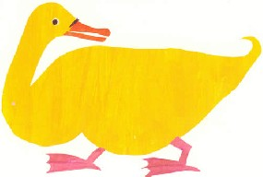
Yellow duck, yellow duck, what do you see?
I see a blue horse looking at me.

Slide 5
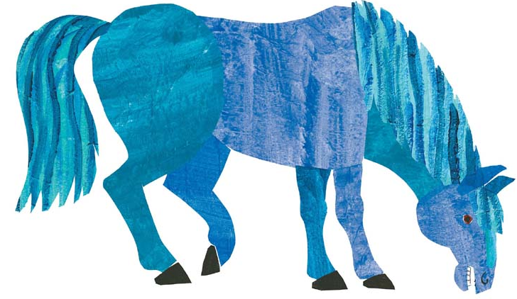
Blue horse, blue horse, what do you see?
I see a green frog looking at me.

Slide 6
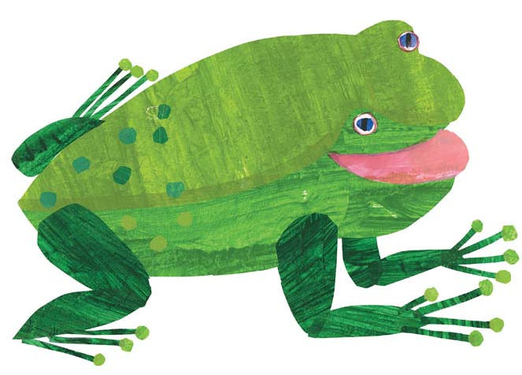
Green frog, green frog, what do you see?
I see a purple cat looking at me.

Slide 7
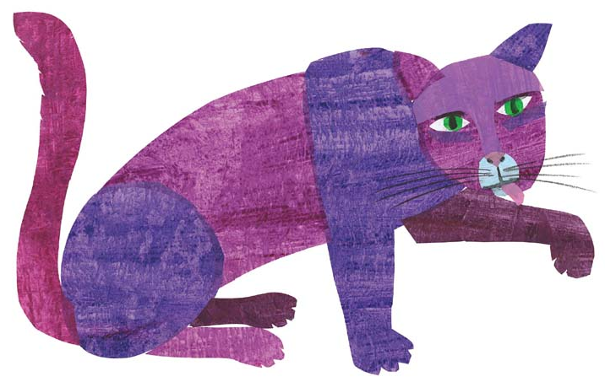
Purple cat, purple cat, what do you see?
I see a white dog looking at me.

Slide 8
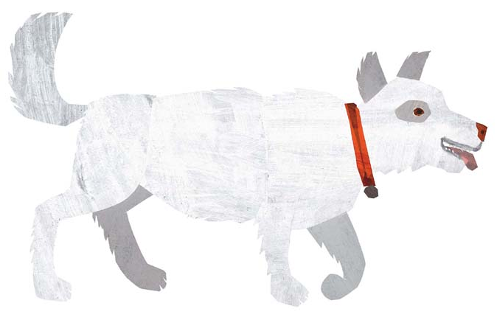
White dog, white dog, what do you see?
I see a black sheep looking at me.

Slide 9
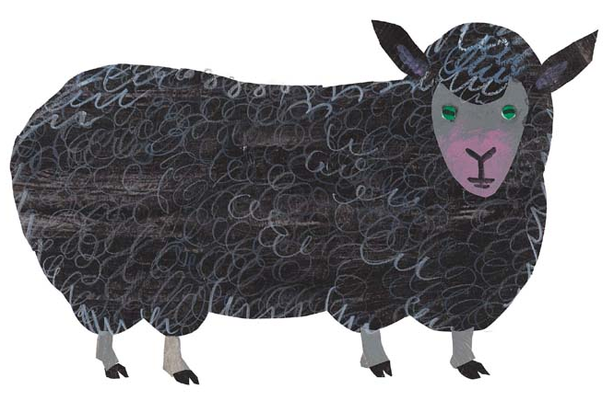
Black sheep, black sheep, what do you see?
I see a goldfish looking at me.

Slide 10
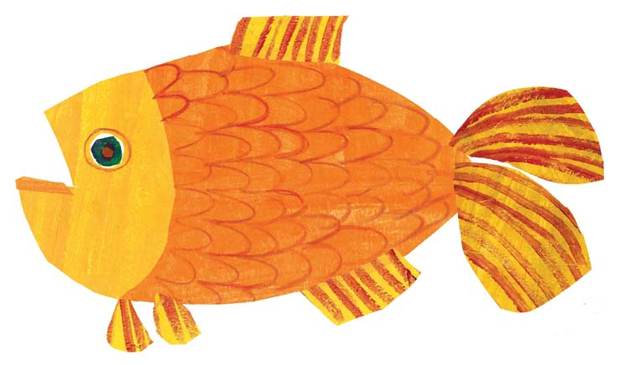
Goldfish, goldfish, what do you see?
I see a teacher looking at me.

Slide 11
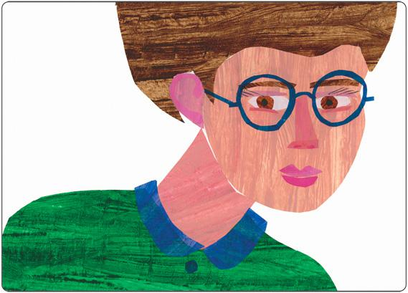
Teacher, teacher, what do you see?
I see children looking at me.

Slide 12
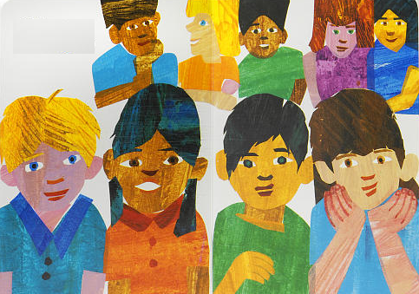
Children, children, what do you see?

Slide 13






We see
a brown bear,
a red bird,
a yellow duck,
a blue horse,
a green frog,
a purple cat,
a white dog,
a black sheep,
a goldfish…

Slide 14
…and a teacher looking at us.
That’s what we see.

Slide 15

The end.

