Slide 1


A Home for Teddy

Slide 2

This is
Teddy

Slide 3
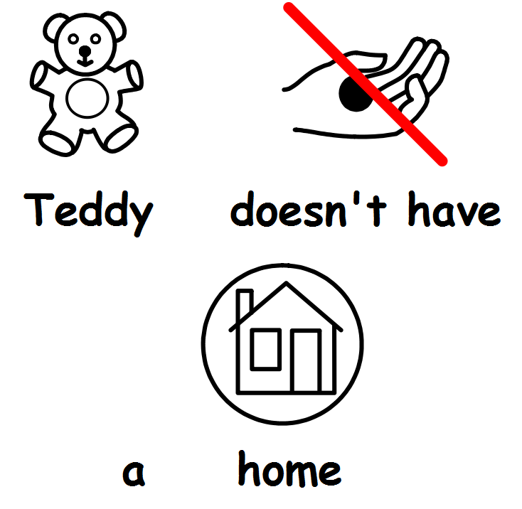

Slide 4


This is
Sarah

Slide 5
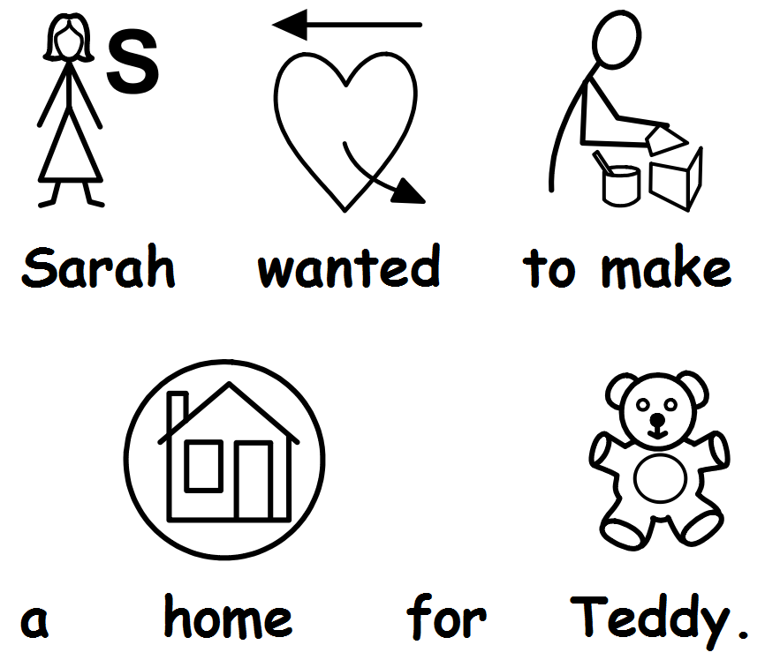

Slide 6
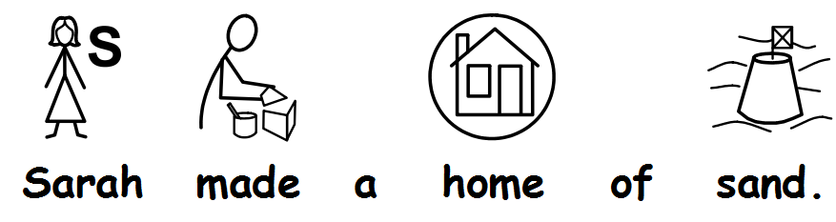

Slide 7


Slide 8


Slide 9
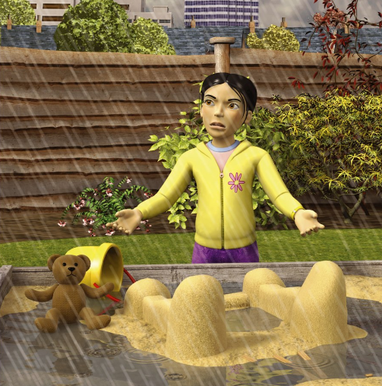

Slide 10
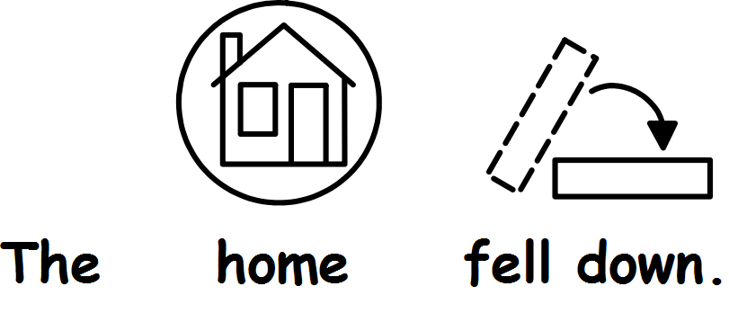

Slide 13


Slide 14
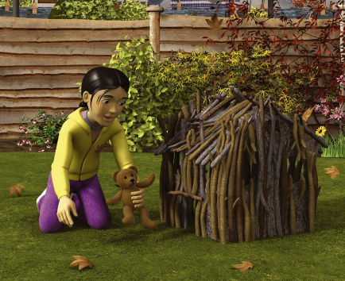

Slide 15


Slide 16
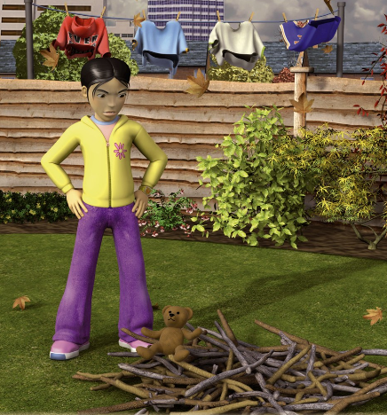

Slide 20


Slide 21
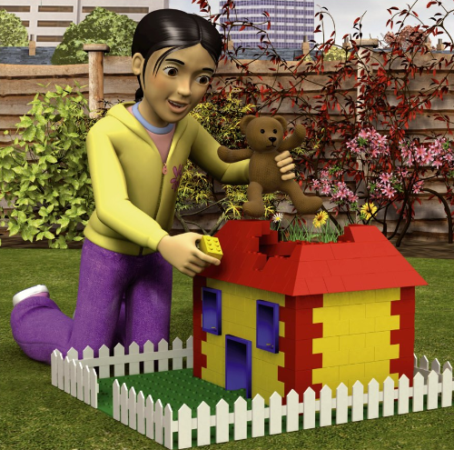

Slide 22


Slide 23


Slide 24
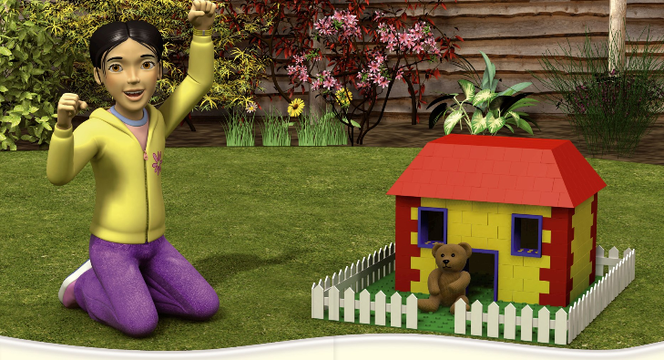

Slide 25


