Slide 1
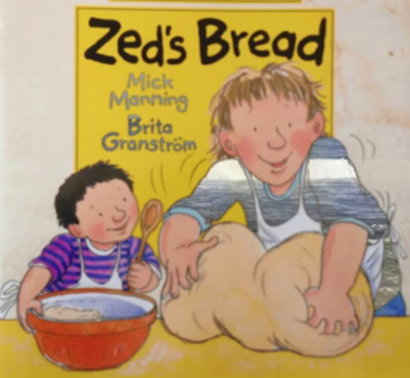

Slide 2
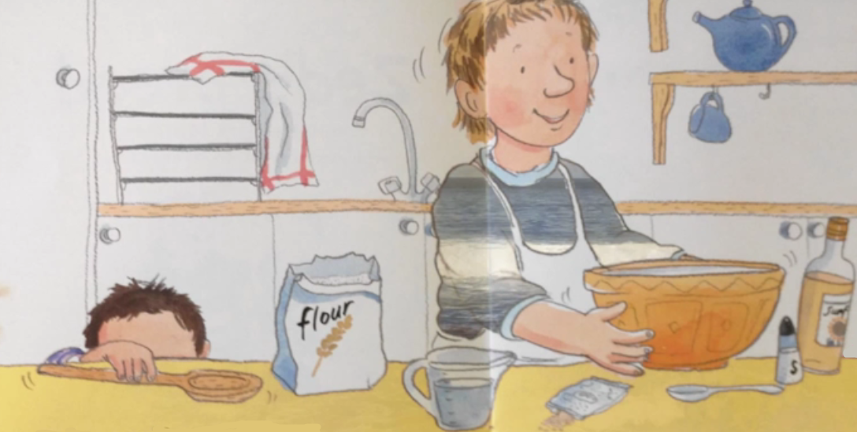

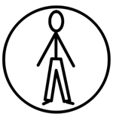
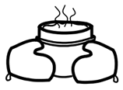
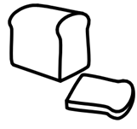
Zed and dad are baking bread.

Slide 3


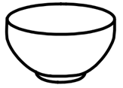
They got
a spoon,
a jug
and a bowl.

Slide 4
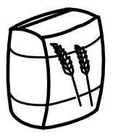
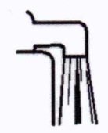
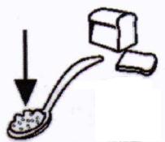
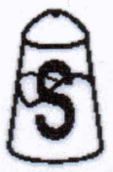
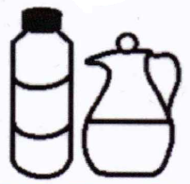
flour,
water,
They got
yeast,
salt
and oil.

Slide 5
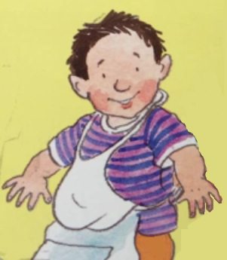


I love
making
bread.
said Zed.

Slide 6
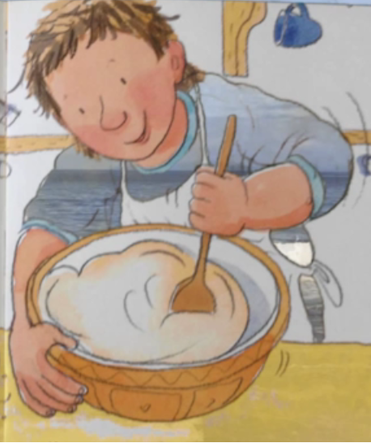


Dad mixed the ingredients into a dough.

Slide 7



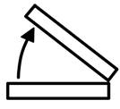
He scooped and stirred it, lifted and folded it.

Slide 8
I love
making
bread.
said Zed.

Slide 9
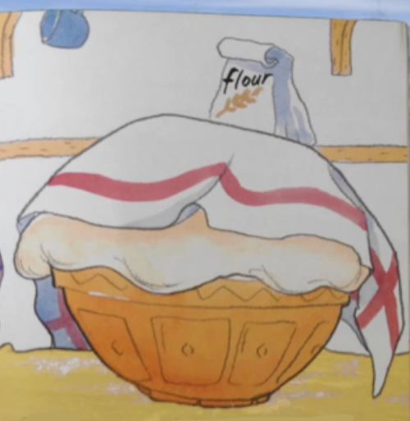
They left the dough in a warm place to rise.

Slide 10

It grew bigger and bigger.

Slide 11
I love
making
bread.
said Zed.

Slide 12
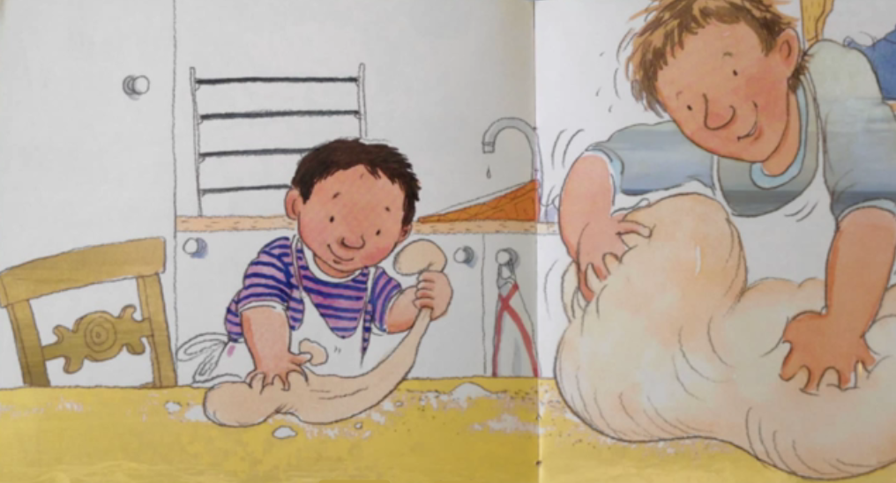
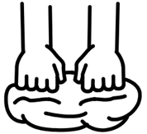
They kneaded the dough.

Slide 13

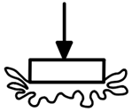

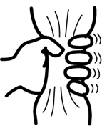
They punched and squashed it, stretched and squeezed it.

Slide 14
I love
making
bread.
said Zed.

Slide 15
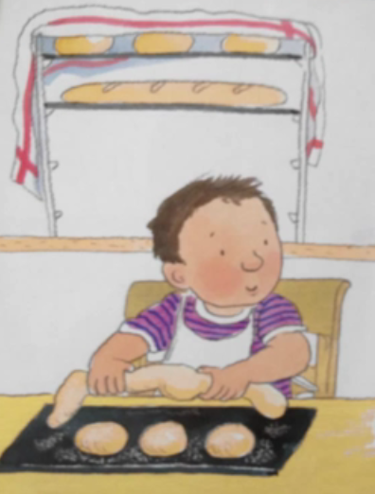
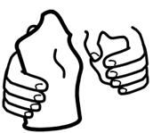
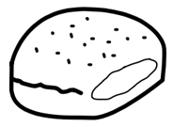
Zed moulded the dough into rolls.

Slide 16
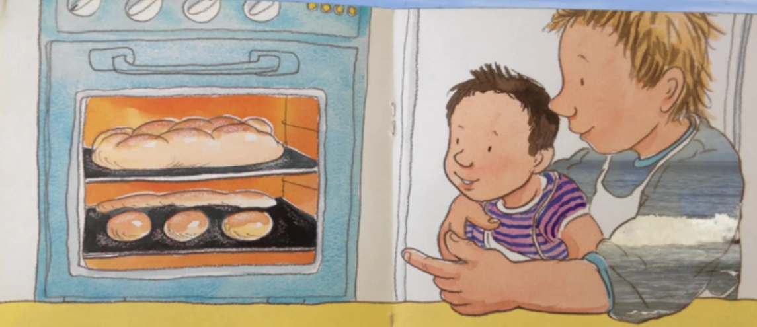
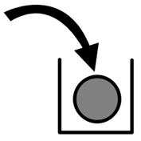
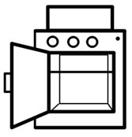
Dad put the dough in the oven.

Slide 17
It turned golden brown, crispy and crunchy.

Slide 18
I love
making
bread.
said Zed.

Slide 19
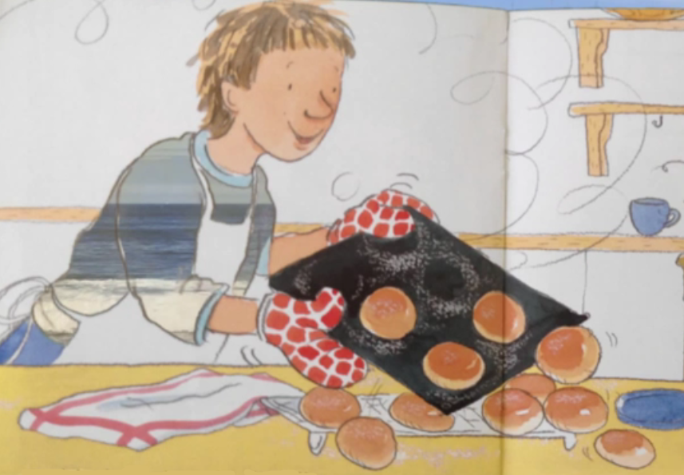
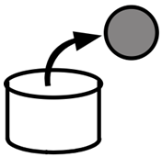
Dad took the bread out of the oven.

Slide 20
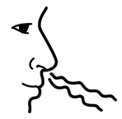

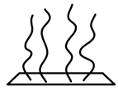
It was crusty and hot and it smelt really good.

Slide 21
I love
making
bread.
said Zed.

Slide 22
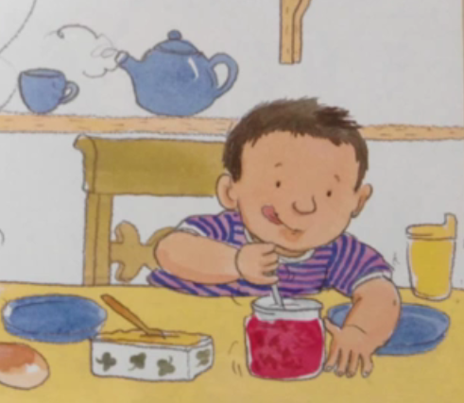

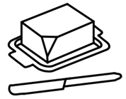

Zed spread them with butter and jam.

Slide 23
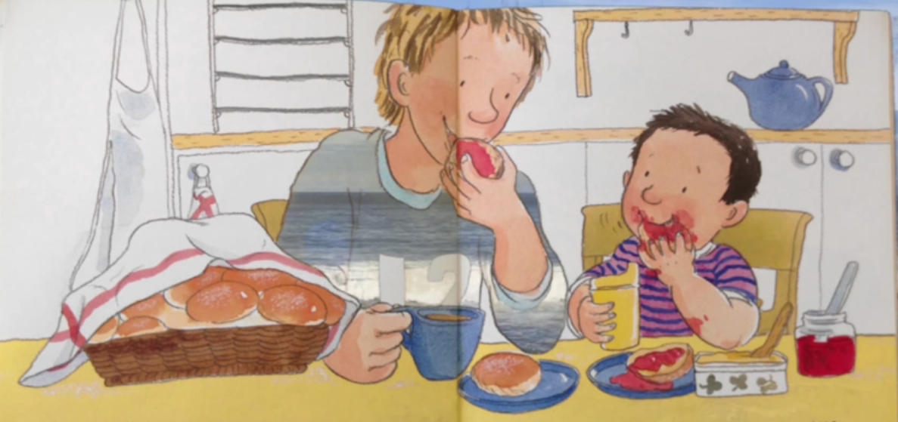
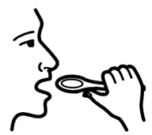
I love
eating
bread.
said Zed.

Slide 24

The end.

