Slide 1
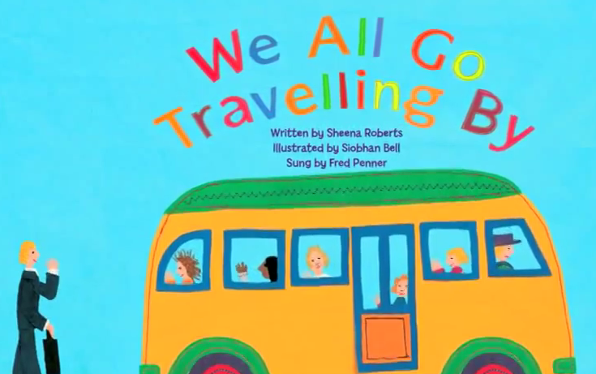

Slide 2
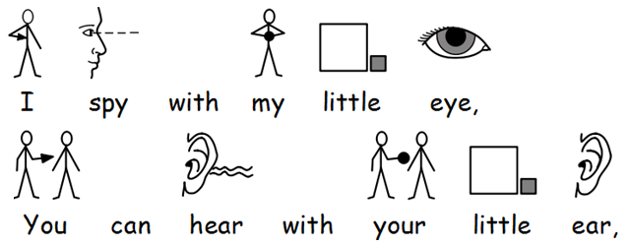

Slide 3
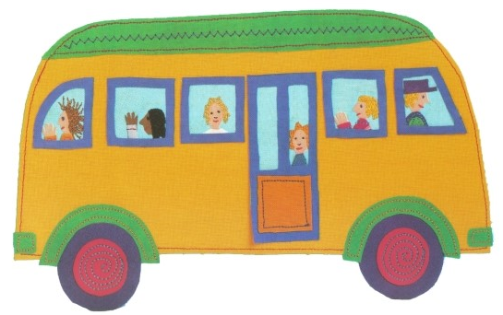
A yellow school bus goes beep-beep-beep.

Slide 4
And we all go travelling by, bye-bye,
And we all go travelling by.

Slide 6
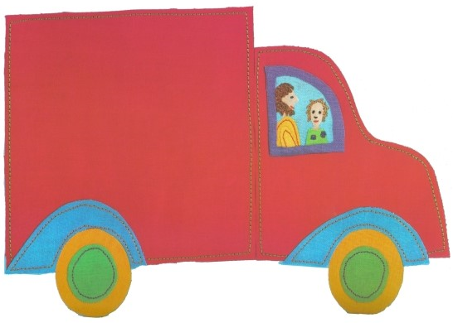
A bright red truck goes rumble-rumble-rumble.

Slide 7

A yellow school bus goes beep-beep-beep.

Slide 8
And we all go travelling by, bye-bye,
And we all go travelling by.

Slide 10
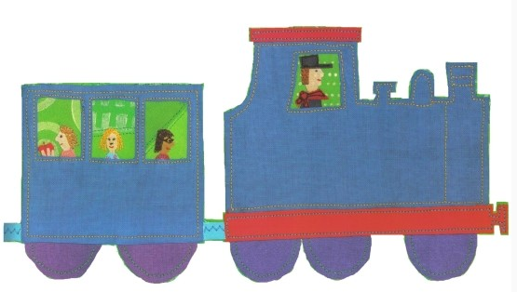
A long blue train goes chuff-chuff-chuff.

Slide 11

A bright red truck goes rumble-rumble-rumble.
A yellow school bus goes beep-beep-beep.

Slide 12
And we all go travelling by, bye-bye,
And we all go travelling by.

Slide 14
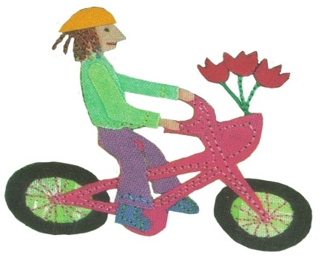
A shiny pink bike goes
ring-ring-ring.

Slide 15

A long blue train goes chuf-chuf-chuf.
A bright red truck goes rumble-rumble-rumble.
A yellow school bus goes beep-beep-beep.

Slide 16
And we all go travelling by, bye-bye,
And we all go travelling by.

Slide 18
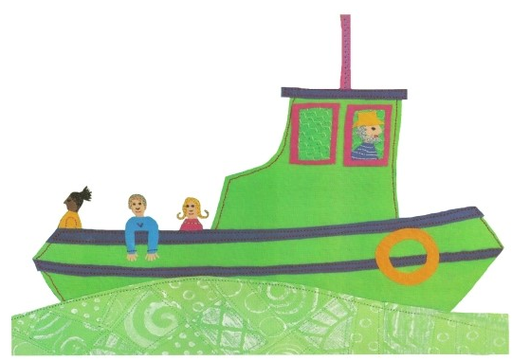
A little green boat goes chug-a-lug-a-lug.

Slide 19

A shiny pink bike goes ring-ring-ring.
A long blue train goes chuf-chuf-chuf.
A bright red truck goes rumble-rumble-rumble.
A yellow school bus goes beep-beep-beep.

Slide 21
And we all go travelling by, bye-bye,
And we all go travelling by.

Slide 22
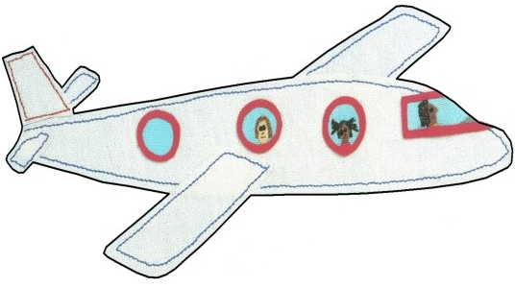
A big white plane goes neeeeee-oww.

Slide 23

A little green boat goes chug-a-lug-a-lug.
A shiny pink bike goes ring-ring-ring.
A long blue train goes chuf-chuf-chuf.
A bright red truck goes rumble-rumble-rumble.

Slide 24
A yellow school bus goes beep-beep-beep.

Slide 26
And we all go travelling by, bye-bye,
And we all go travelling by.

Slide 27
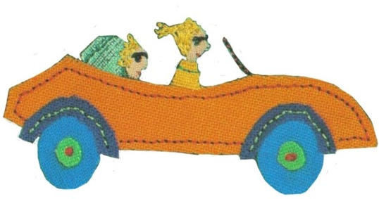
A fast orange car goes vroom-vroom-vroom.

Slide 28
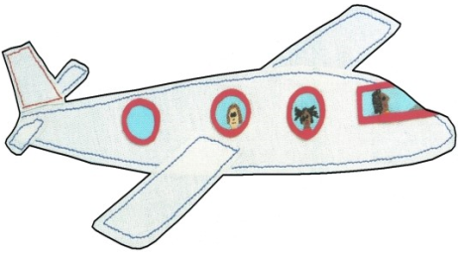
A big white plane goes neeeeee-owww.
A little green boat goes chug-a-lug-a-lug.
A shiny pink bike goes ring-ring-ring.
A long blue train goes chuf-chuf-chuf.

Slide 29

A bright red truck goes rumble-rumble-rumble.
A yellow school bus goes beep-beep-beep.

Slide 31
And we all go travelling by, bye-bye,
And we all go travelling by.

Slide 32
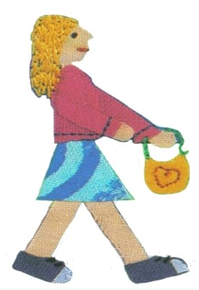
Two purple shoes go
tap-tap-tap.

Slide 33

A fast orange car goes vroom-vroom-vroom.
A big white plane goes neeeeee-owww.
A little green boat goes chug-a-lug-a-lug.
A shiny pink bike goes ring-ring-ring.

Slide 34
A long blue train goes chuf-chuf-chuf.
A bright red truck goes rumble-rumble-rumble.
A yellow school bus goes beep-beep-beep.

Slide 36
And we all go travelling by, bye-bye,
And we all go travelling by.

Slide 37
And we all go travelling by, bye-bye,
And we all go travelling by.

Slide 39
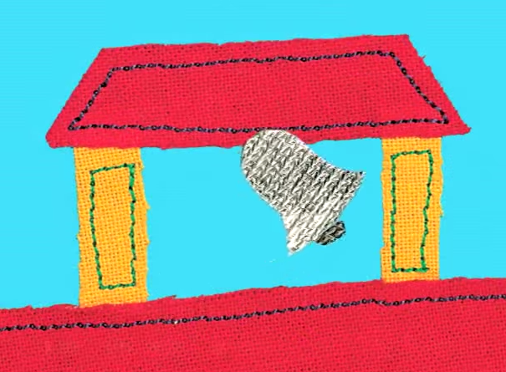
A loud silver bell goes
ding-a-ling-a-ling.

Slide 40
And we all start another school day, hooray!
And we all start another school day!

Slide 41

The end.

