Slide 1

The very hungry caterpillar

Slide 2
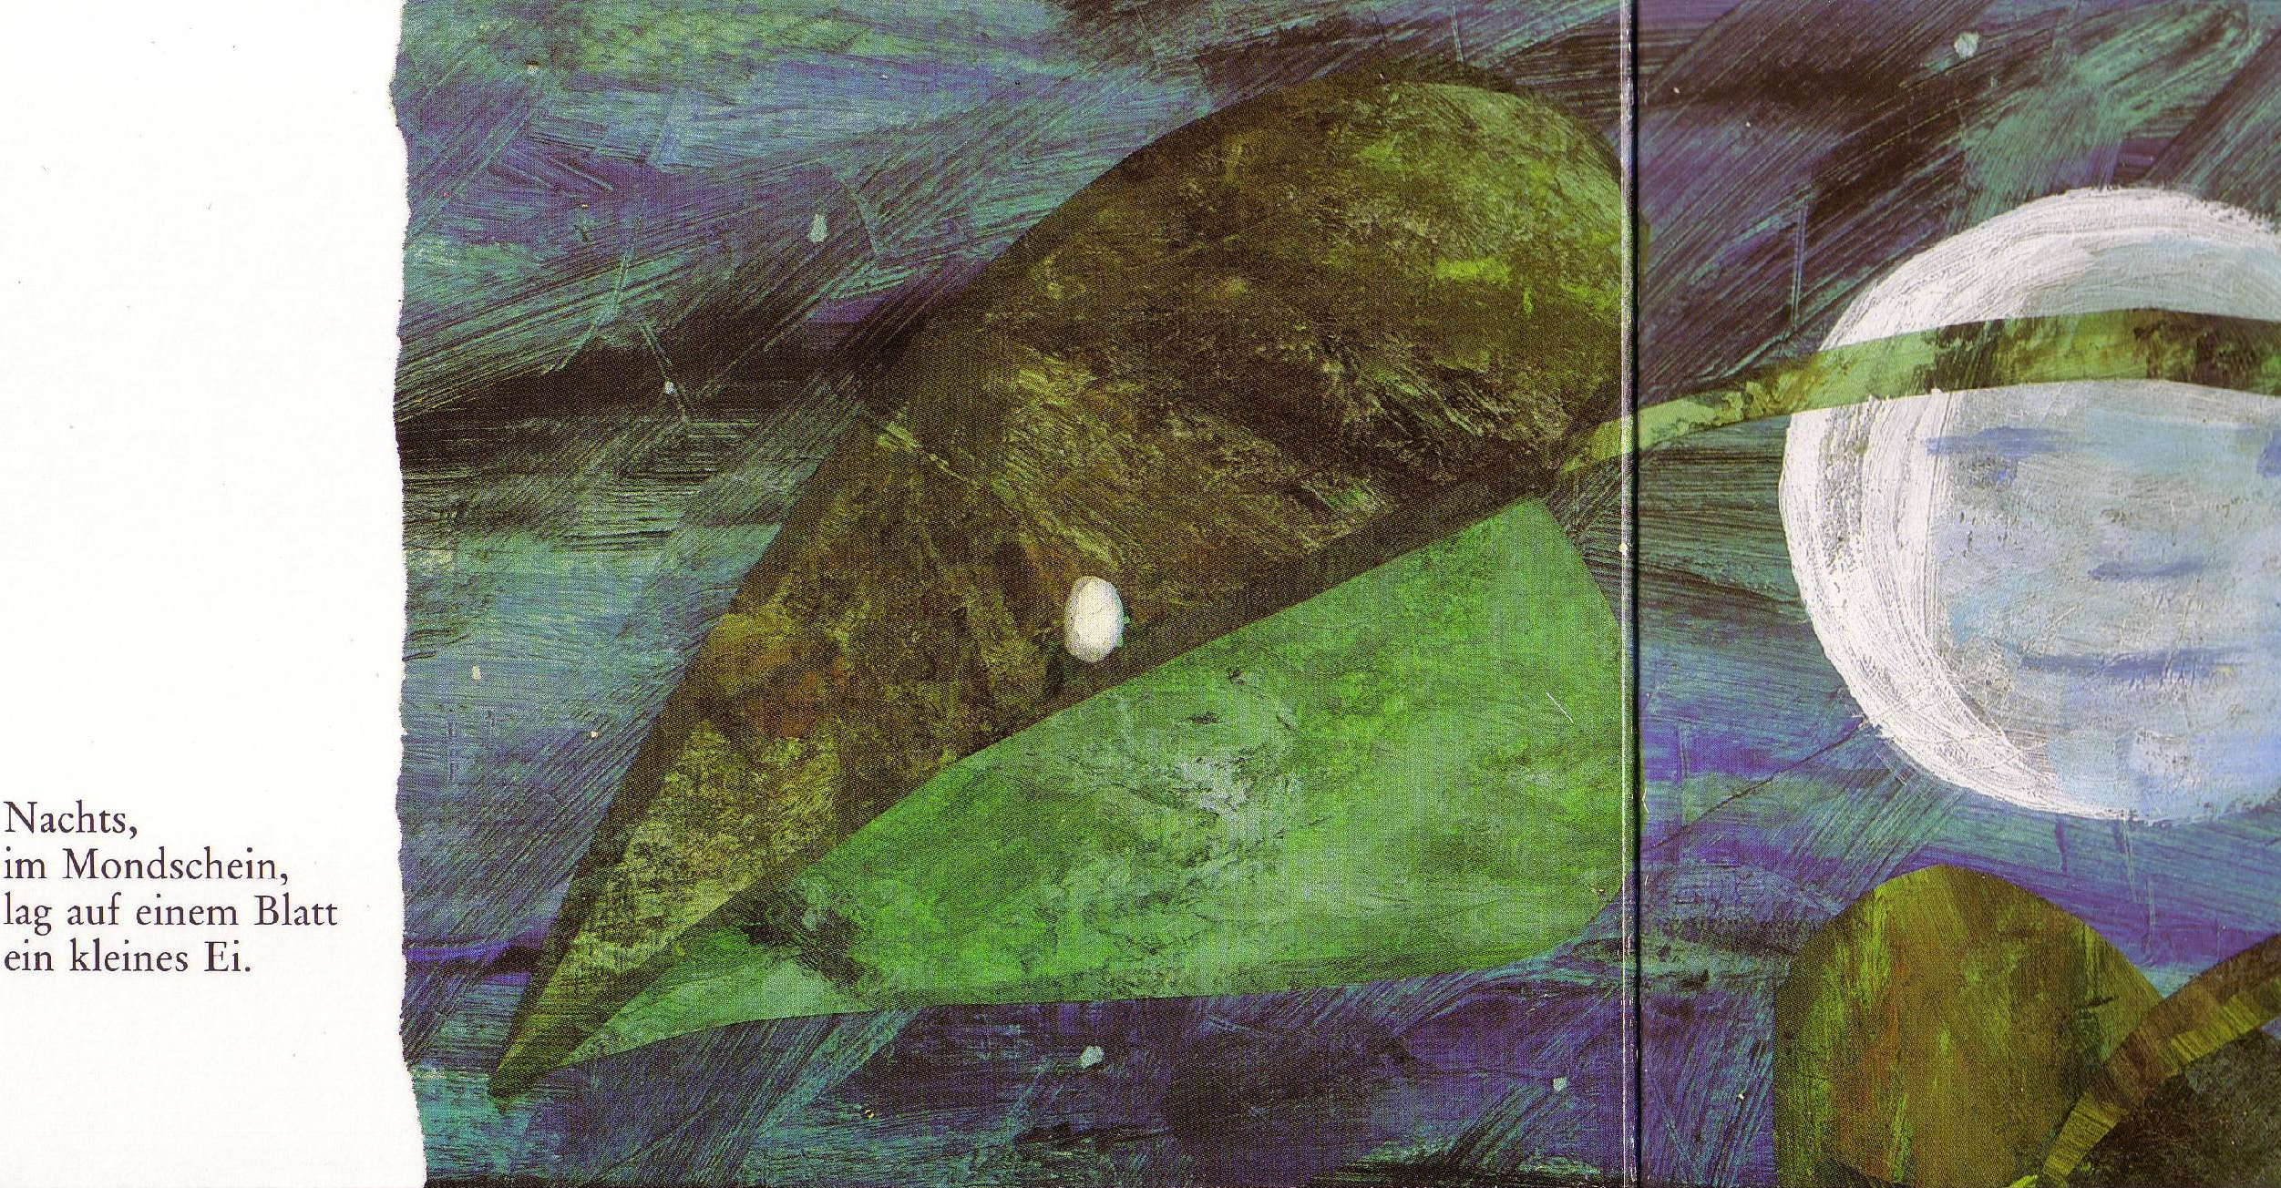
In the light of the moon a little egg lay on a leaf.
Notes:
One night, in the light of the full moon, a little egg rests on a leaf.

Slide 3
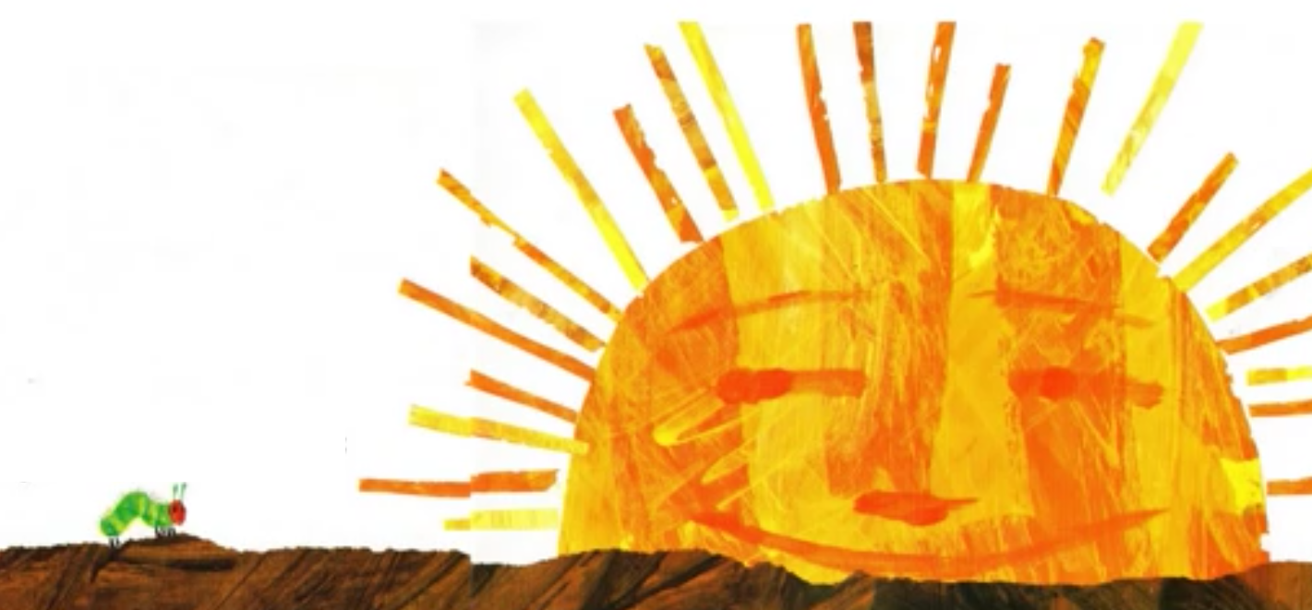
One Sunday morning the warm sun came up and - pop! – out of the egg came a tiny and very hungry caterpillar.
Notes:
One Sunday morning a little caterpillar comes out of the little egg. It is really hungry and looks for something to eat.

Slide 4
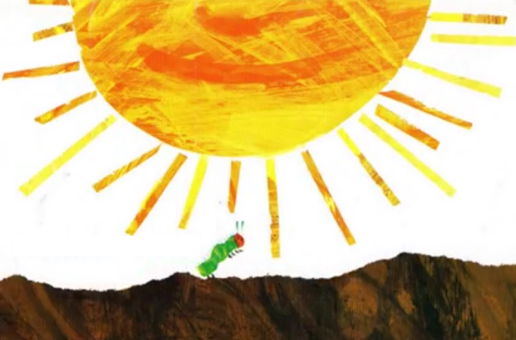
He started to look for some food.
Notes:
One Sunday morning a little caterpillar comes out of the little egg. It is really hungry and looks for something to eat.

Slide 5



On Monday
he ate through 1
apple
Notes:
On Monday it eats an apple but it is still hungry.

Slide 6
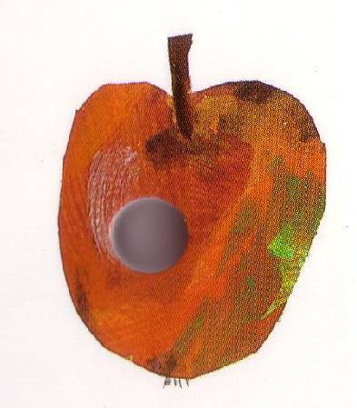
Notes:
On Monday it eats an apple but it is still hungry.

Slide 7

But he was still hungry.
Notes:
On Monday it eats an apple but it is still hungry.

Slide 8



On Tuesday
he ate through 2
pears
Notes:
On Monday it eats an apple but it is still hungry.

Slide 9
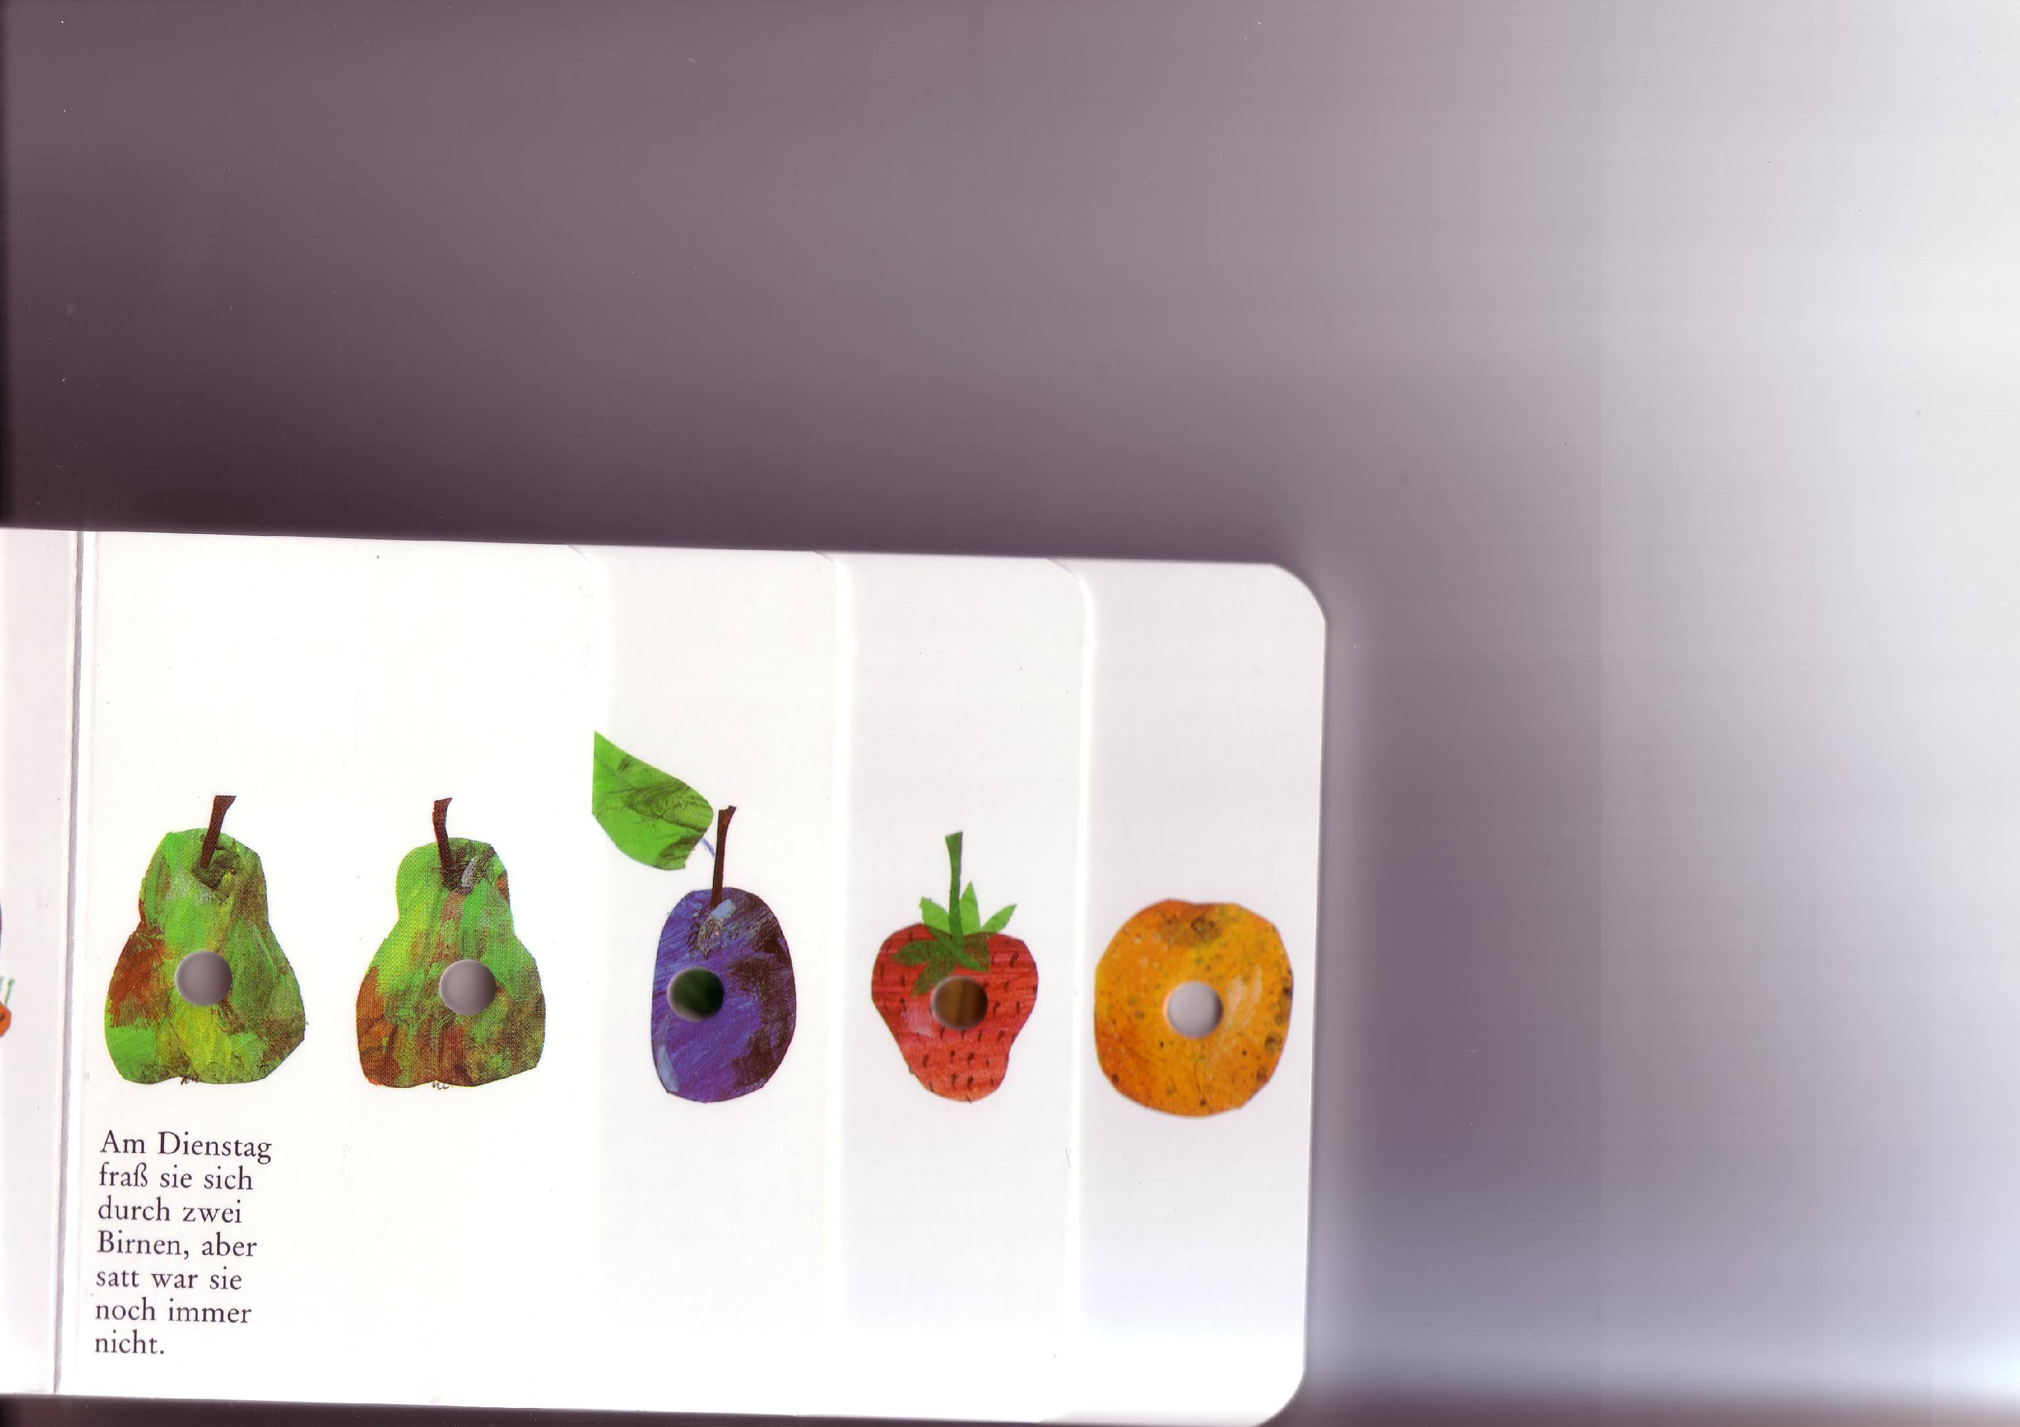
Notes:
On Tuesday it eats two pears but it is still hungry.

Slide 10
But he was still hungry.
Notes:
On Monday it eats an apple but it is still hungry.

Slide 11



On Wednesday
he ate through 3
plums
Notes:
On Monday it eats an apple but it is still hungry.

Slide 12
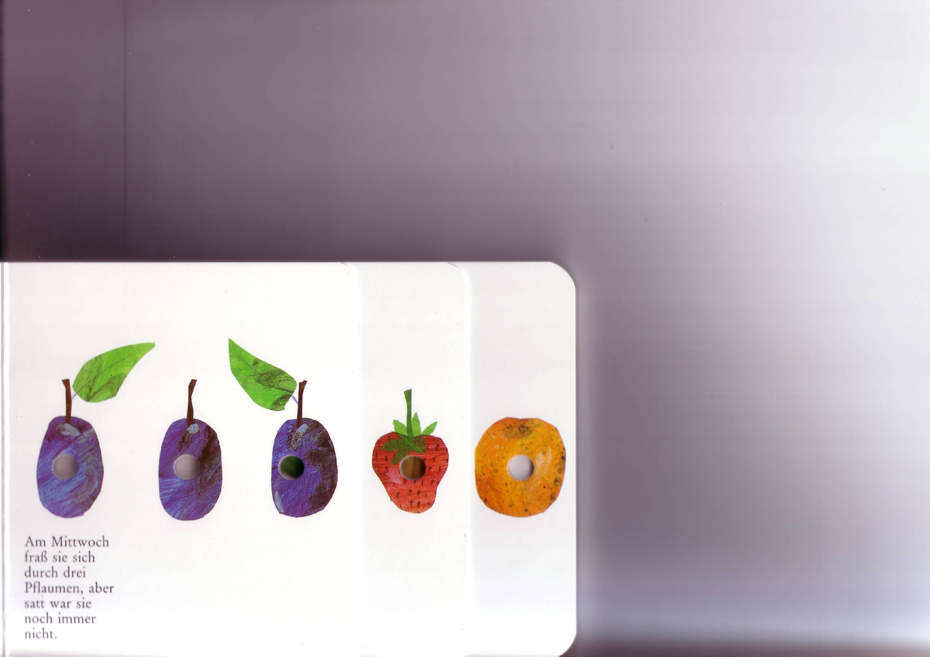
Notes:
On Wednesday it eats 3 plums but it is still hungry.

Slide 13
But he was still hungry.
Notes:
On Monday it eats an apple but it is still hungry.

Slide 14



On Thursday
he ate through 4
strawberries
Notes:
On Monday it eats an apple but it is still hungry.

Slide 15
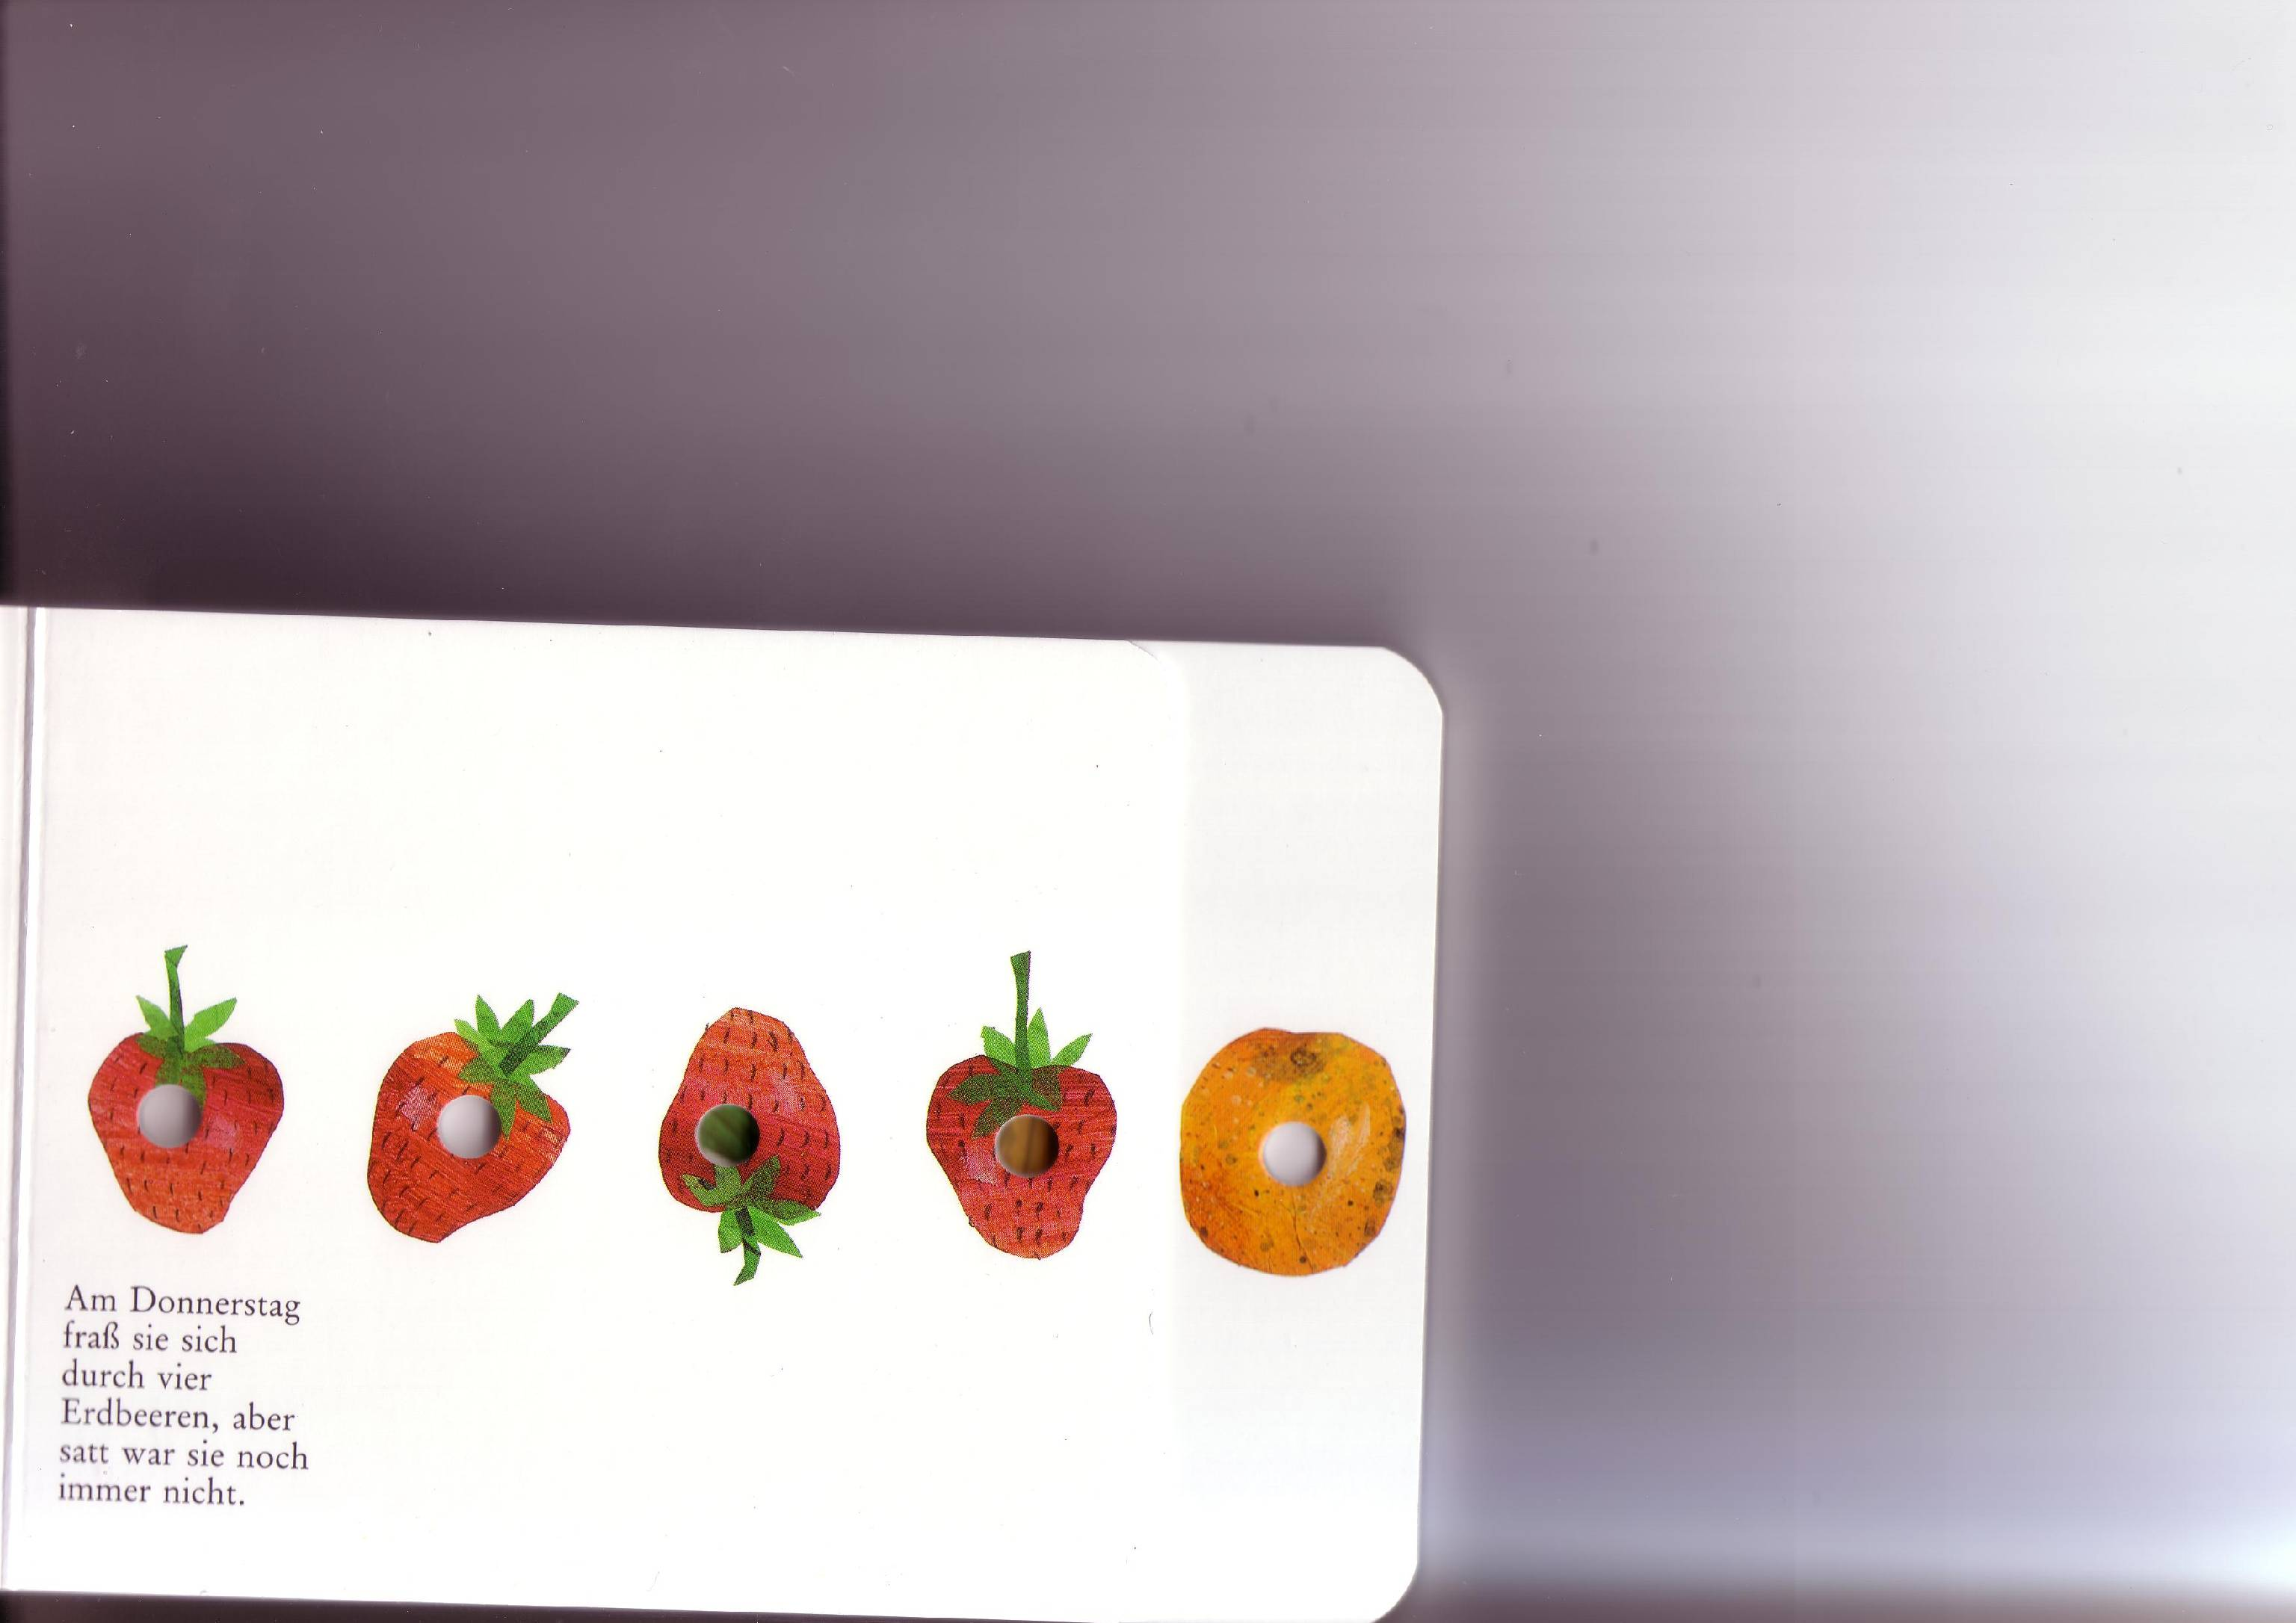
Notes:
On Thursday it eats 4 strawberries but it is still hungry.

Slide 16
But he was still hungry.
Notes:
On Monday it eats an apple but it is still hungry.

Slide 17



On Friday
he ate through 5
oranges
Notes:
On Monday it eats an apple but it is still hungry.

Slide 18
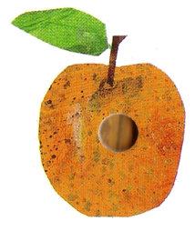
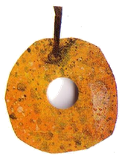

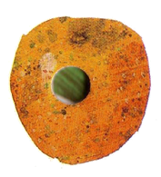
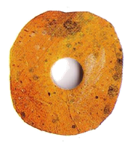
Notes:
On Friday it eats 5 oranges but it is still hungry.

Slide 19
But he was still hungry.
Notes:
On Monday it eats an apple but it is still hungry.

Slide 20

On Saturday
he ate through…
Notes:
On Monday it eats an apple but it is still hungry.

Slide 21
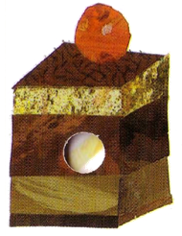
one piece of chocolate cake,

Slide 22
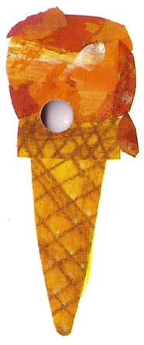
one ice-cream cone,

Slide 23
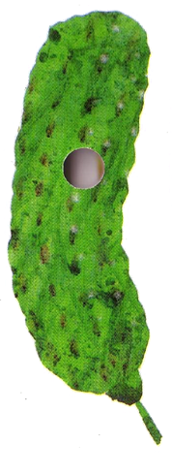
one pickle,

Slide 24
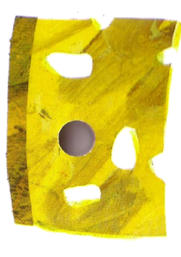
one slice of Swiss cheese,

Slide 25
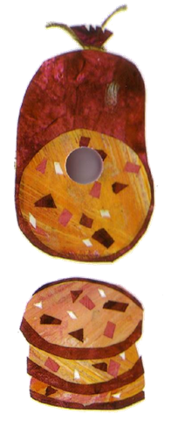
one slice of salami,

Slide 26
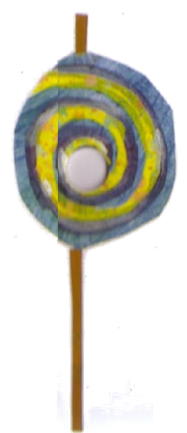
one lollipop,

Slide 27
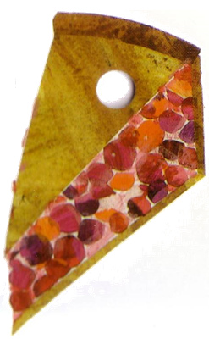
one piece of cherry pie,

Slide 28
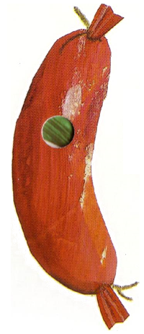
one sausage,

Slide 29
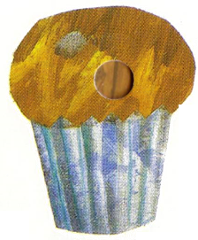
one cupcake,

Slide 30
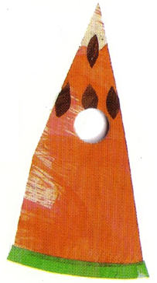
and one slice of watermelon.

Slide 31

That night he had stomach ache.

Slide 32


The next day was Sunday again
he ate through one nice leaf,
Notes:
On Monday it eats an apple but it is still hungry.

Slide 33

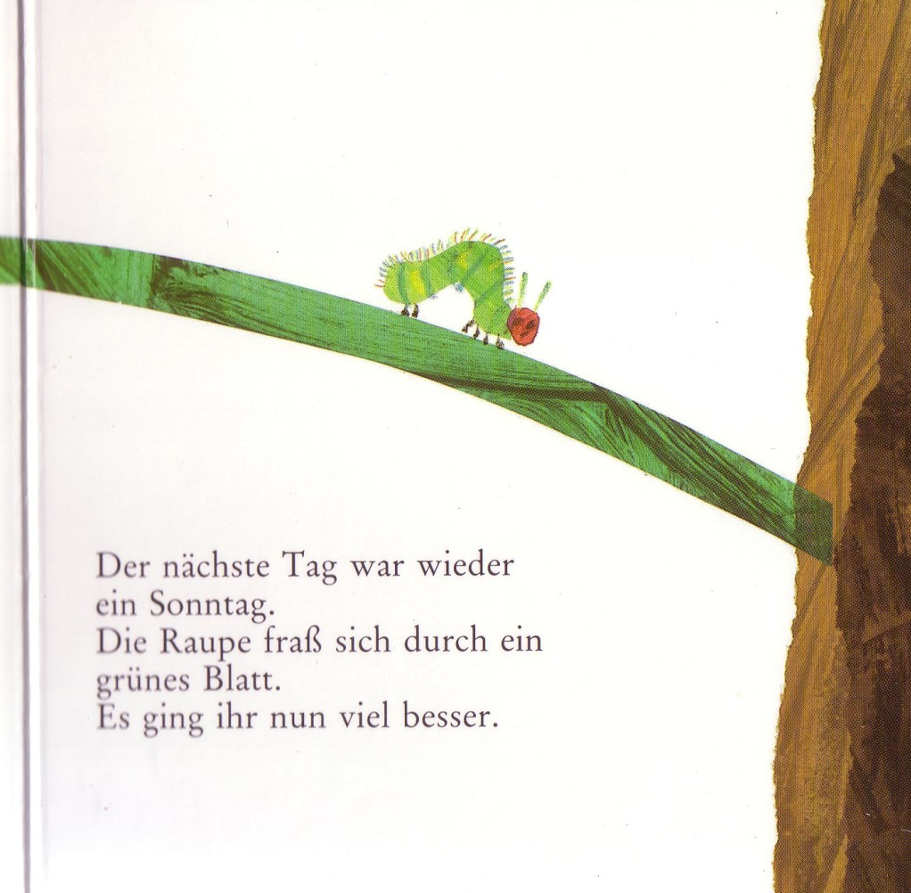
and after that he felt much better.

Slide 34
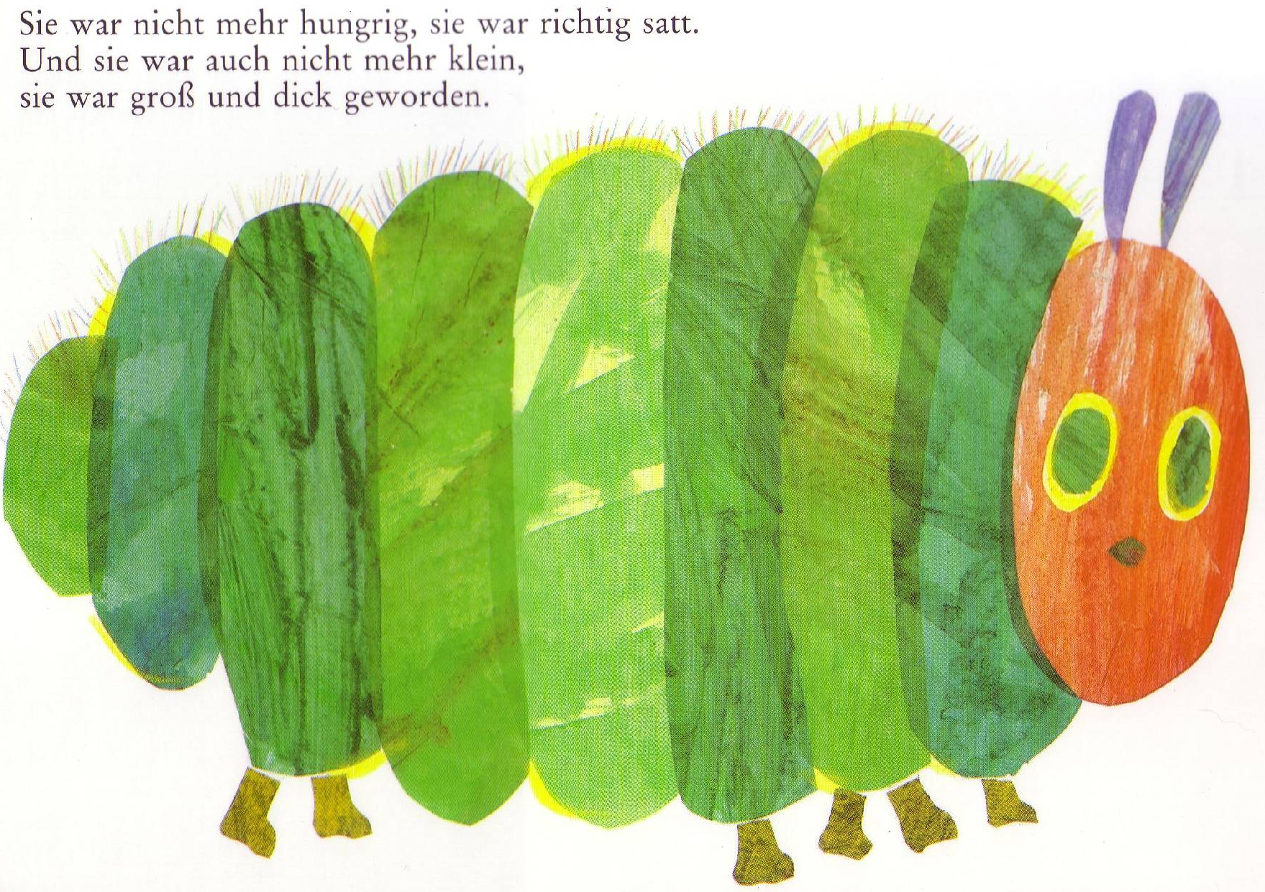
Now he wasn’t hungry any more – and he wasn’t a little caterpillar any more. He was a big, fat caterpillar.
Notes:
It isn’t hungry any more and it is a big fat caterpillar.

Slide 35
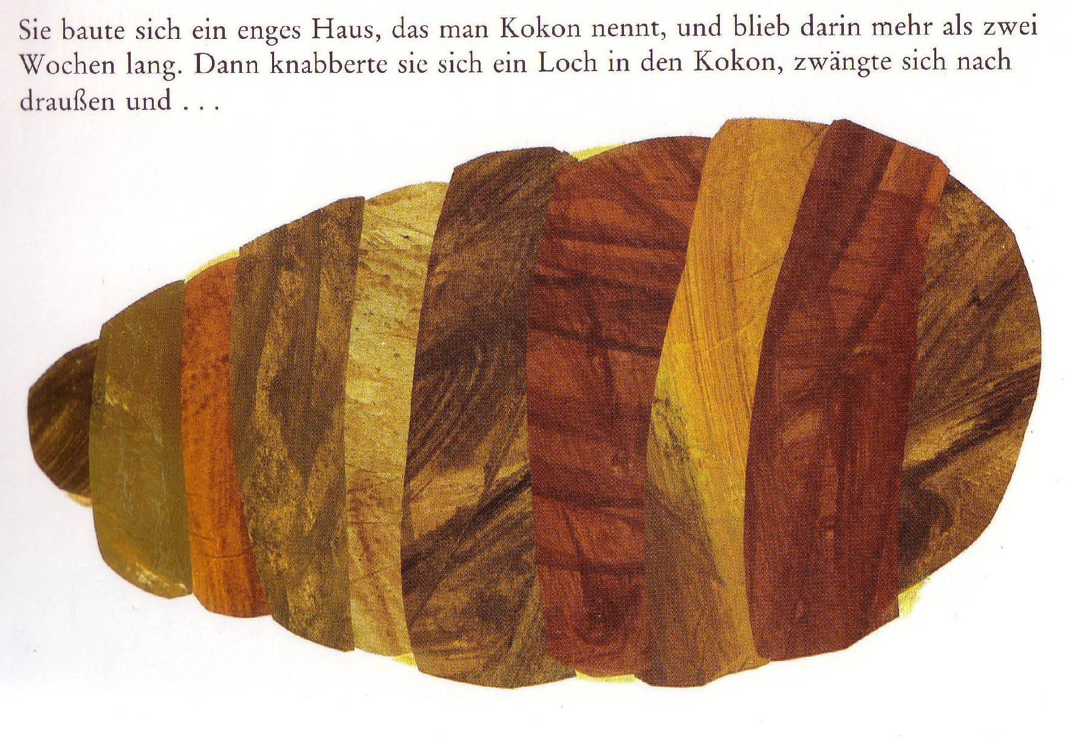
He built a small house, called a cocoon, around himself. He stayed inside for more than two weeks.
Notes:
It builds a house, a cocoon, and stays there for more than 2 weeks. One day it makes a little hole in the cocoon and pushes outside.

Slide 36
Then he nibbled a hole in the cocoon, pushed his way out and…
Notes:
It builds a house, a cocoon, and stays there for more than 2 weeks. One day it makes a little hole in the cocoon and pushes outside.

Slide 37
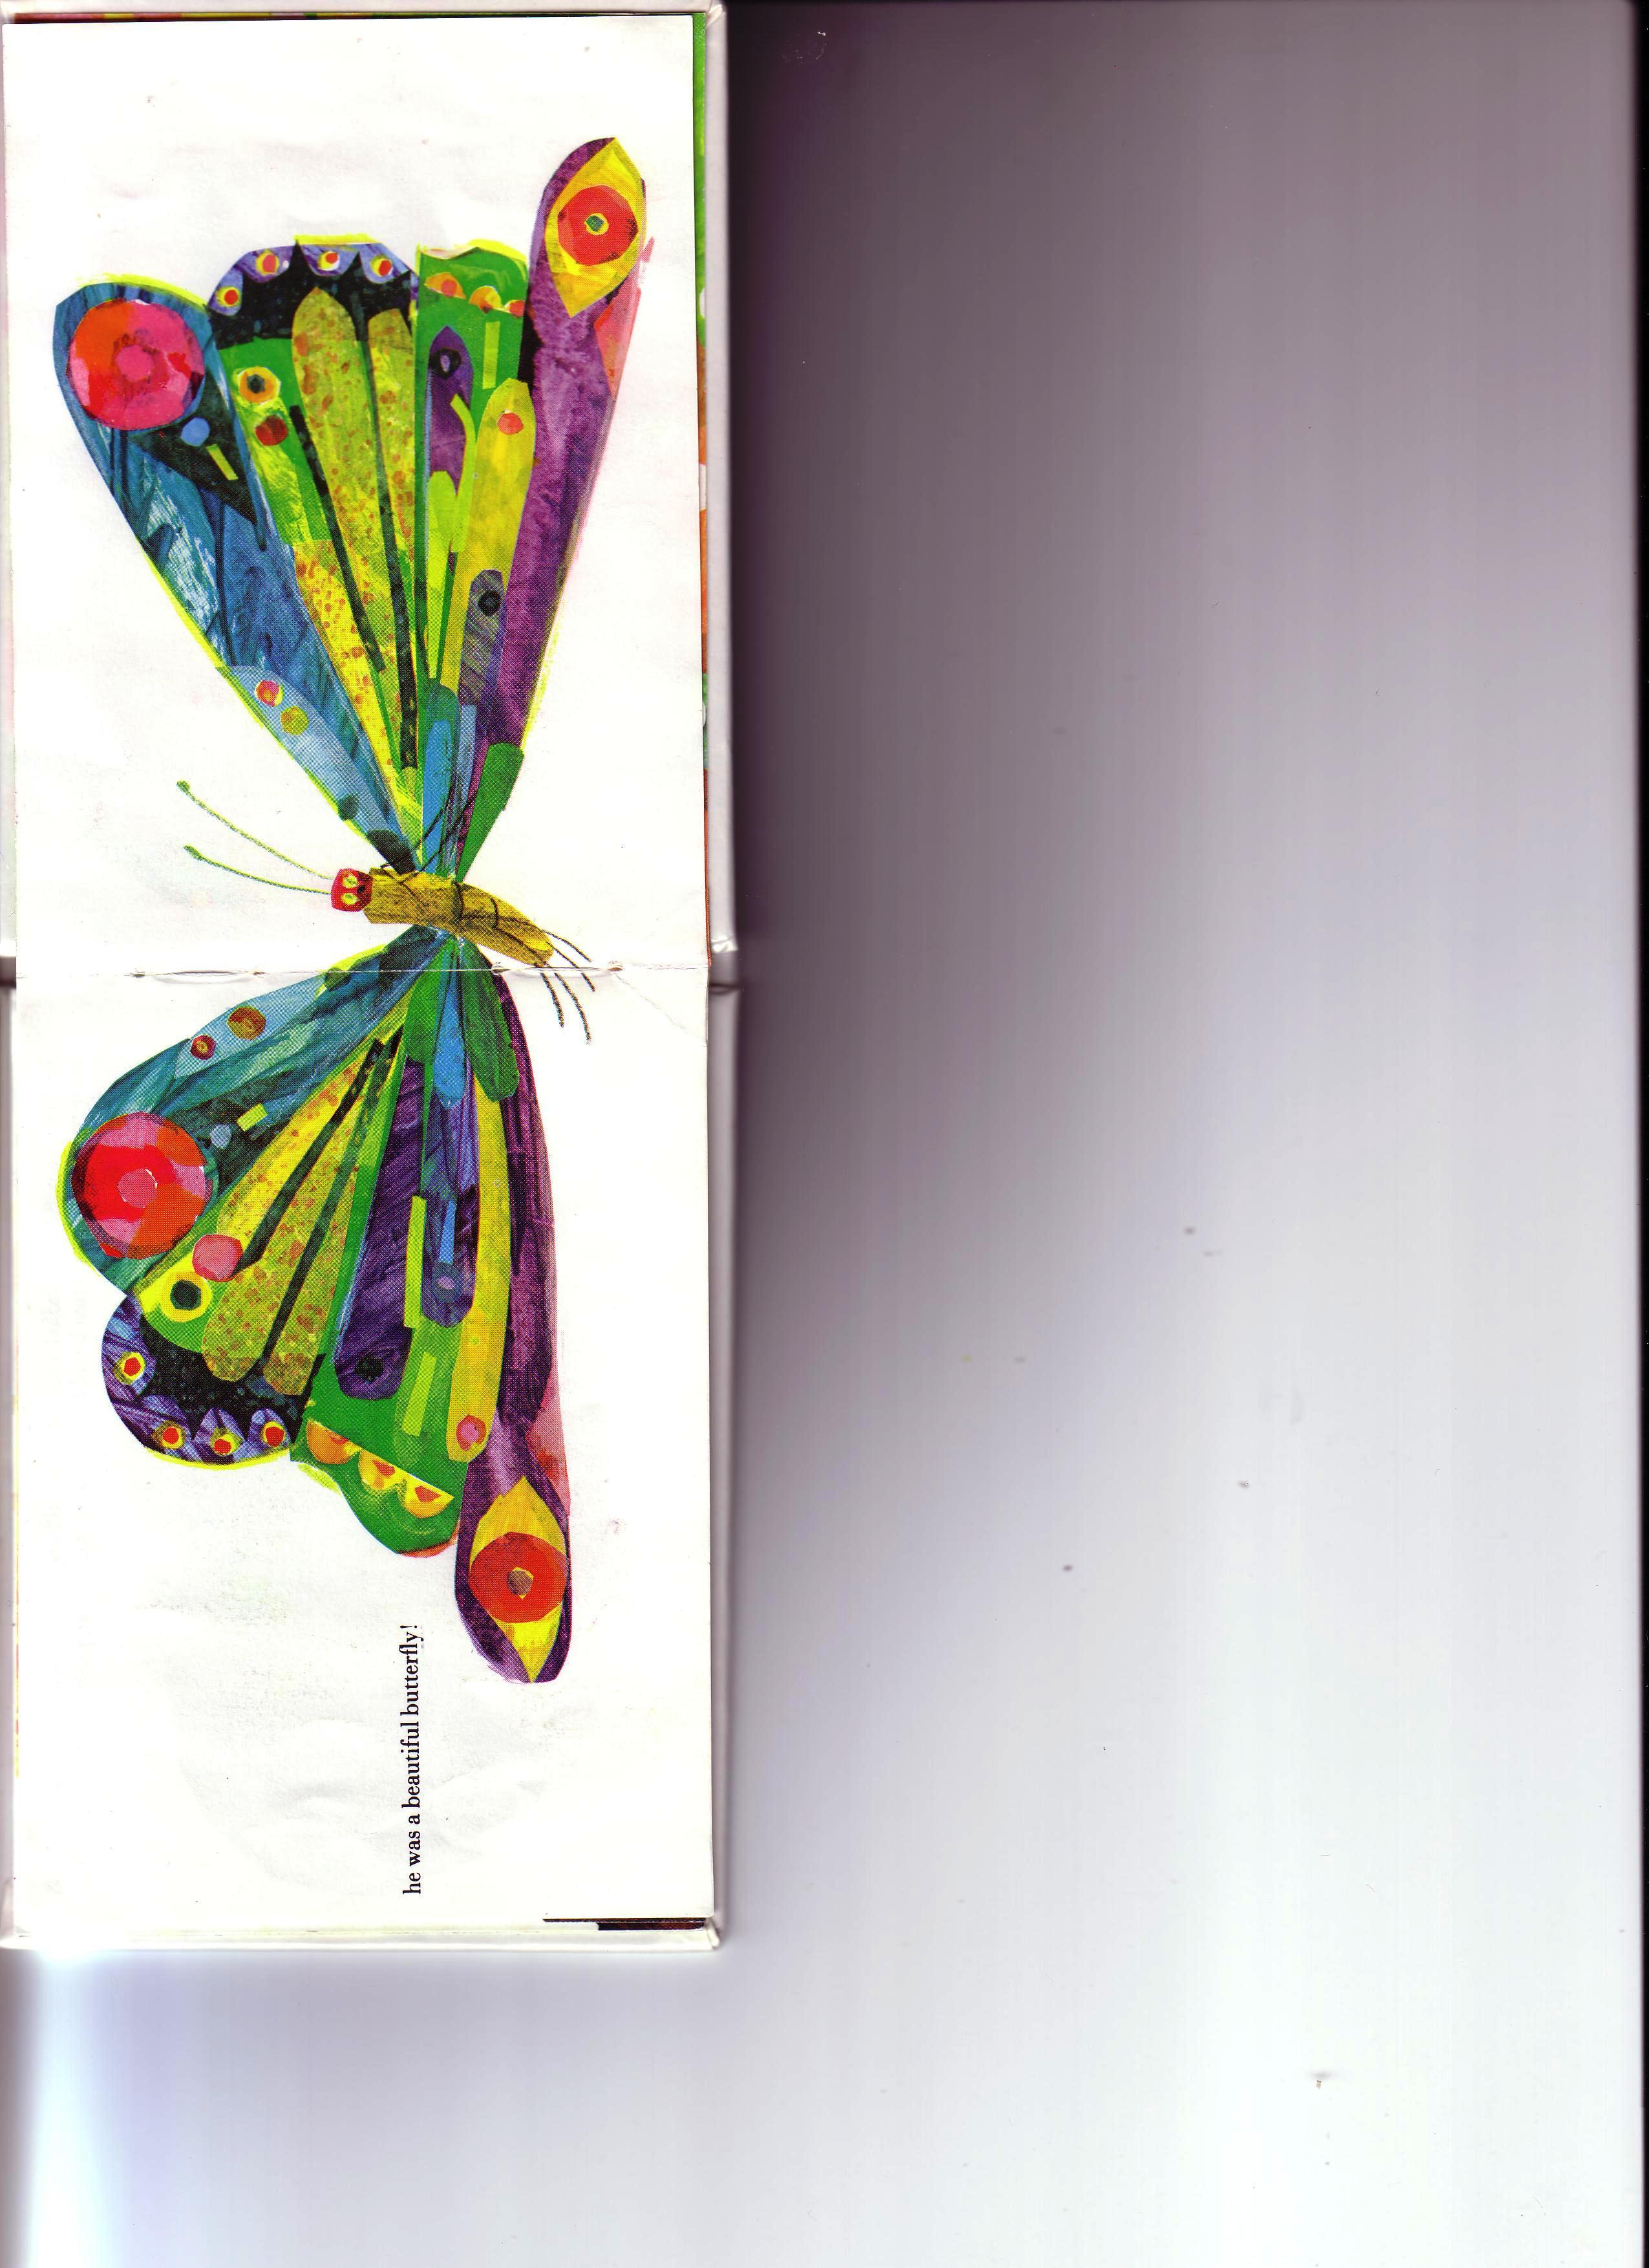
He was a beautiful butterfly!
Notes:
It has transformed into a beautiful butterfly!

Slide 38

The end.

