Slide 1
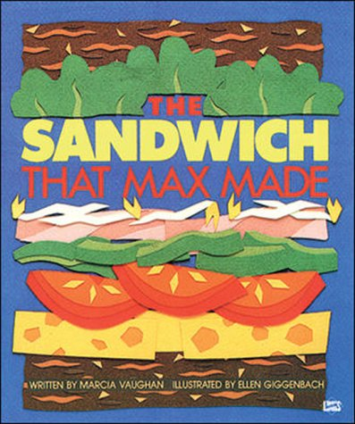

Slide 2
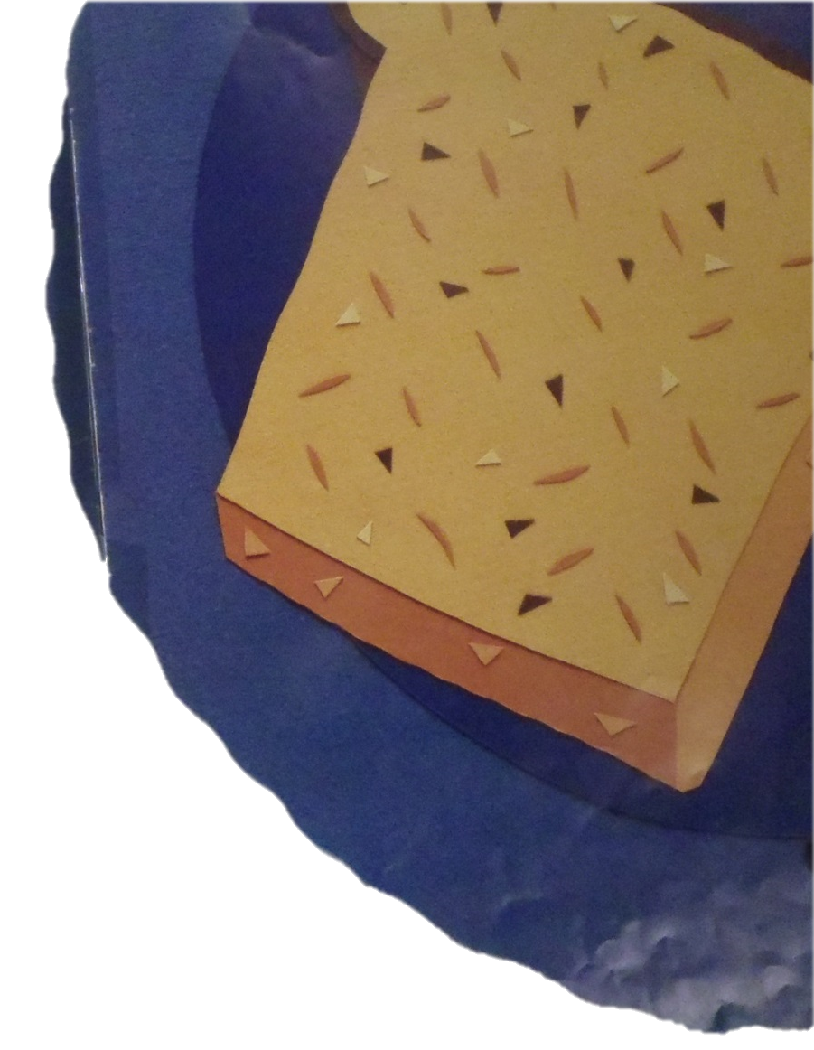
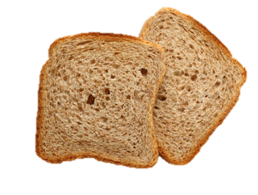
This is the brown bread that started the sandwich that Max made.

Slide 3
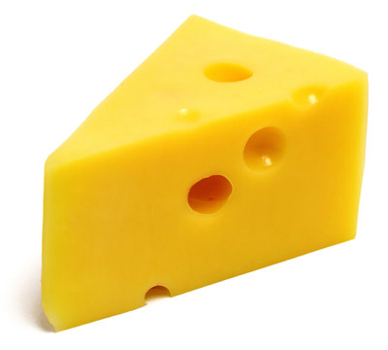
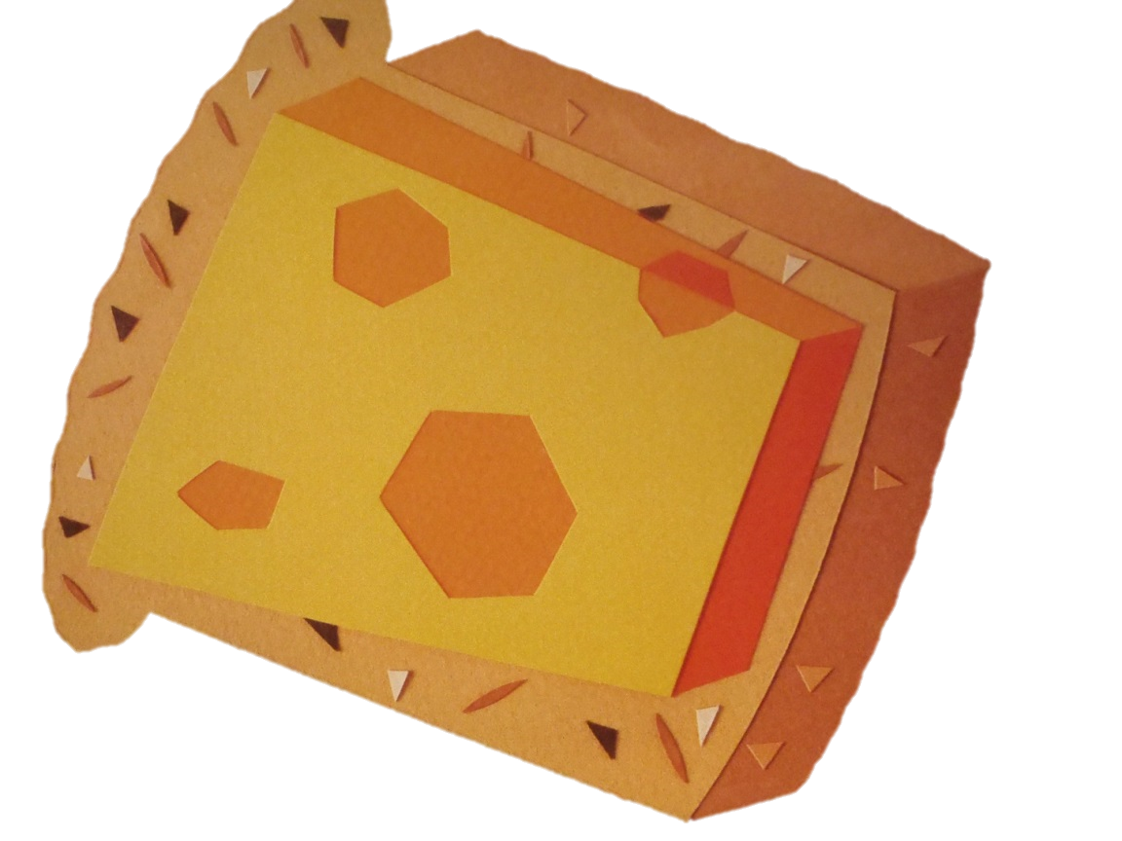
This is the yellow cheese that sits on the brown bread that started the sandwich that Max made.

Slide 4
This is the red tomato that lies on the yellow cheese that sits on the brown bread that started the sandwich that Max made.

Slide 5
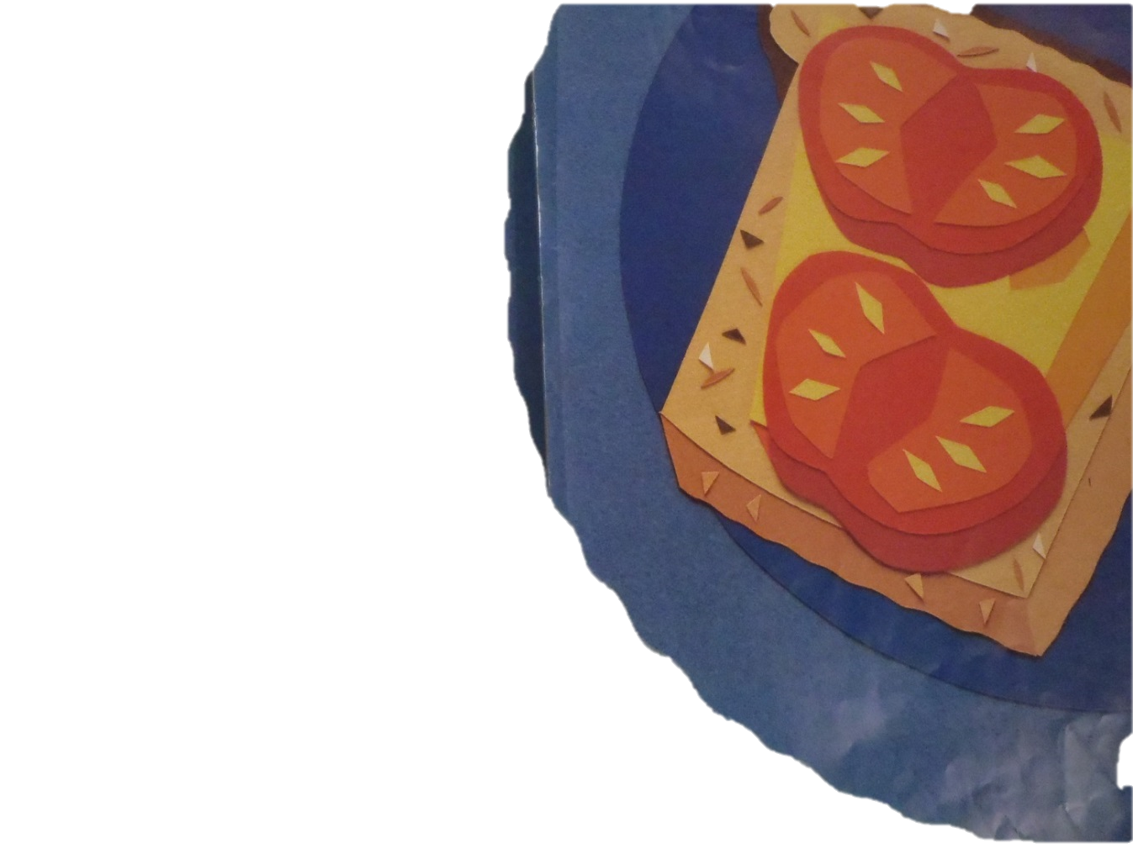
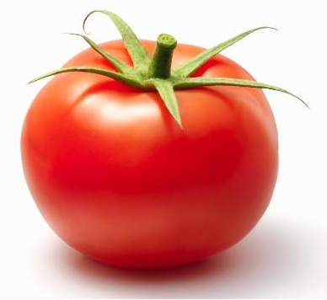

Slide 6
This is the green pepper that goes on the red tomato that lies on the yellow cheese that sits on the brown bread that started the sandwich that Max made.

Slide 7
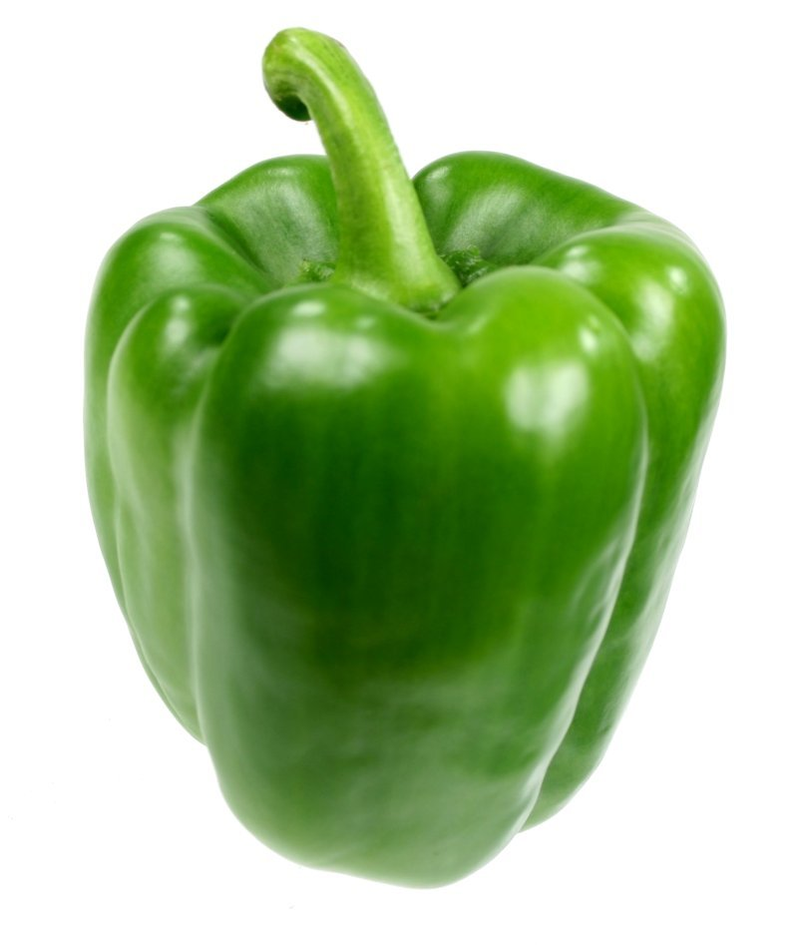
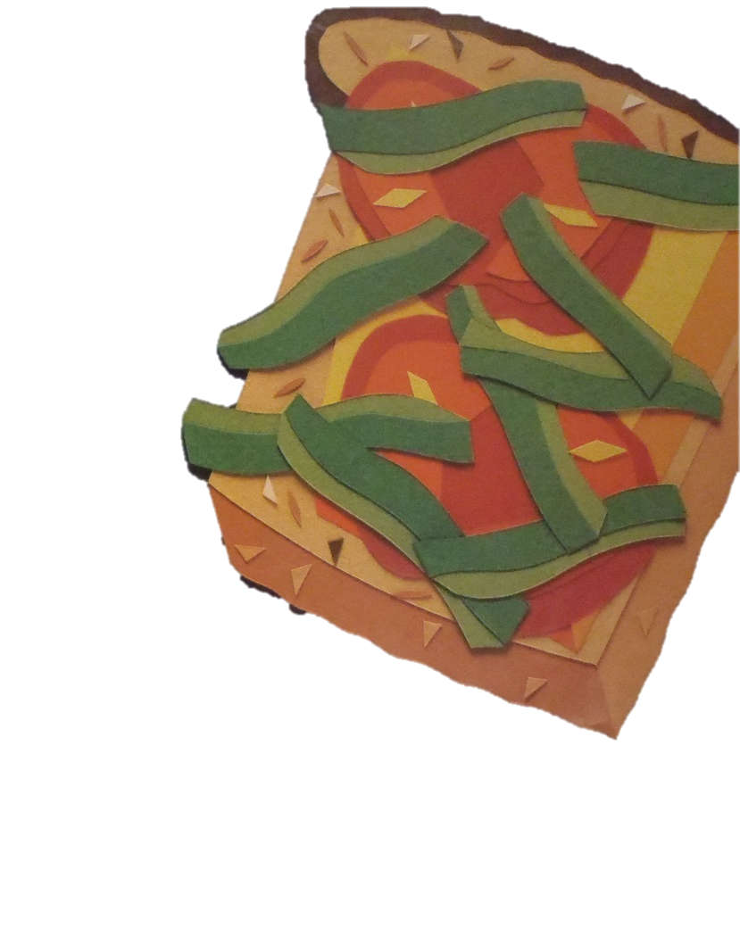

Slide 8
This is the pink ham that covers the green pepper that goes on the red tomato that lies on the yellow cheese that sits on the brown bread that started the sandwich that Max made.

Slide 9
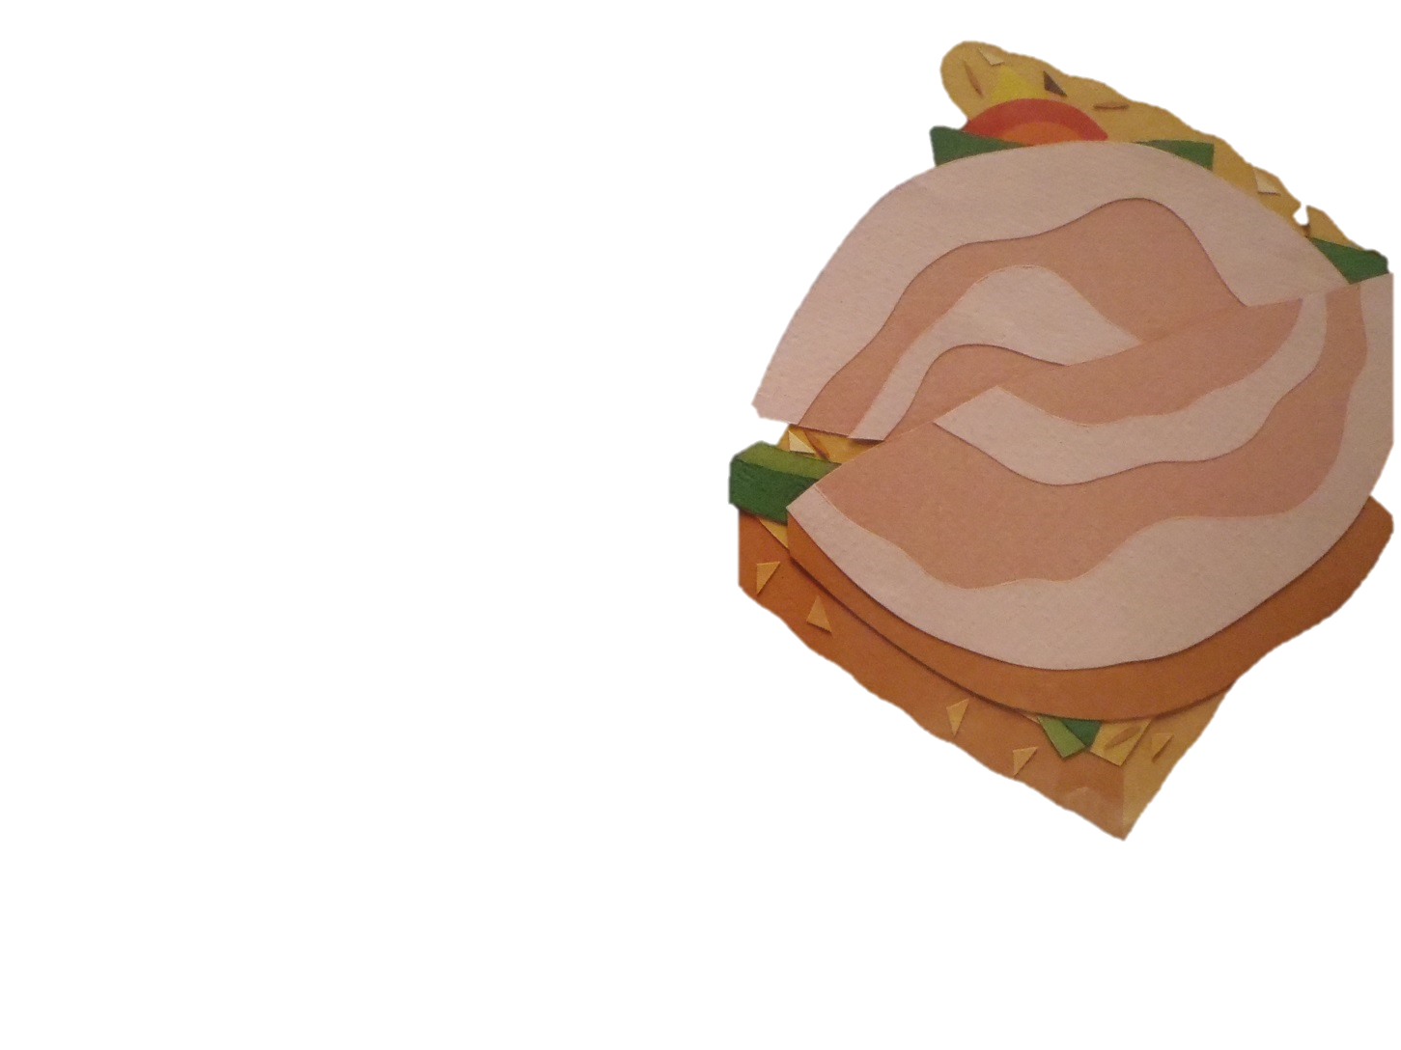
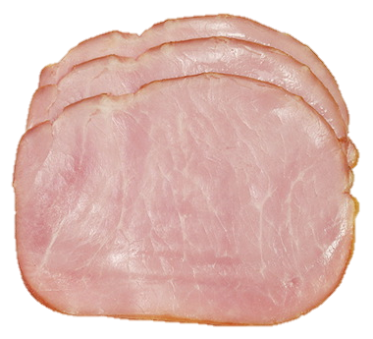

Slide 10
These are the white sprouts that speckle the pink ham that covers the green pepper that goes on the red tomato that lies on the yellow cheese that sits on the brown bread that started the sandwich that Max made.

Slide 11
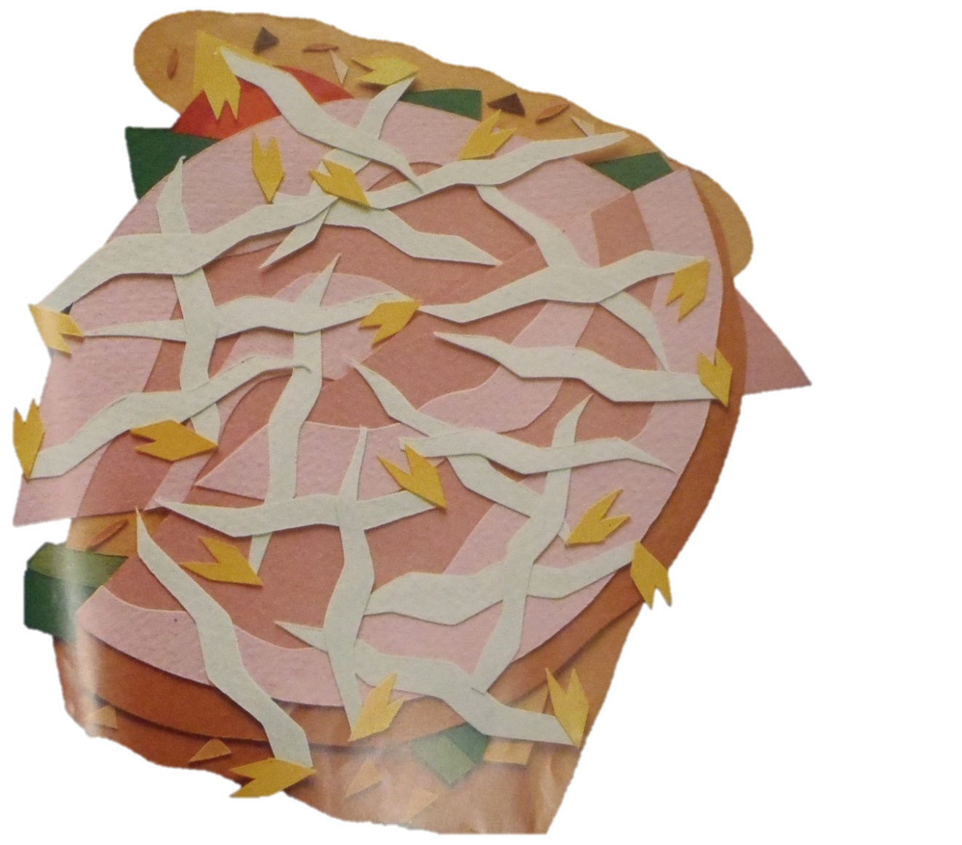
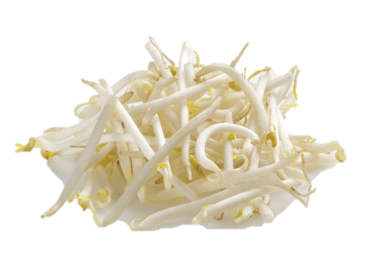

Slide 12
This is the green lettuce that tops the white sprouts that speckle the pink ham that covers the green pepper that goes on the red tomato that lies on the yellow cheese that sits on the brown bread that started the sandwich that Max made.

Slide 13
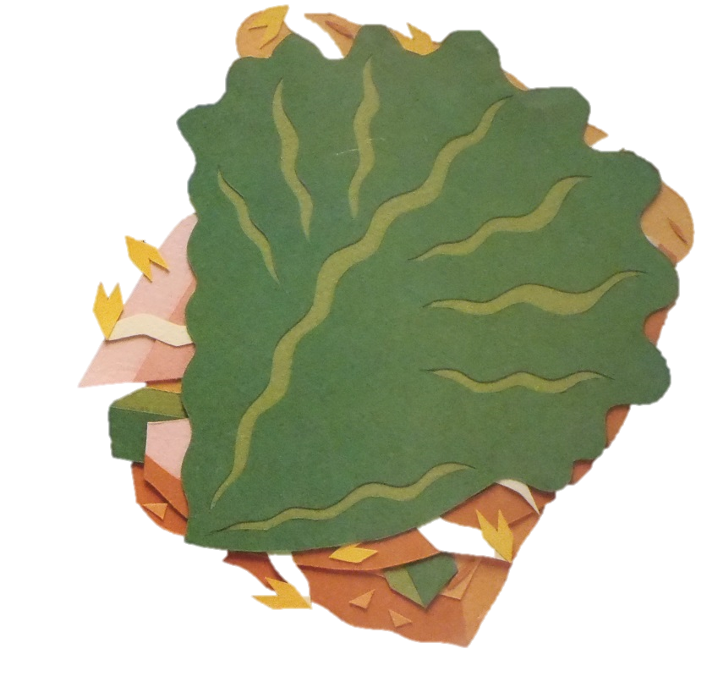
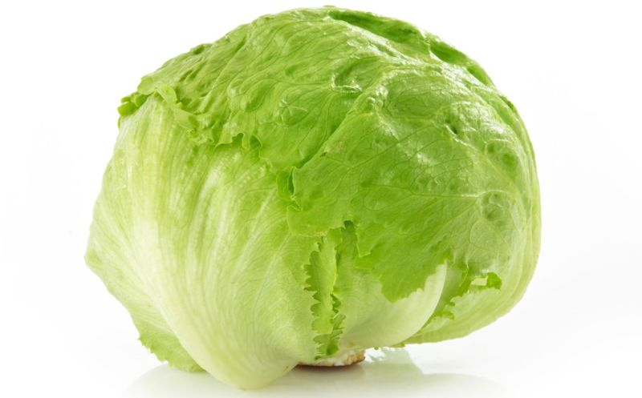

Slide 14
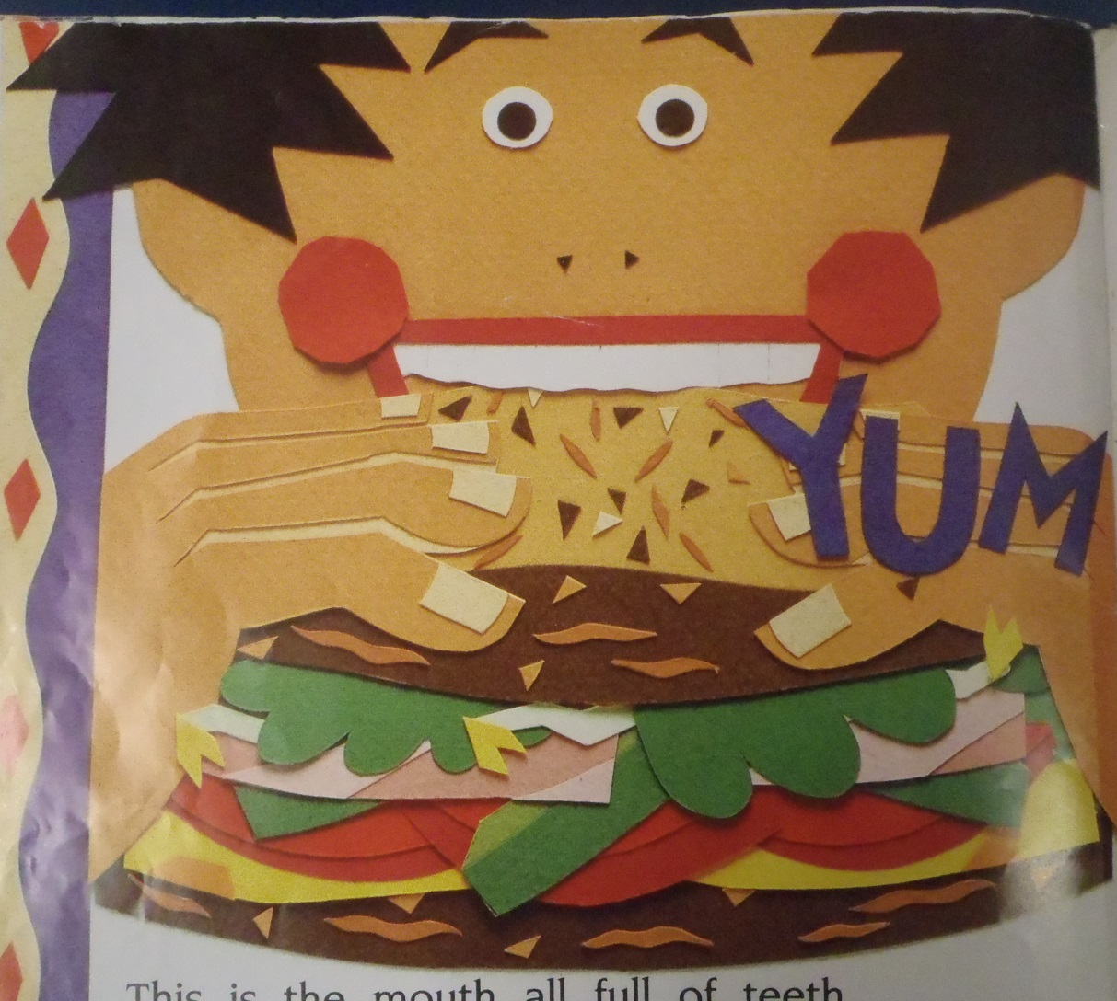
This is the mouth full of teeth that eats the sandwich that Max made.

Slide 15

The end.

