Slide 1
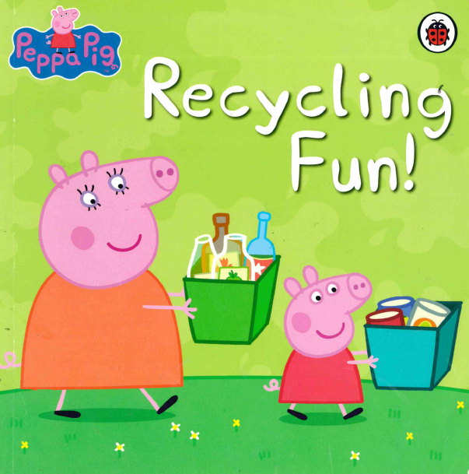


Slide 2
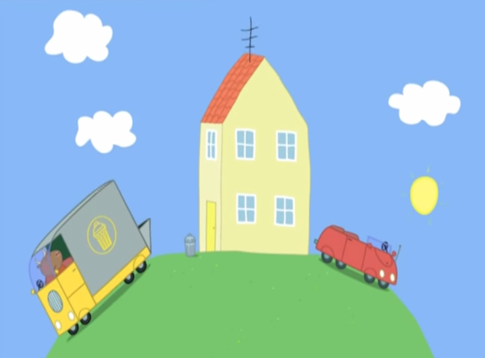


Mr Bull, the binman is
collecting the rubbish.

Slide 3
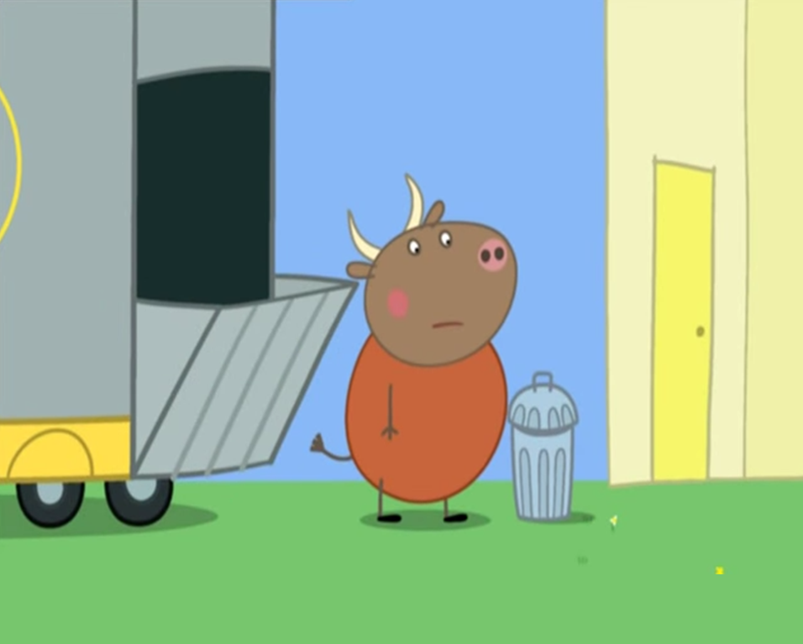


It is early in the morning so tries to be as quiet as he can.

Slide 4
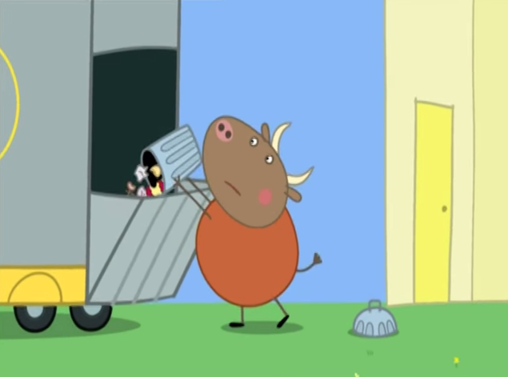
CRASH CLANK!
But Mr Bull is not very good at being quiet.

Slide 5
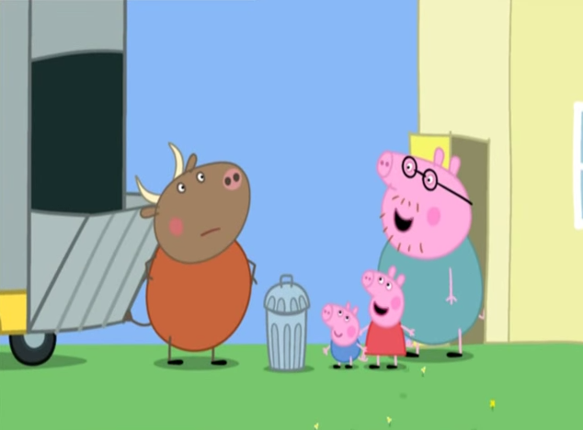
Hello, Mr Bull
Hello, everyone

Slide 6

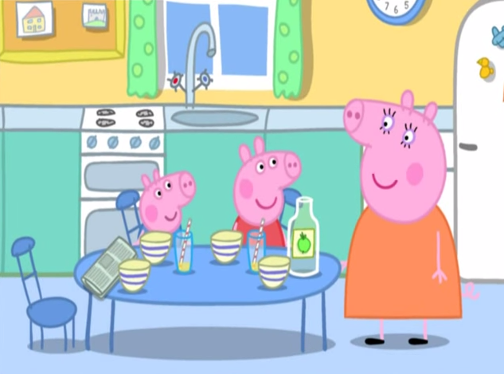
Peppa and George are helping to clear up the breakfast things.

Slide 7
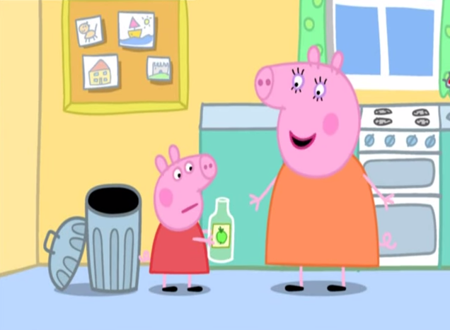
We don’t put bottles in the rubbish bin. They can be recycled.

Slide 8
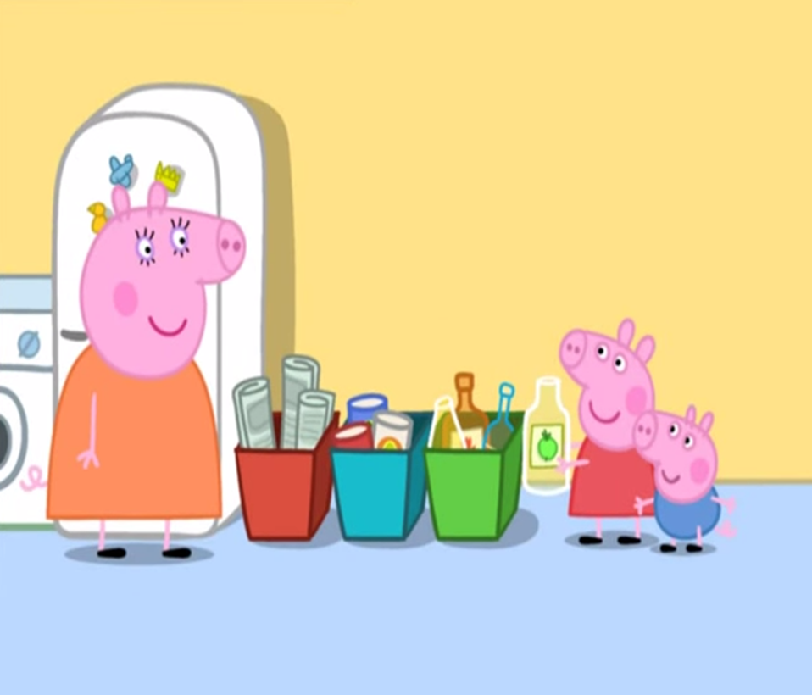


Peppa put the bottle in the
green bin.

Slide 9
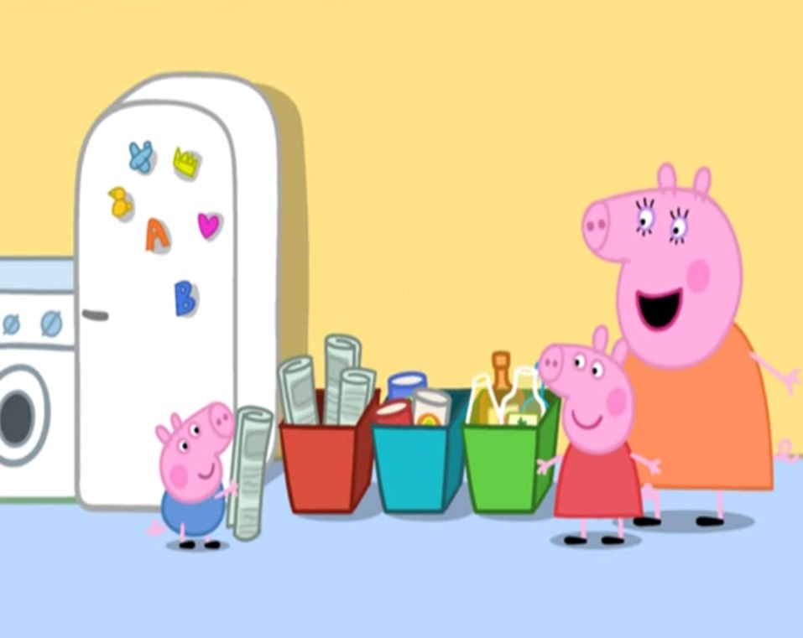


And George put Daddy’s
newspaper in the red bin.

Slide 10
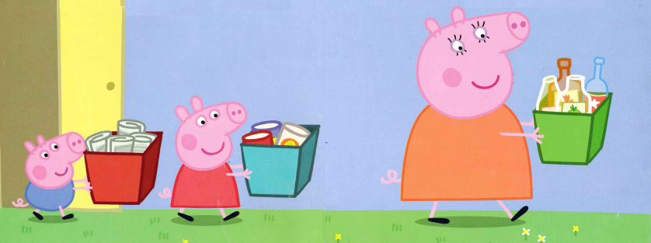

Soon they have collected enough things, so Peppa and her family set off for the
recycling centre.

Slide 11
Mummy Pig has the bottles in the green bin.

Slide 12


Peppa has the tin cans in the blue bin.

Slide 13
George has the newspapers in the red bin.

Slide 14
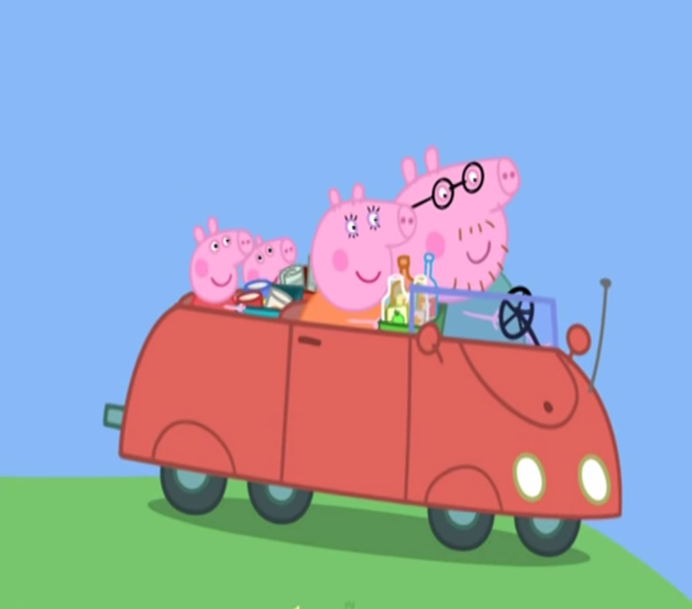
Yes!
Is everyone ready?

Slide 15
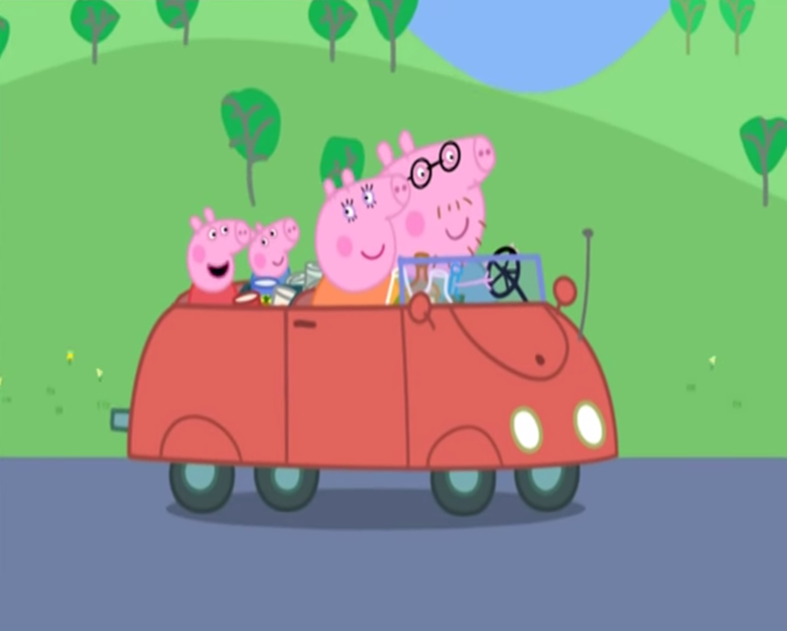
Clink, clink, rattle, rattle, rustle, rustle!

Slide 16
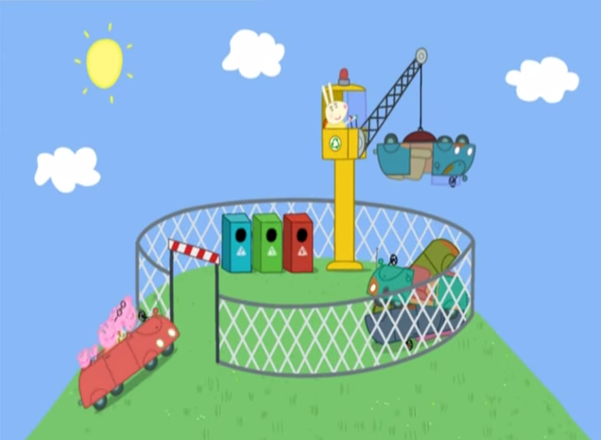
Soon they arrived at Miss Rabbit’s recycling centre.

Slide 17



Miss Rabbit is sitting high up in a
big crane. She is busy recycling all the rusty
old cars. It is very
noisy.

Slide 18
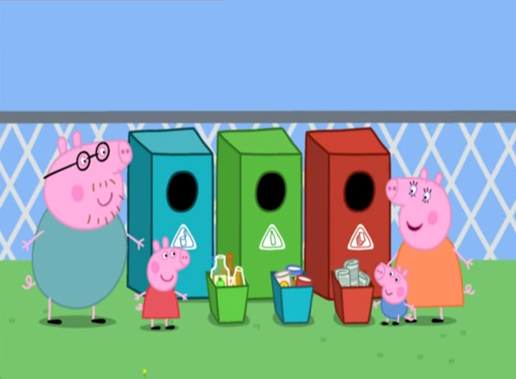
Who knows which bin the bottles go in?
The green one!

Slide 19
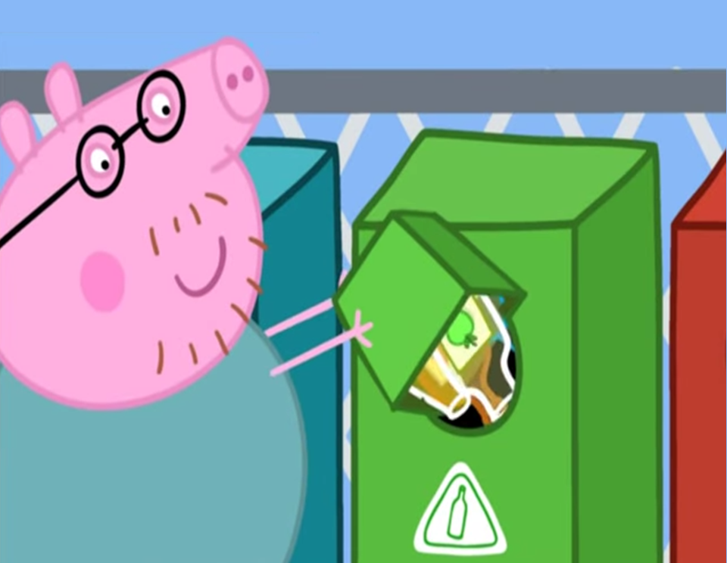
Clink! Clink!

Slide 20
And the cans go in the blue on!

Slide 21
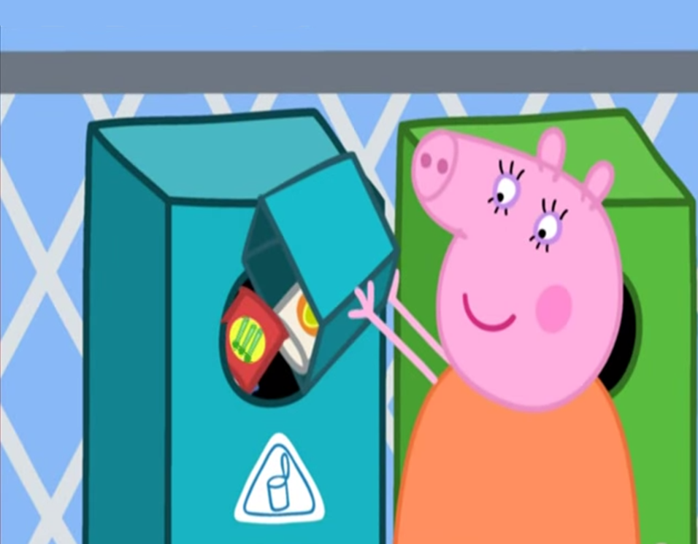
Rattle! Rattle!

Slide 22
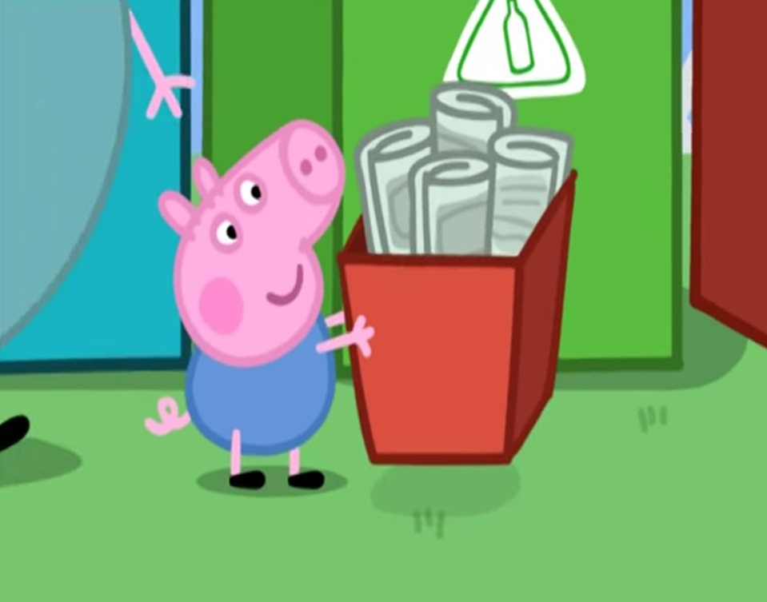
George wants to recycle the newspapers.

Slide 23
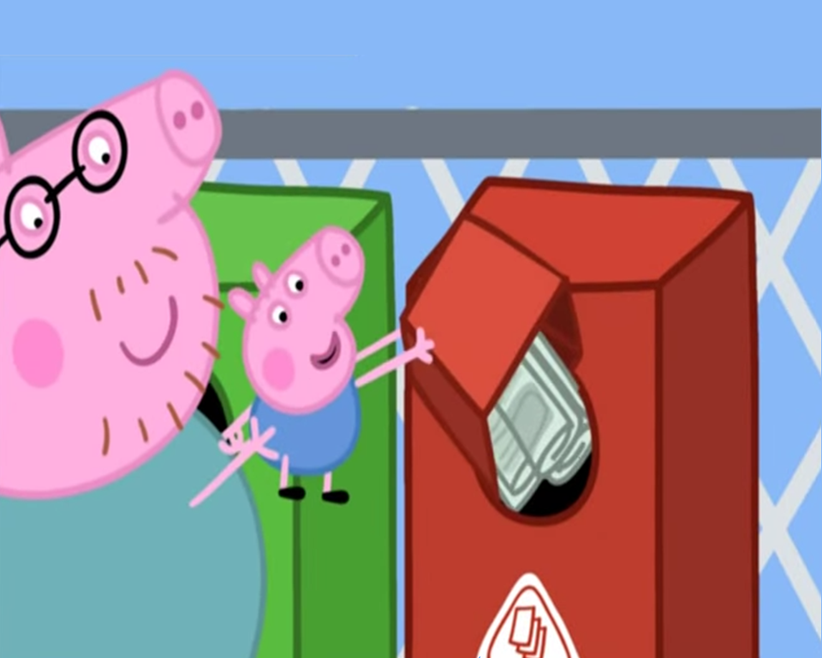
Rustle! Rustle!

Slide 24
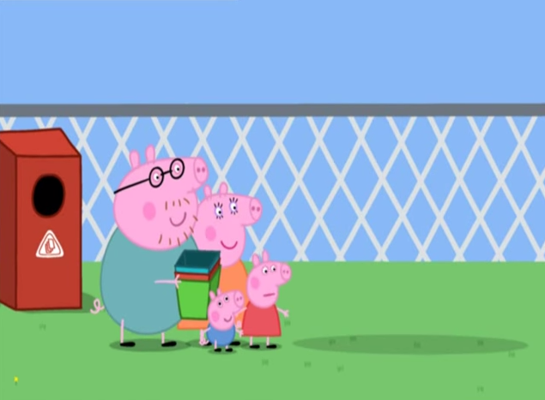
Where’s our car gone?

Slide 25
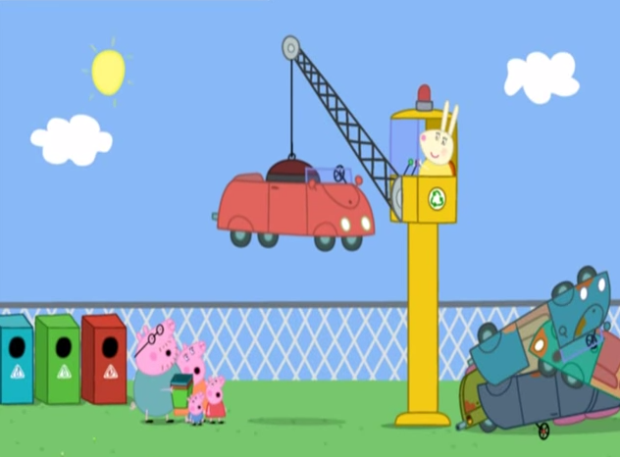
Stand back!
Stop! Our car isn’t old and rusty!
Miss Rabbit is about to recycle Peppa’s car!

Slide 26
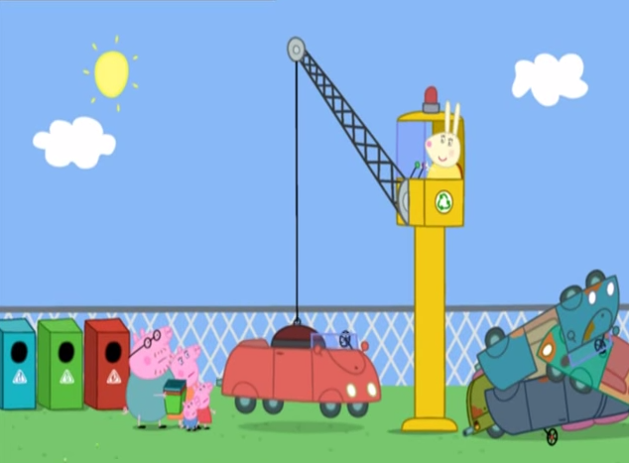
Ha Ha! Silly me! I just love recycling!
So do we! But we also love our little car!

Slide 27
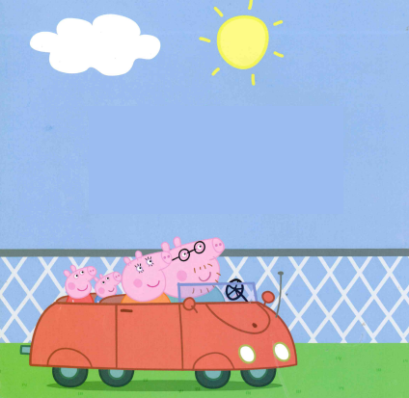
The end.

