Slide 1
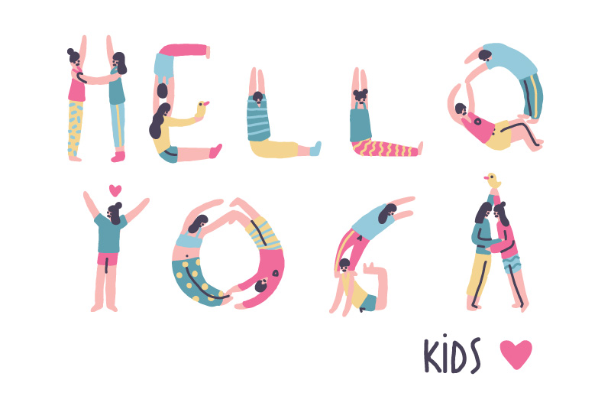
Movement Sequence 1
Start sitting on the mat with legs crossed. Encourages the children to find their sitting bones and gives a sense of feeling grounded.
Belly breathing exercise – Belly – Ribs - Chest
Chanting exercise – HA-REE-OM
Sensory awareness exercise
Movement Sequence – to support with digestive system
Sound breaths
Relaxation

Slide 2
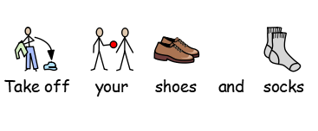

Slide 3
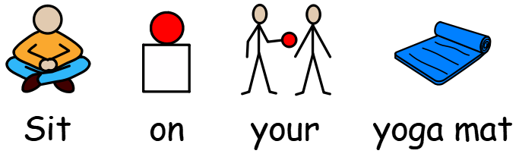
1

Slide 4
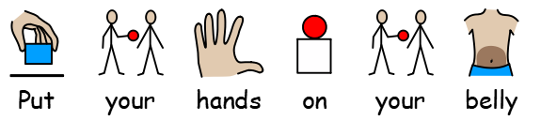
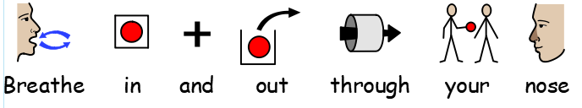
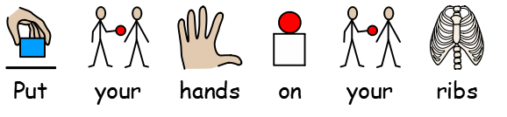
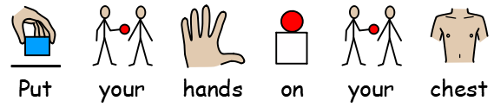
2
X 4
X 4
X 4
Work your way back again – chest – ribs – belly

Slide 5
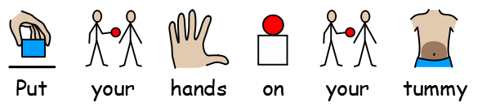
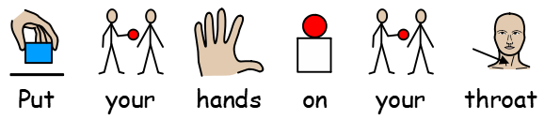
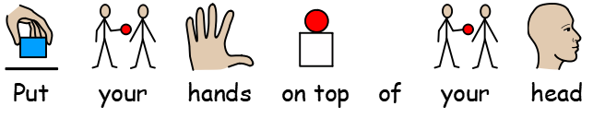
3 HA- REE- AUM
HA
Make a ‘HA’ sound. Feel how tummy moves.
REE
Make a ‘REE’ sound. Feel vibration in the throat.
AUM
Make a ‘AUM’ (hum) sound. Feel vibration in through top of your head.
Blend all of the movements and sounds together to sing the HA-REE-AUM song.

Slide 6
3 HA- REE- AUM
Name chanting
AUM, NAME, AUM, NAME, AUM, NAME, AUM
Pat legs on the AUM and clap hands together on the NAME.
“HA – REE – AUM
HA – REE – AUM
HA – REE, HA – REE,
HA – REE- AUM”

Slide 7
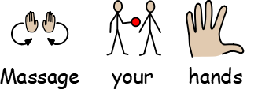
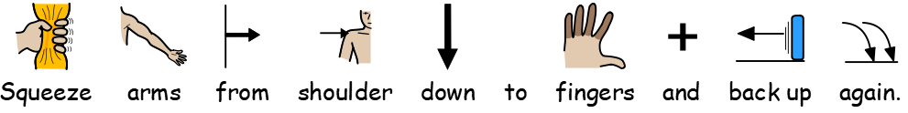
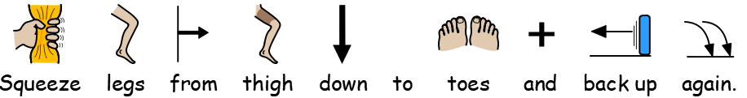
4 Sensory Awareness
Higher Functioning children should be encourages to do this independently.
Repeat on both arms.
Repeat on both legs.

Slide 8
4 Sensory Awareness
Play the drums
Pat legs all the way down to toes and back up again.
“Can you play the drums on your legs?”
Bounce Knees
“Can you bounce your knees for 10 seconds”
“Count with me… 1,2,3…”
Rock and Roll
Bring legs up to chest give them a cuddles.
Hook arms underneath both legs and gently roll onto your back and up to sitting again.
Repeat 5 times.

Slide 9
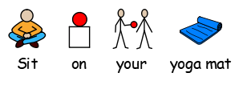
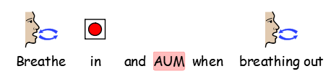
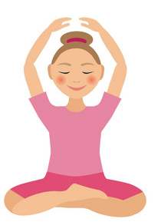
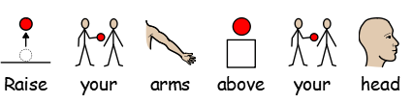
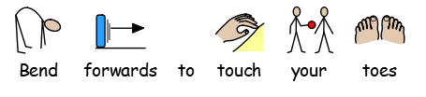
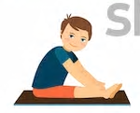
5 Movement Sequence
Repeat 3 times
1
*Repeat sequence 4 times*
2

Slide 10
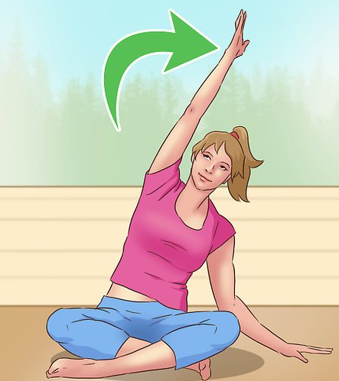
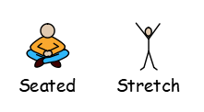
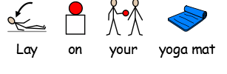
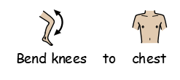
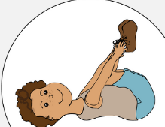
5 Movement Sequence
3
Repeat on each side 3 times
4
5
Rock gently from side to side.

Slide 11
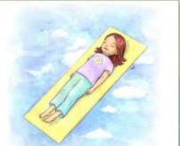
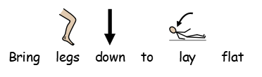
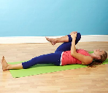

5 Movement Sequence
6
“Can you touch your knee with your nose?”
*Repeat 4 times*
7
“Can you draw little circles with your knee?”
Repeat sequence on the left leg.

Slide 12
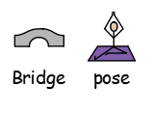
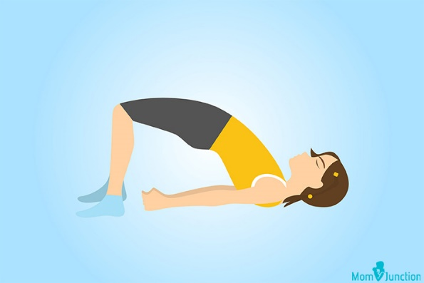
5 Movement Sequence
“Can you draw little circles with both knees?”
8
“Can you hold the bridge pose for 5 seconds?”
*Repeat 3 times*
9

Slide 13
5 Movement Sequence
10
Roll and drop knees to the side. Stretch arms out to the side.
Let chin and head all to the opposite side.
Inhale and exhale 4 times.
*Repeat on the opposite side*
11

Slide 14
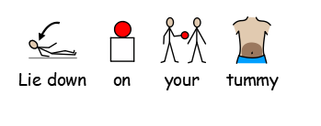

Slide 15

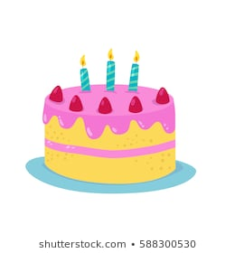
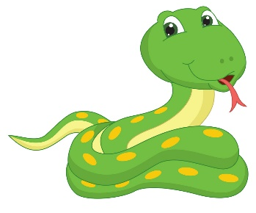
6 Sound Breaths
Shhh the baby.
Inhale through nose, ‘shhhhhh’ as you enhale. Repeat 3 times.
Inhale through nose, blow out through mouth as if you are blowing out candles on a birthday cake. Repeat 3 times.
Inhale through nose, hiss ‘sssssss’ like a snake on
exhale. Repeat 3 times.
Finish with 3 AUM’s.

Slide 16
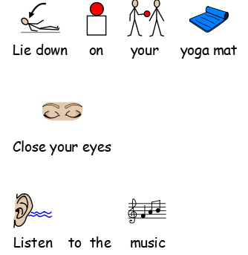
7 Relaxation
*OPTIONAL*
Supporting adults can provide children with foot massages during this time.

Slide 17


