Slide 1

Using iPads to communicate and understand

Slide 2
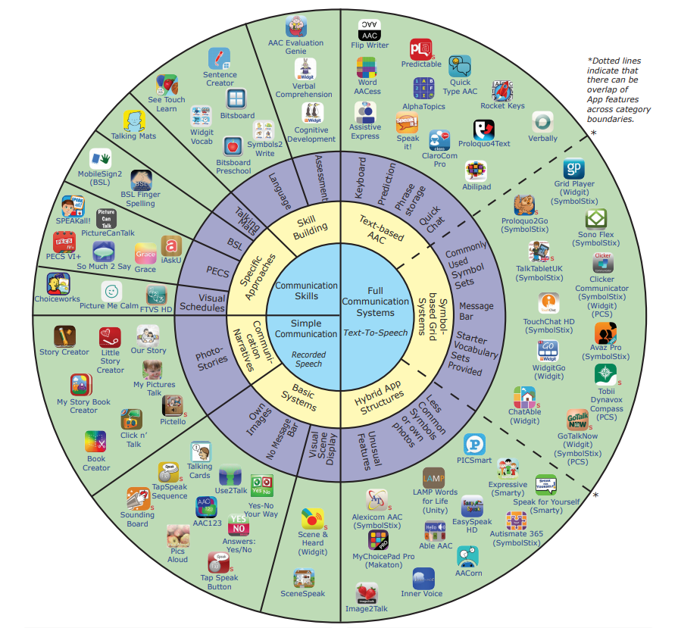
iPad apps

Slide 3
Pros ---- Cons
Adaptability
Easily updateable
Accessible to many children
Motivating
Expensive
Lots of distractions
Can be difficult to always take with children or leave alone

Slide 4
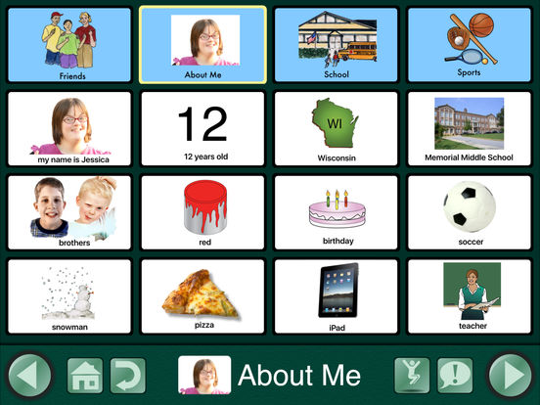
Go talk
Cost – Free, Full version
£60
Review
Very adaptable
Can be used on a very simple level to more advanced settings
Easy to use

Slide 5
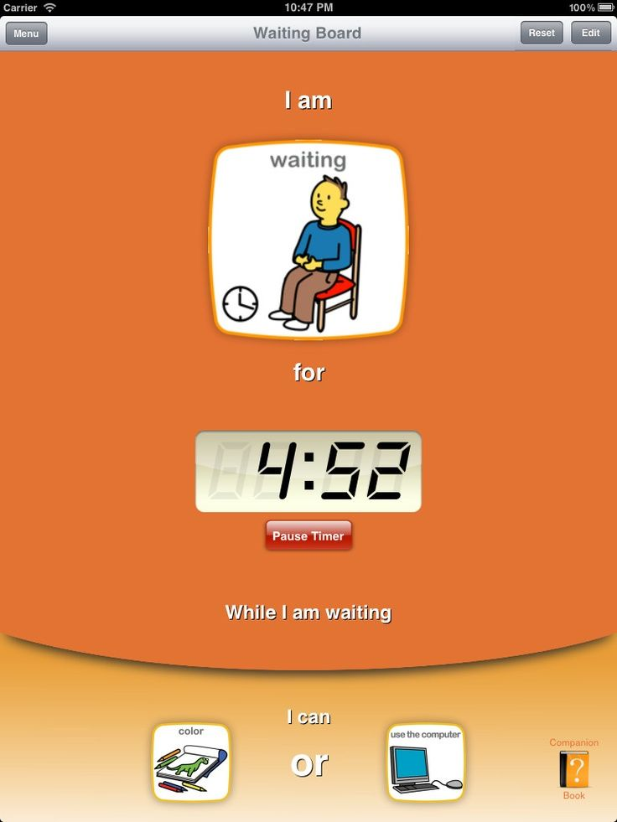
Choiceworks – new app on all iPads
Encourage children to understand the world around them more

Slide 6
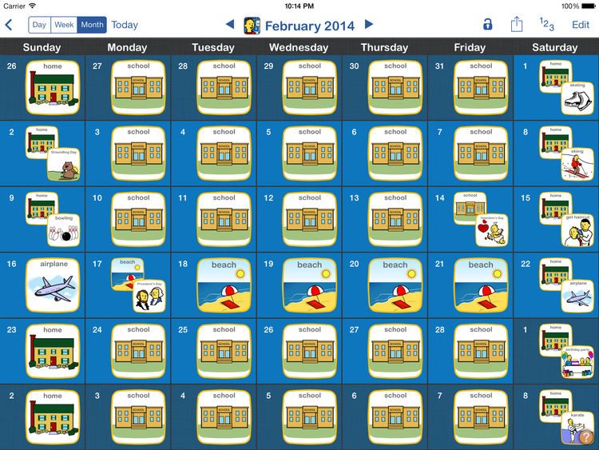
Make timetables that can be easily edited.

Slide 7
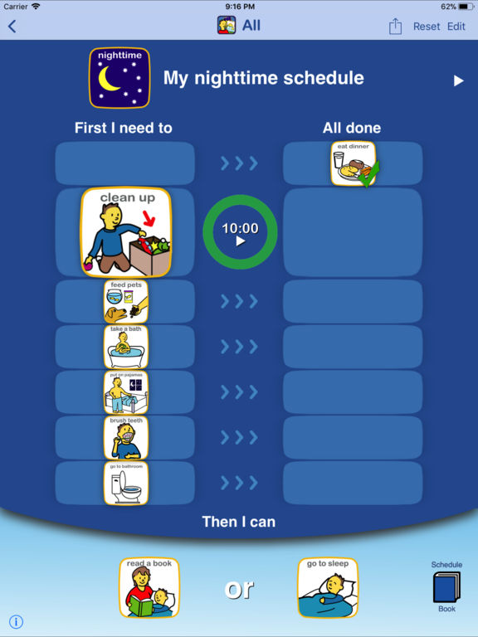
Make schedules that help children understand the routines of the day.

Slide 8
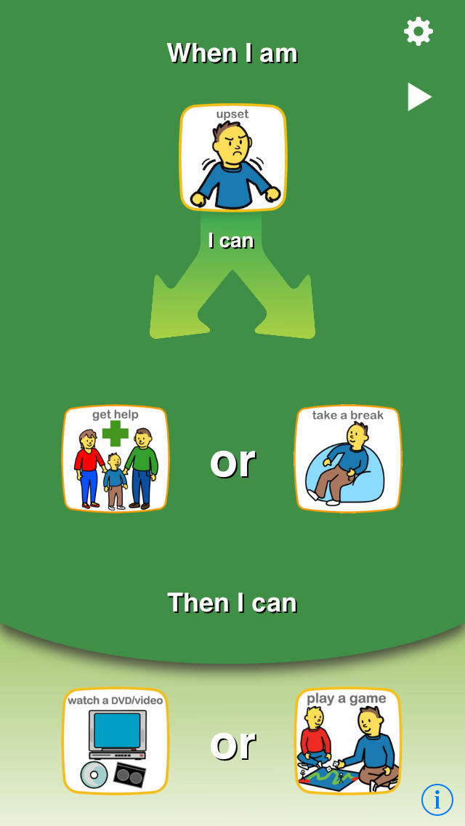
Discuss emotions and help children regulate themselves.

Slide 9

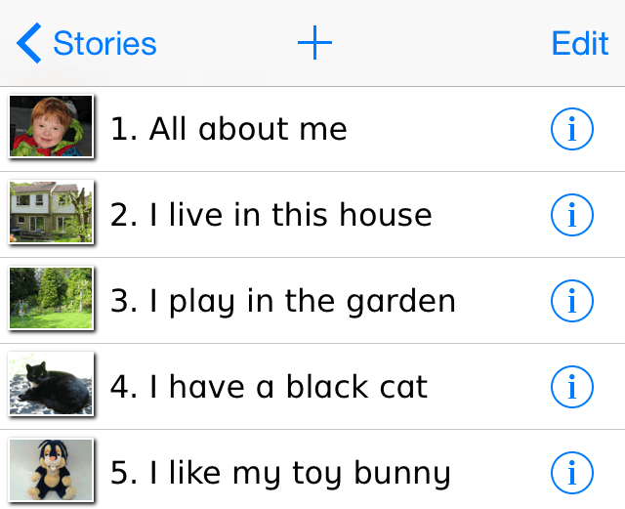
Special stories / storybook creator
Create stories so that children can understand more about the world around them.

Slide 10
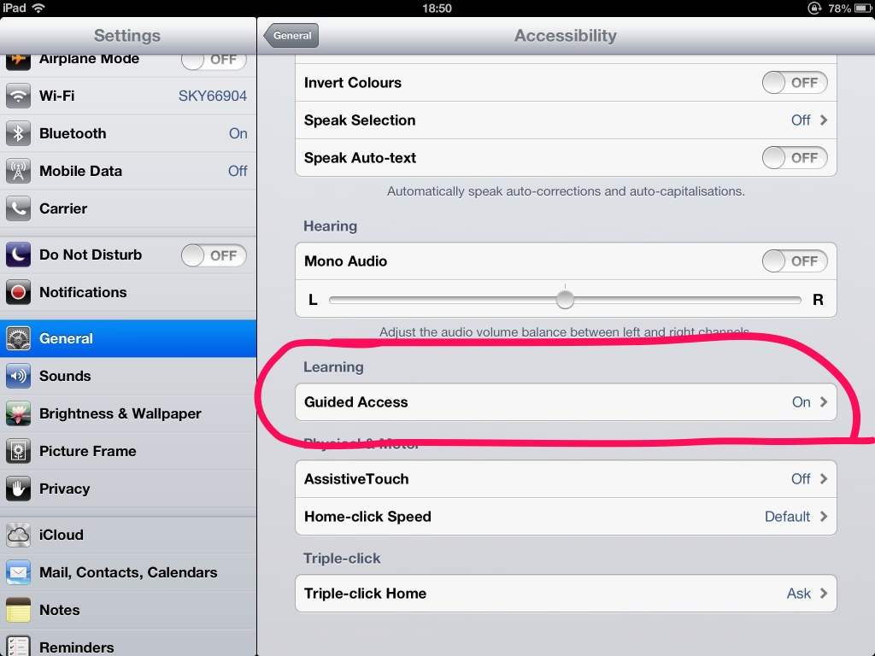
Tips to use the iPad for communication
Use guided access to limit the functions of the iPad to the one app.
Set up Guided Access
Tap Settings > General > Accessibility > Guided Access to set up Guided Access. From there, here's what you can do:
Turn Guided Access on or off
Set a passcode that controls the use of Guided Access and prevents someone from leaving an active session
Set whether the device can go to sleep during a session

